Slide 1
Wilfred Owen

Slide 2
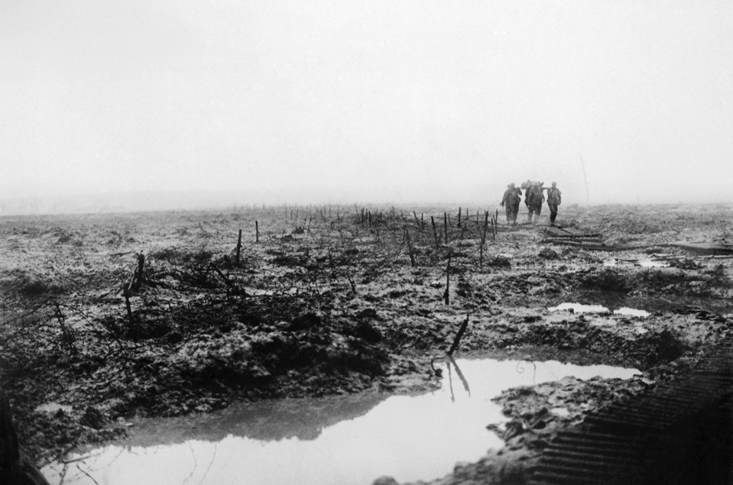
© IWM
The main British offensive in 1917 was at Ypres against the Passchendaele Ridge. Unusually heavy rain fell. Stretcher bearers, like these Canadians on 14 November, struggled to bring back the wounded. © IWM (CO 2252)

Slide 3
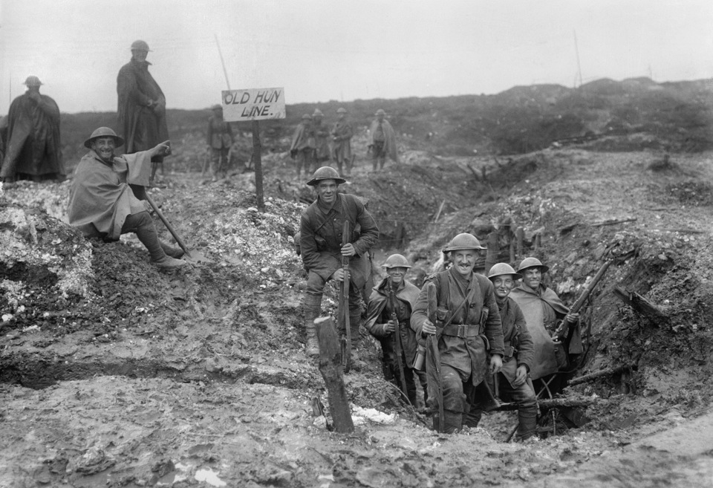
British troops at Serre, France, 1917 © IWM (Q 1787)

Slide 4
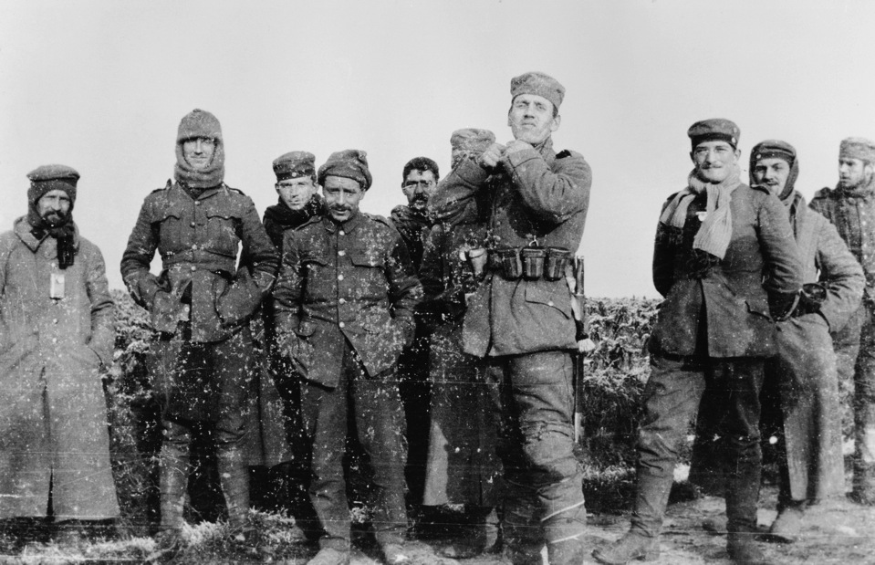
British soldiers (from the Royal Warwickshire Regiment) and German soldiers (from the 134th Saxon Regiment) together. Photograph taken December 26, 1914 by Second Lieutenant Cyril Drummond © IWM (HU 35801)

Slide 5
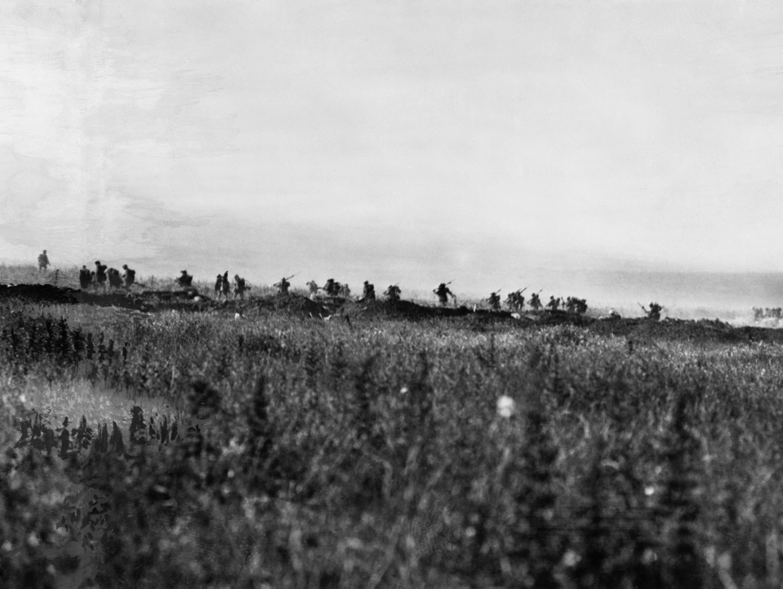
Exposure
© IWM (Q 52)

Slide 6
Exposure by Wilfred Owen – first verse
Our brains ache, in the merciless iced east winds that knife us...
Wearied we keep awake because the night is silent...
Low drooping flares confuse our memory of the salient...
Worried by silence, sentries whisper, curious, nervous,
But nothing happens.

Slide 7
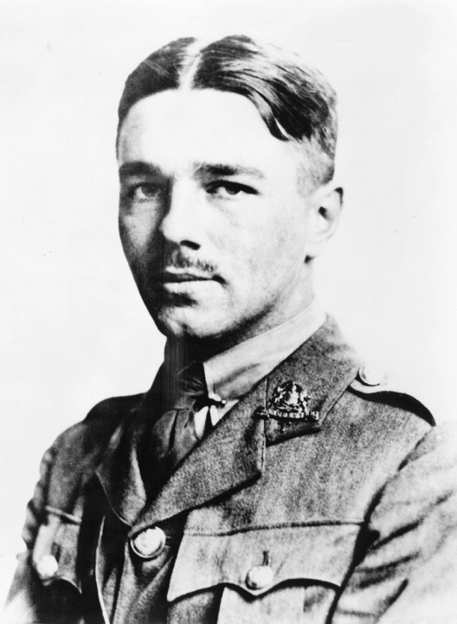
Wilfred Owen in 1916

Slide 8
Exposure by Wilfred Owen – final verse
To-night, His frost will fasten on this mud and us,
Shrivelling many hands and puckering foreheads crisp.
The burying-party, picks and shovels in their shaking grasp,
Pause over half-known faces. All their eyes are ice,
But nothing happens.

