Slide 1
Remote learning
TeachingEnglish lesson
September 2020

Slide 2
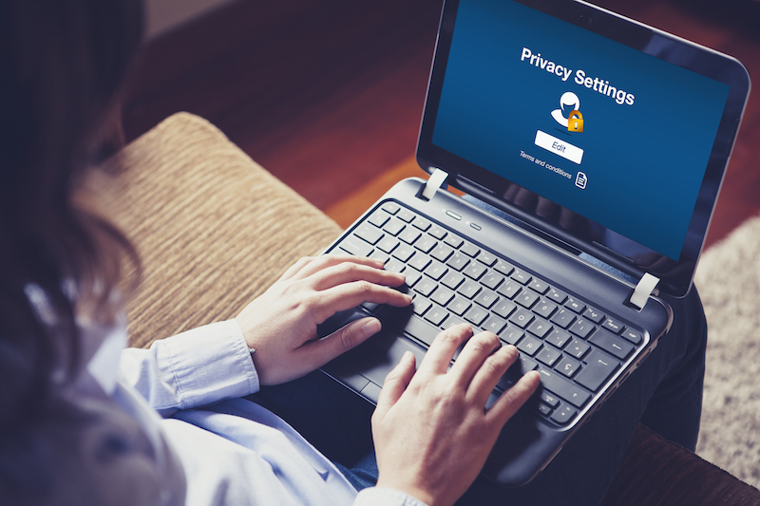
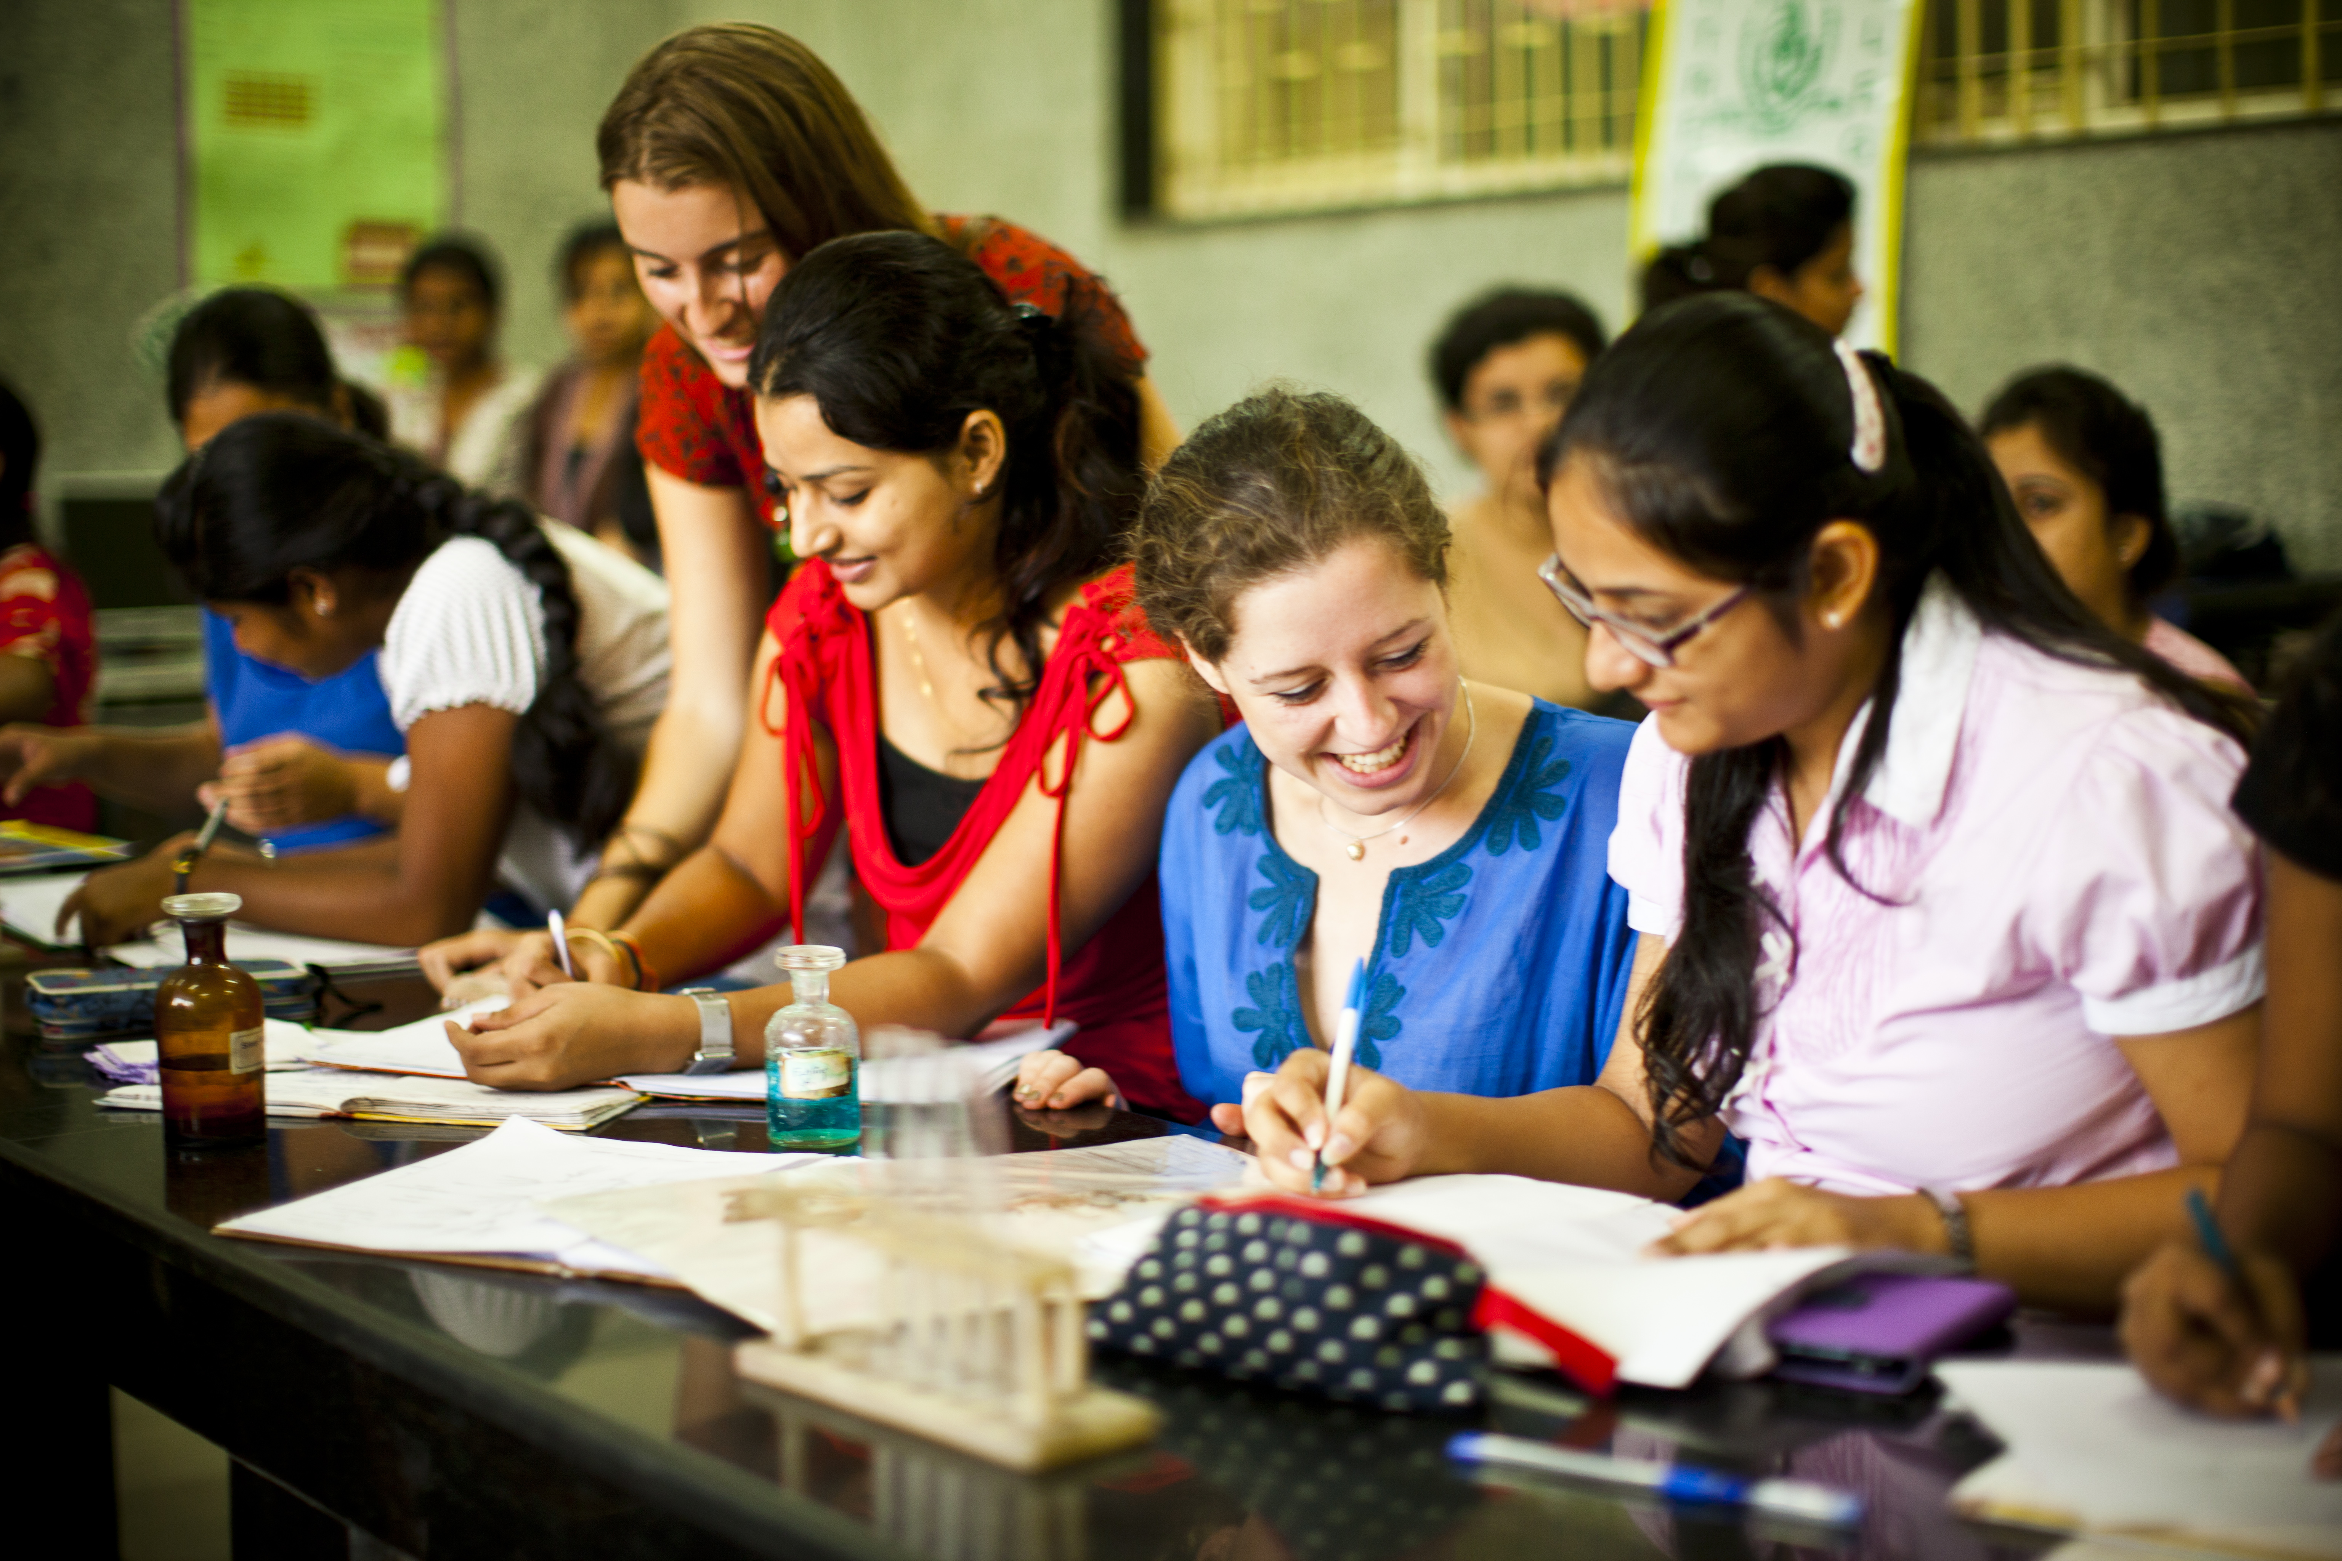
Remote learning
Look at the images. Which adjectives do you associate with each image? Why?
productive fun lonely collaborative frustrating
efficient enjoyable easy relaxed hard work
independent reliable

Slide 3
Remote learning
Write three positive and three negative things about each way of learning, e.g.
Remote learning is more relaxed because you can do it from your sofa.
Remote learning can be frustrating if the technology you are using doesn’t work well.

Slide 4
Remote learning
You are going to complete a short survey about your experiences of remote learning. Either write your answers in the chat or complete the survey online.
What type of learning did you do during lockdown?
Online classes with teachers every day
My teachers sent me work online every day and I had to complete it alone
Online classes a few times a week or less
None
Other (give a brief description)

Slide 5
Remote learning
You are going to complete a short survey about your experiences of remote learning. Either write your answers in the chat or complete the survey online.
2. During your time remote learning do you think you learned:
the same as usual?
more than usual?
less than usual?

Slide 6
Remote learning
You are going to complete a short survey about your experiences of remote learning. Either write your answers in the chat or complete the survey online.
3. What were the best things about learning from home?

Slide 7
Remote learning
You are going to complete a short survey about your experiences of remote learning. Either write your answers in the chat or complete the survey online.
4. And what were the worst things about learning from home?

Slide 8
Remote learning
You are going to complete a short survey about your experiences of remote learning. Either write your answers in the chat or complete the survey online.
5. What did you miss most about face-to-face classes at school?

Slide 9
Remote learning
You are going to watch a video of Augustina, a 17-year-old student from Argentina, talking about her experiences of online learning. As you watch, make notes on these questions.
Are there any similarities/differences between Augustina’s experience of online learning and your own experience?
What positive and negative things does she mention about remote learning?
Do you think overall her opinion of remote learning is positive or negative?

Slide 10
Remote learning
Read the texts about remote learning in different countries. Write the letter of the text that mentions the following:
1. Students doing final exams under different conditions from usual
2. Someone having to go into school to pick up worksheets
3. Having connection problems with online video lessons
4. Having to travel a long way to be able to receive lessons
5. Watching lessons on local TV
6. Schools not opening until September
7. Students already having the required technology
8. A lack of investment in schools means it is difficult for teachers to give support to students
9. The role of men and women in supporting home education
10. Not having to get up early
11. Students being able to get extra individual help when necessary
12. Going back to school part-time
13. Finding it harder to focus
14. Watching videos made by the teacher
15. Parents teaching children at home

Slide 11
Remote learning
You are going to write a report about your own experiences of learning online.
A report is a text which explains a situation, gives factual information and gives recommendations. Imagine that your school has asked you to write a report about your experiences of remote learning.
Report:
Formal – use of passive, avoid giving your personal opinion, usually written for a teacher or your boss.
Has clear sections – these usually have headings, so that the different parts are very clear.
Makes recommendations – the final section usually gives recommendations for the future.

Slide 12
Remote learning
You are going to write a report about your own experiences of learning online. Your report should include:
introduction: Explain what the report is about.
your experience of remote learning: Did you do online lessons? Did you work on your own from home? Did you learn through TV or radio? Were you able to keep up with classes?
advantages: What was good or what did you enjoy about remote learning?
disadvantages: What did you miss about learning at school? What didn’t work well?
recommendations: What would improve the situation if you had to return to remote learning in the future?

Slide 13
Remote learning
Part | Useful language
Introduction | This report will outline/explain/evaluate … The purpose of this report is to evaluate/make recommendations/reflect on …
Experience of remote learning at … (name of school) Advantages Disadvantages | In general, Classes were given online / classes took place … Students were able to … One advantage was … … was an improvement on regular classes because … On the other hand, … A major disadvantage was … Generally speaking, students felt/were …
Recommendations | In order to improve remote learning in the future, I would recommend … (verb+ing / noun) The following changes would improve the situation: … The best solutions would be … Based on the experience I had, I’d strongly recommend … (verb+ing / noun)

Slide 14
Remote learning
Remember, a report should be formal. Look at the different options below. Which is better for a report, a or b?
This report is about remote learning. I’ll talk about what happened at my school and what was good and bad. Then I’ll give some recommendations.
This report will outline the remote learning at St Paul’s school, assess the positive and negative aspects of this remote learning and go on to give recommendations about how remote learning could be improved in the future.

Slide 15
Remote learning
Remember, a report should be formal. Look at the different options below. Which is better for a report, a or b?
In general, the online classes provided by the school were effective. One major advantage was that students learned to organise their time more effectively, deciding when they wanted to study and when to take breaks. Many students commented that they appreciated this way of working as it made them more independent. Time management is also an important skill for the future.
The online classes were generally good. One good thing was that we could learn more independently and organise our own time. This is important for the future.

Slide 16
Remote learning
Remember, a report should be formal. Look at the different options below. Which is better for a report, a or b?
On the other hand, students reported that they missed face-to-face interaction with their classmates and teachers and sometimes felt isolated.
On the other hand, I missed seeing my classmates and teachers every day.

Slide 17
Remote learning
Remember, a report should be formal. Look at the different options below. Which is better for a report, a or b?
It would be good to do more face-to-face classes online so that students can feel more connected and also so that they can ask their teachers questions if they have doubts.
In order to improve remote learning in the future, I would recommend offering more online classes so that students can feel more connected and are able to resolve doubts with their teachers more quickly.

Slide 18
Remote learning
TeachingEnglish lessons
Thanks for attending the lesson

