Slide 1
TeachingEnglish lessons
Are you active or not?
May 2021
www.teachingenglish.org.uk

Slide 2
Types of activities
Match:
zero/low intensity activities •
your body has to do some work, but you can still speak easily (but you can’t sing!)
your body has to work hard, you feel out of breath and it’s difficult to speak
your body is not active or not very active
medium intensity activities •
high intensity activities
•
www.teachingenglish.org.uk

Slide 3
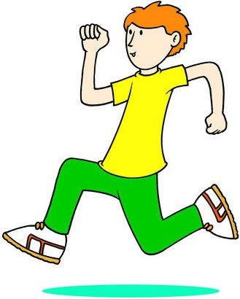
Categorising activities
Copy this table:
A. zero/low intensity activities | B. medium intensity activities | C. high intensity activities
www.teachingenglish.org.uk

Slide 4
Types of activities
Write the activities in your table:
dancing
drawing or painting gymnastics
martial arts
playing computer games playing in the playground playing tag or chase playing the piano reading a book
riding a bike
riding a bike fast or on hills riding a scooter
rollerblading running skateboarding skipping with a rope
sports like football and hockey travelling by car
walking fast walking slowly walking the dog
walking up the stairs watching videos watching TV
www.teachingenglish.org.uk

Slide 5
Categorising answers
Suggested answers:
A. zero/low intensity activities | B. medium intensity activities | C. high intensity activities
playing the piano walking slowly playing computer games watching TV watching videos reading a book drawing or painting travelling by car | walking the dog walking fast playing in the playground riding a bike riding a scooter skateboarding rollerblading dancing | walking up the stairs running playing tag or chase riding a bike fast or on hills skipping with a rope sports like football and hockey gymnastics martial arts
www.teachingenglish.org.uk

Slide 6
Exercise actions
touch your toes
dance
jump
skip
march
do lunges
squat
hop
run on the spot
do star jumps

Slide 7
Demonstrating a workout
Describing the actions | Encouraging people to exercise
First, you need to… Next, you… After that you… … again To finish… | Keep going! You’re doing great! Well done! You can rest now.

Slide 8
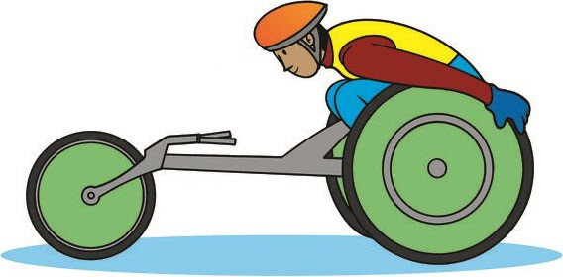
Activity quiz
How much physical activity do you need to do every day?
Do you do enough? Let’s find out!
Write the numbers 1 to 7.
Read the questions.
Write a, b or c next to each number.
www.teachingenglish.org.uk

Slide 9
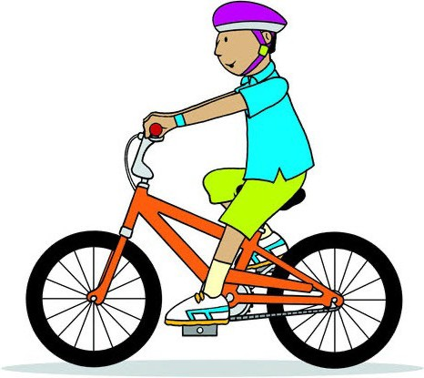
Quiz – question 1
Do you walk or ride your bike to school or another place?
Yes, every day.
Some days.
No.
www.teachingenglish.org.uk

Slide 10
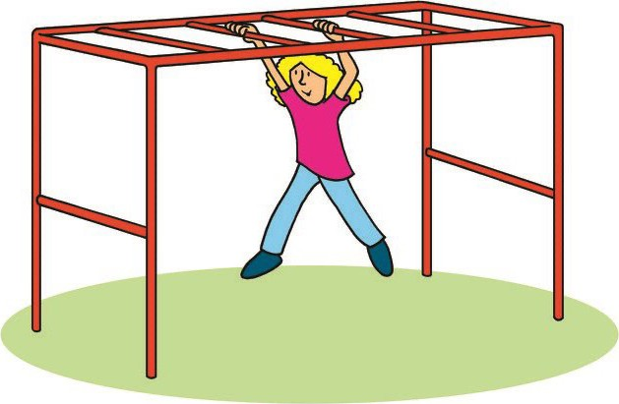
Quiz question 2
Do you play in the playground (doing something active) at school in break times?
Yes, every day.
Some days.
No.
www.teachingenglish.org.uk

Slide 11
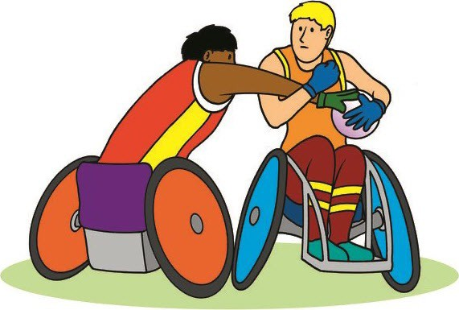
Quiz question 3
Do you have sports lessons at school?
Yes, every day.
Some days.
No.
www.teachingenglish.org.uk

Slide 12
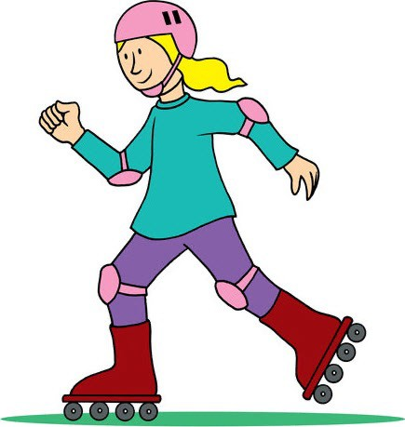
Quiz question 4
Do you ride your bike or scooter, or go skateboarding or rollerblading after school?
Yes, every day.
Some days.
No.
www.teachingenglish.org.uk

Slide 13
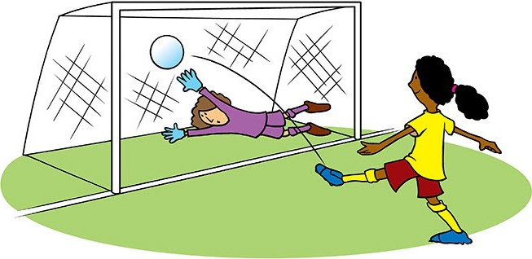
Quiz question 5
Do you do a sports activity, like football or gymnastics, after school?
Yes, every day.
Some days.
No.
www.teachingenglish.org.uk

Slide 14
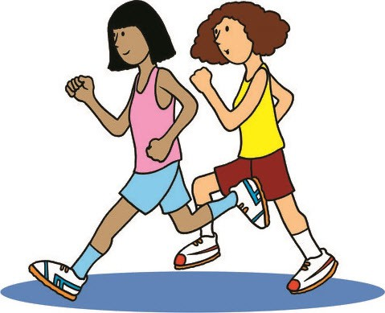
Quiz question 6
Do you do another physical activity that makes you breathe harder?
Yes, every day.
Some days.
No.
www.teachingenglish.org.uk

Slide 15
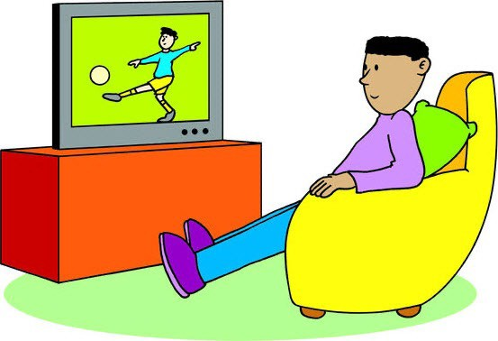
Quiz question 7
How many hours do you spend looking at a screen every day (for fun, not for school or homework), like watching TV, playing computer games, watching videos or chatting to your friends online?
Less than one hour.
Between one and two hours.
More than two hours.
www.teachingenglish.org.uk

Slide 16
Results
Mostly A: Great! It looks like you do lots of physical activities every day. Well done!
Mostly B: Keep going! It looks like you do some different activities every day. Does it add up to 60 minutes? If yes, great! If not, what other activities would you like to try?
Mostly C: OK, let’s see. It looks like you don’t do many different physical activities every day. Do you do one or two activities for a longer time? If not, try to do more. What activities would you like to try?
www.teachingenglish.org.uk

Slide 17
Lia’s exercise routine
How many minutes of exercise does Lia do every day?
When | What | How long
before school | do an exercise video | 5 minutes
going to school | walk to school | 10 minutes
at lunch time | play a running game with my friends in the playground | 15 minutes
after school (Tuesdays and Fridays) | go to swimming lessons | 30 minutes
after school (Mondays, Wednesdays and Thursdays) | ride my bike in the park (if it’s sunny) OR dance to my favourite songs at home (if it’s rainy) do some skipping or hula-hooping | 20 minutes 10 minutes
in the evening | walk the dog | 15 minutes
Total:
www.teachingenglish.org.uk

Slide 18
Are you active or not?
Name:
When | What | How long
Total:
www.teachingenglish.org.uk

Slide 19
TeachingEnglish lessons
Are you active or not?
Thanks for coming!
www.teachingenglish.org.uk

