Slide 1
Unsung heroes
TeachingEnglish lesson
January 2024

Slide 2


Write down the names of five people you consider to be heroes.
You have 3 minutes. Starting from…NOW!
Who are your heroes?

Slide 3
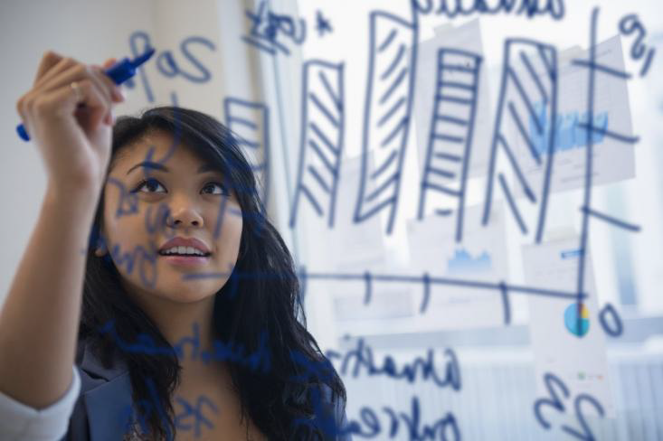
Unsung heroes
Mary Seacole
Mary Anning
Dr Megan Coffee
Irena Sendler
Hilary Lister
Which of these women are you most impressed by?

Slide 4
Who are your heroes?

Slide 5
Unsung heroes

