Slide 1
Where do you shop?

Slide 2
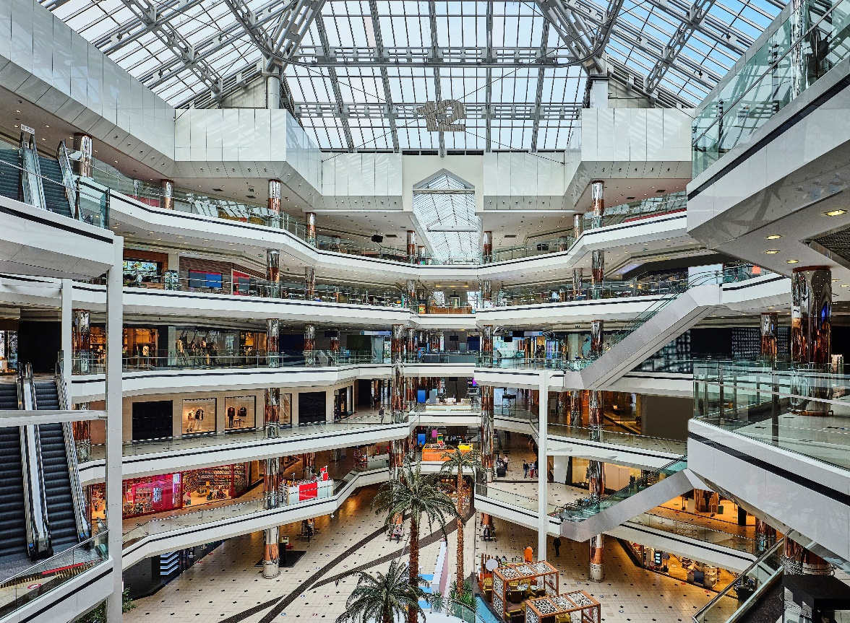
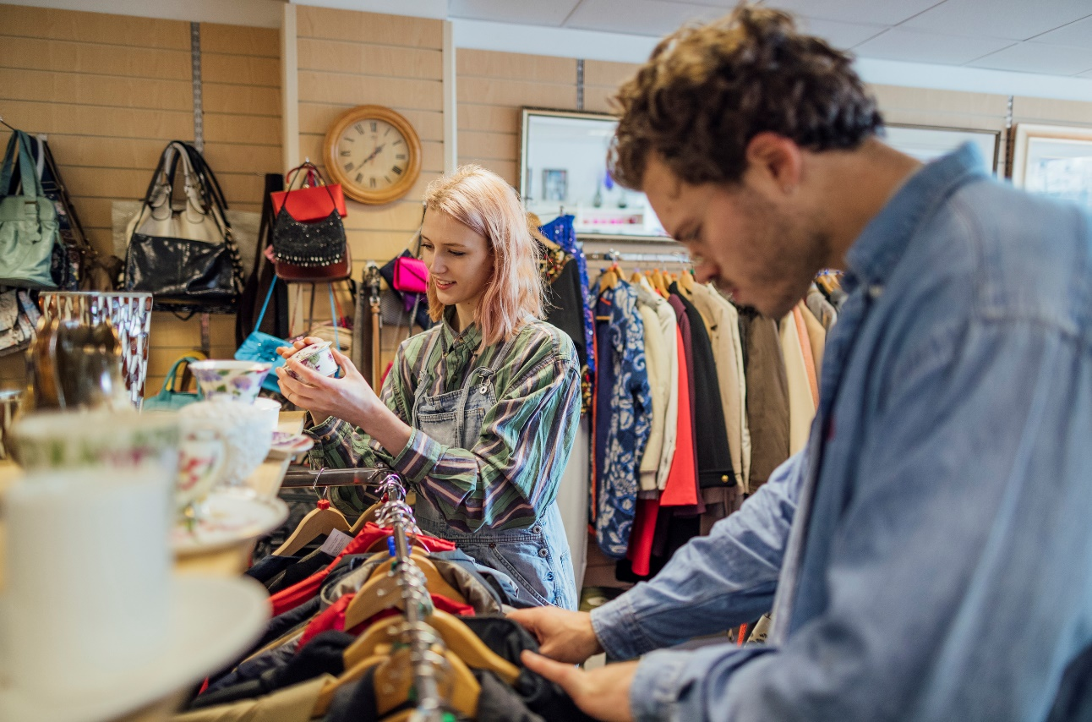
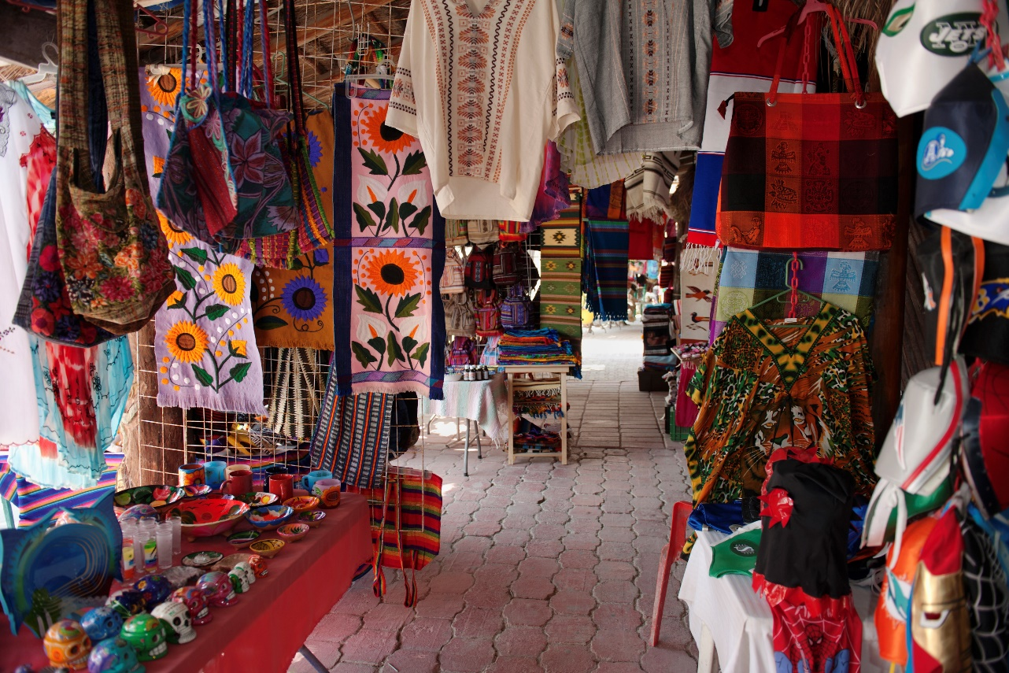
What is the same …
and what is different about these places?

Slide 3
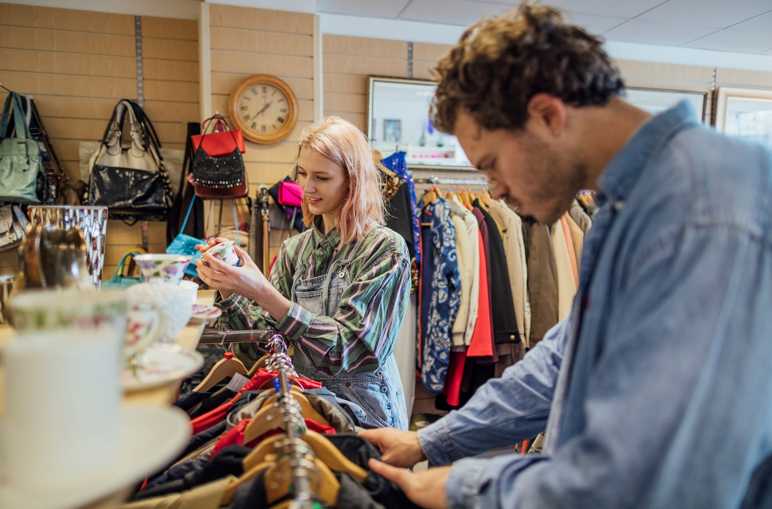
Listen to three people talking about these places.
2
3
1
Put them in the order you hear them.

Slide 4
1
2
3
4
something for everyone
local food
furniture
spices
reduce waste
accessories
textiles
(give money to) charity
5
6
7
8

Slide 5
Listen again to the three speakers talking about the market, the shopping centre and the charity shop.
Answer these questions:
What can we buy in each place?
Why do the people like shopping there?

Slide 6
I love going to the local market. The colours are amazing! There are so many colours from the fruit and vegetables and all the different textiles. And then there are all the different spices that smell so nice. When I visit the market, I see, smell, taste, feel and hear so many things that make me happy. The food is fresh and local, and so delicious!
I really like going to the big shopping centre. My friends and I are always excited because there are so many shops and places to eat. There are so many people – like families, groups of teenagers, older people. There’s something for everyone. I like the fashion shops because I love finding new ways to look good!
In the UK, we have lots of charity shops. They are sometimes called second-hand shops because people give clothes that they don’t wear any more, and other people can buy them. People can give books or furniture they don’t use any more as well. I prefer shopping there because I find unusual clothes and cool accessories like belts and bags for a good price. I can buy awesome clothes AND it helps reduce waste.

Slide 7
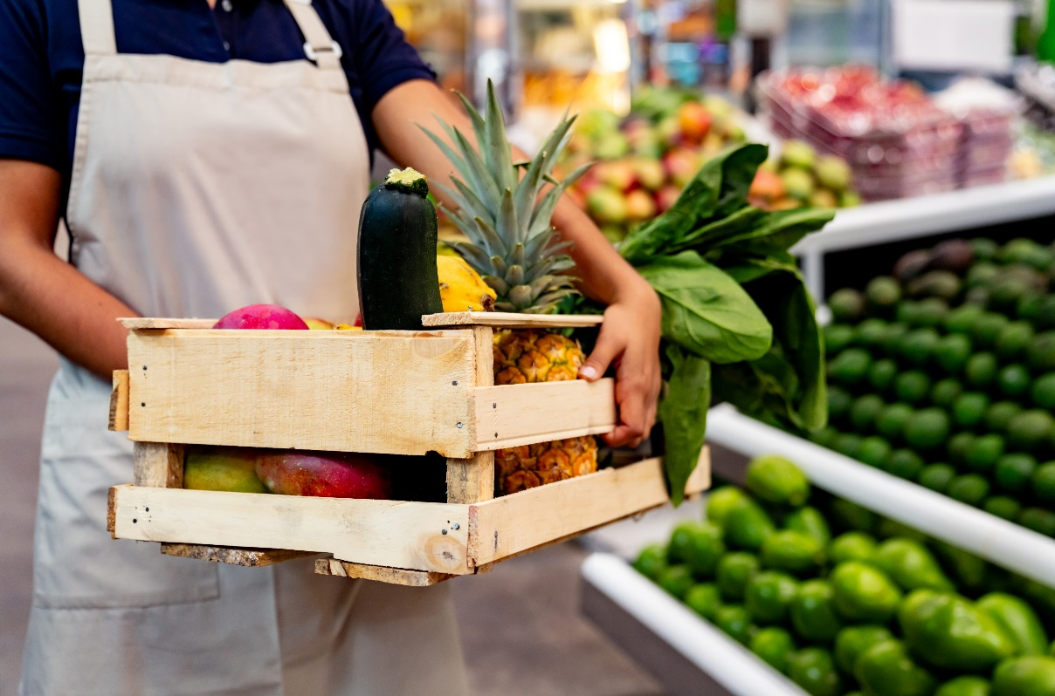
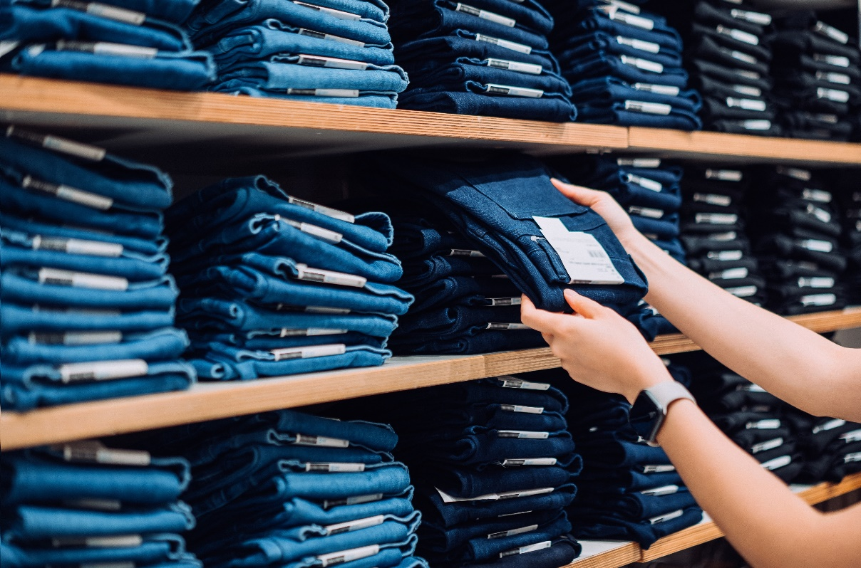
Where did I buy these things?
a second-hand shirt
local fruit and vegetables
new jeans
from a charity shop
from a market
from a shopping centre

Slide 8
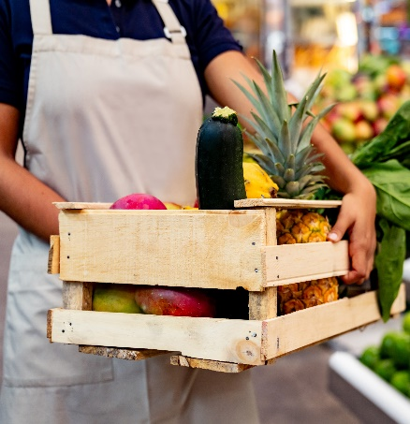
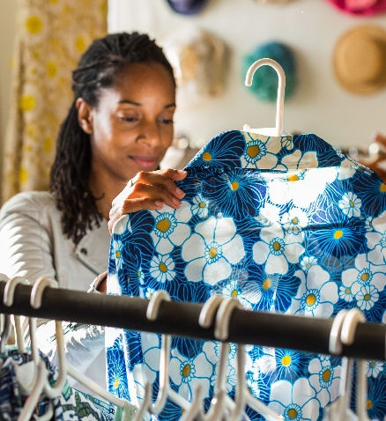
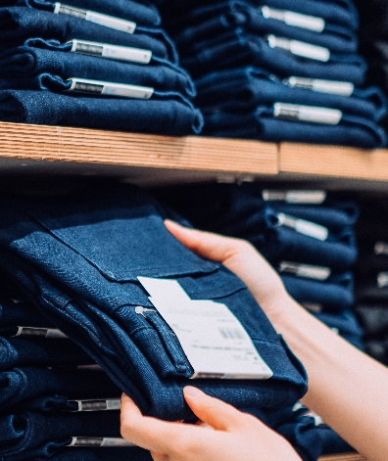
second-hand shirts from a charity shop
local fruit and vegetables from a market
new jeans from a shopping centre
Someone made them in a big factory.
Someone made them in a big factory.
We eat them and we can put the waste back into the land.
We buy them after someone has used them.
We buy them new.
We reduce waste when we buy them.
We buy them fresh.
Big ships, lorries or aeroplanes transport them to different countries.
The money goes to people who need help.
People who live near us get the money.
We could give them to a second-hand shop when we don't want them anymore.
We could give them to a second-hand shop when we don't want them any more.

Slide 9
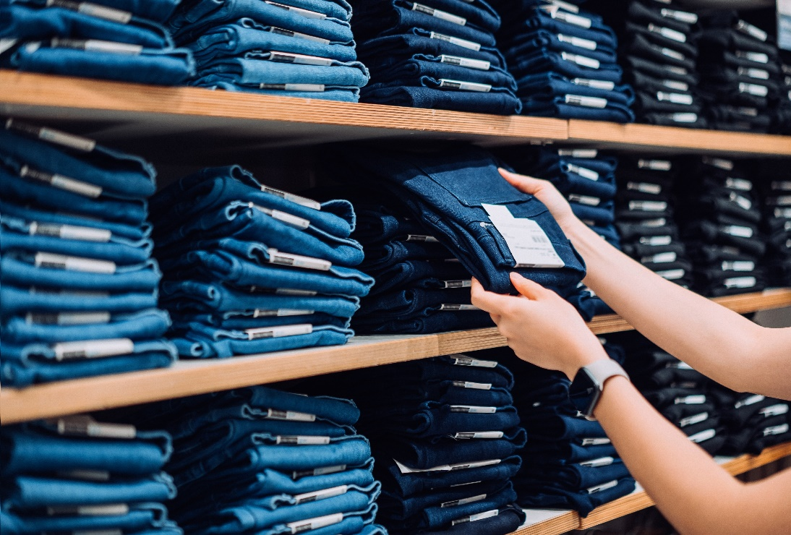
Which is the best to buy for people and the environment?

