Slide 1


Starting a new school

Slide 2
Task 1. Discuss the following with your partner. Share your number and the reason why you chose it.
How would you feel if:
you joined a sports team for the first time?
5. very confident
you went to a party and didn’t know anyone there?
4.
you had to sit next to a student who has just joined your class?
you started a new school?
3.
2.
1. very nervous

Slide 3

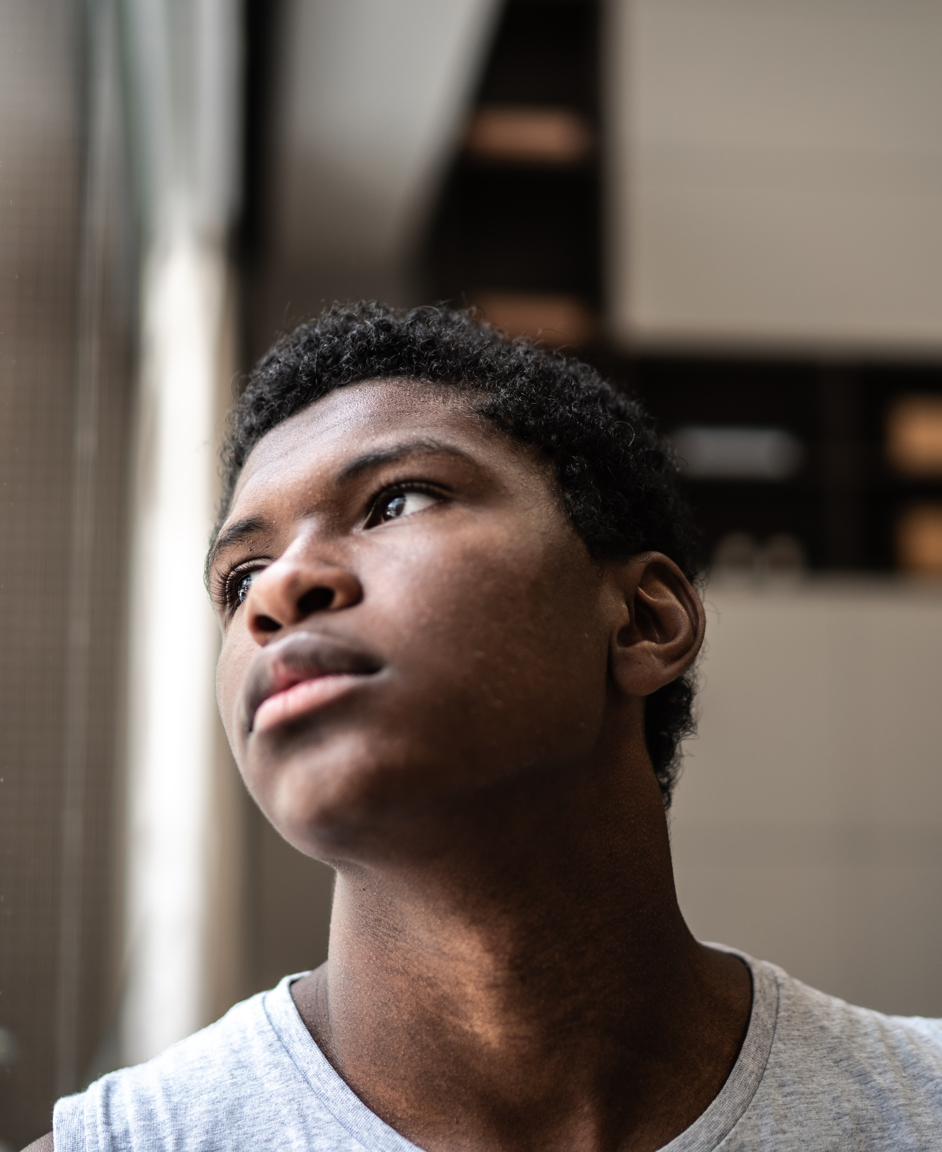
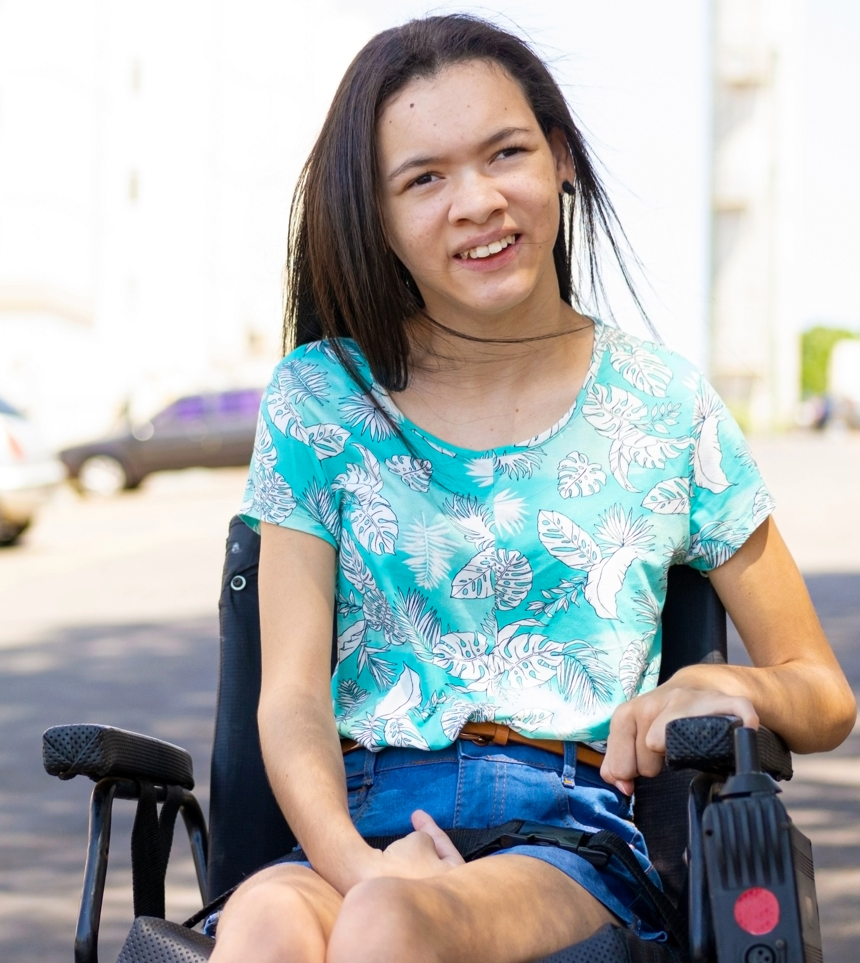
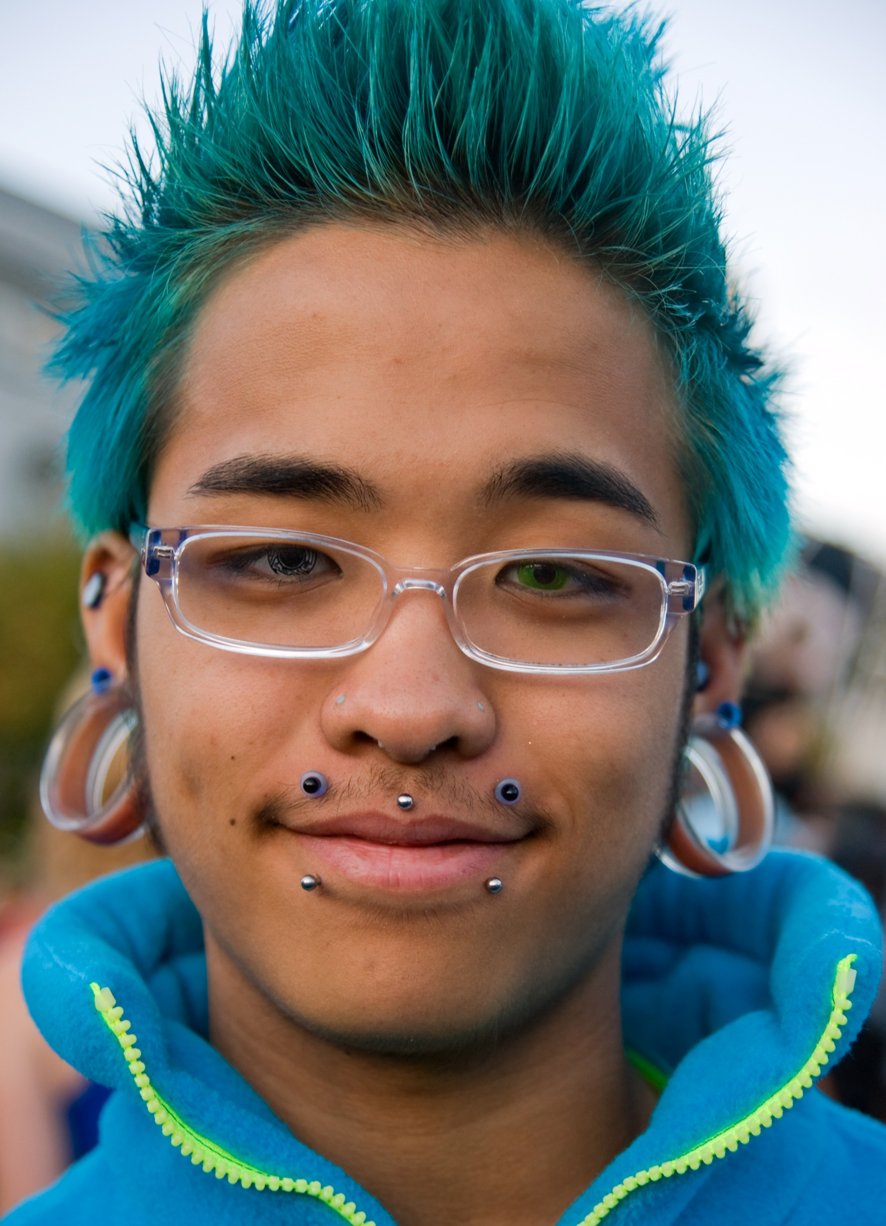
These teenagers are starting a new school. How do you think they feel?

Slide 4

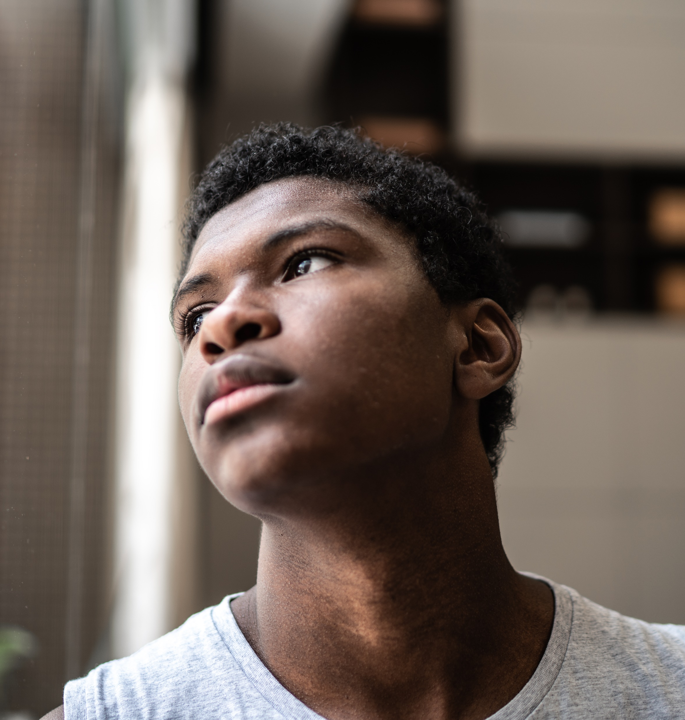
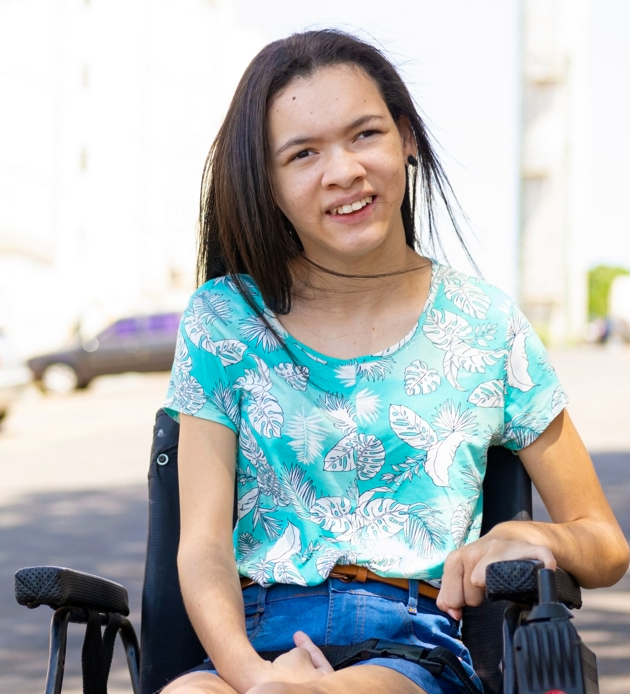
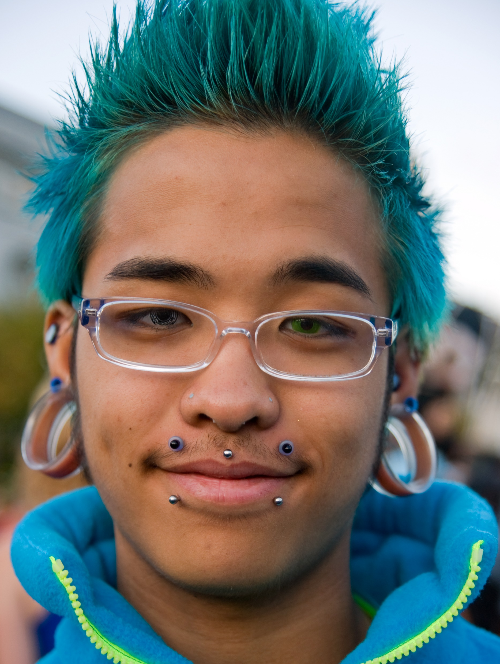
Task 2. Listen to them talking about their new school experience. Match the student to what they say.
1. Zainab
Zainab
2. Femi
3. Hanna
4. Adam
a. I felt uncomfortable because people didn’t want to talk to me.
b. People are always looking at me, and I’m often alone.
c. The biggest problem
for me was connected
to my language skills.
d. I received a lot of support and felt welcomed overall.

Slide 5
Answers:
1. Zainab
Zainab
2. Femi
3. Hanna
4. Adam
c. The biggest problem
for me was connected
to my language skills.
a. I felt uncomfortable because people didn’t want to talk to me.
d. I received a lot of support and felt welcomed overall.
b. People are always looking at me, and I'm often alone.

Slide 6

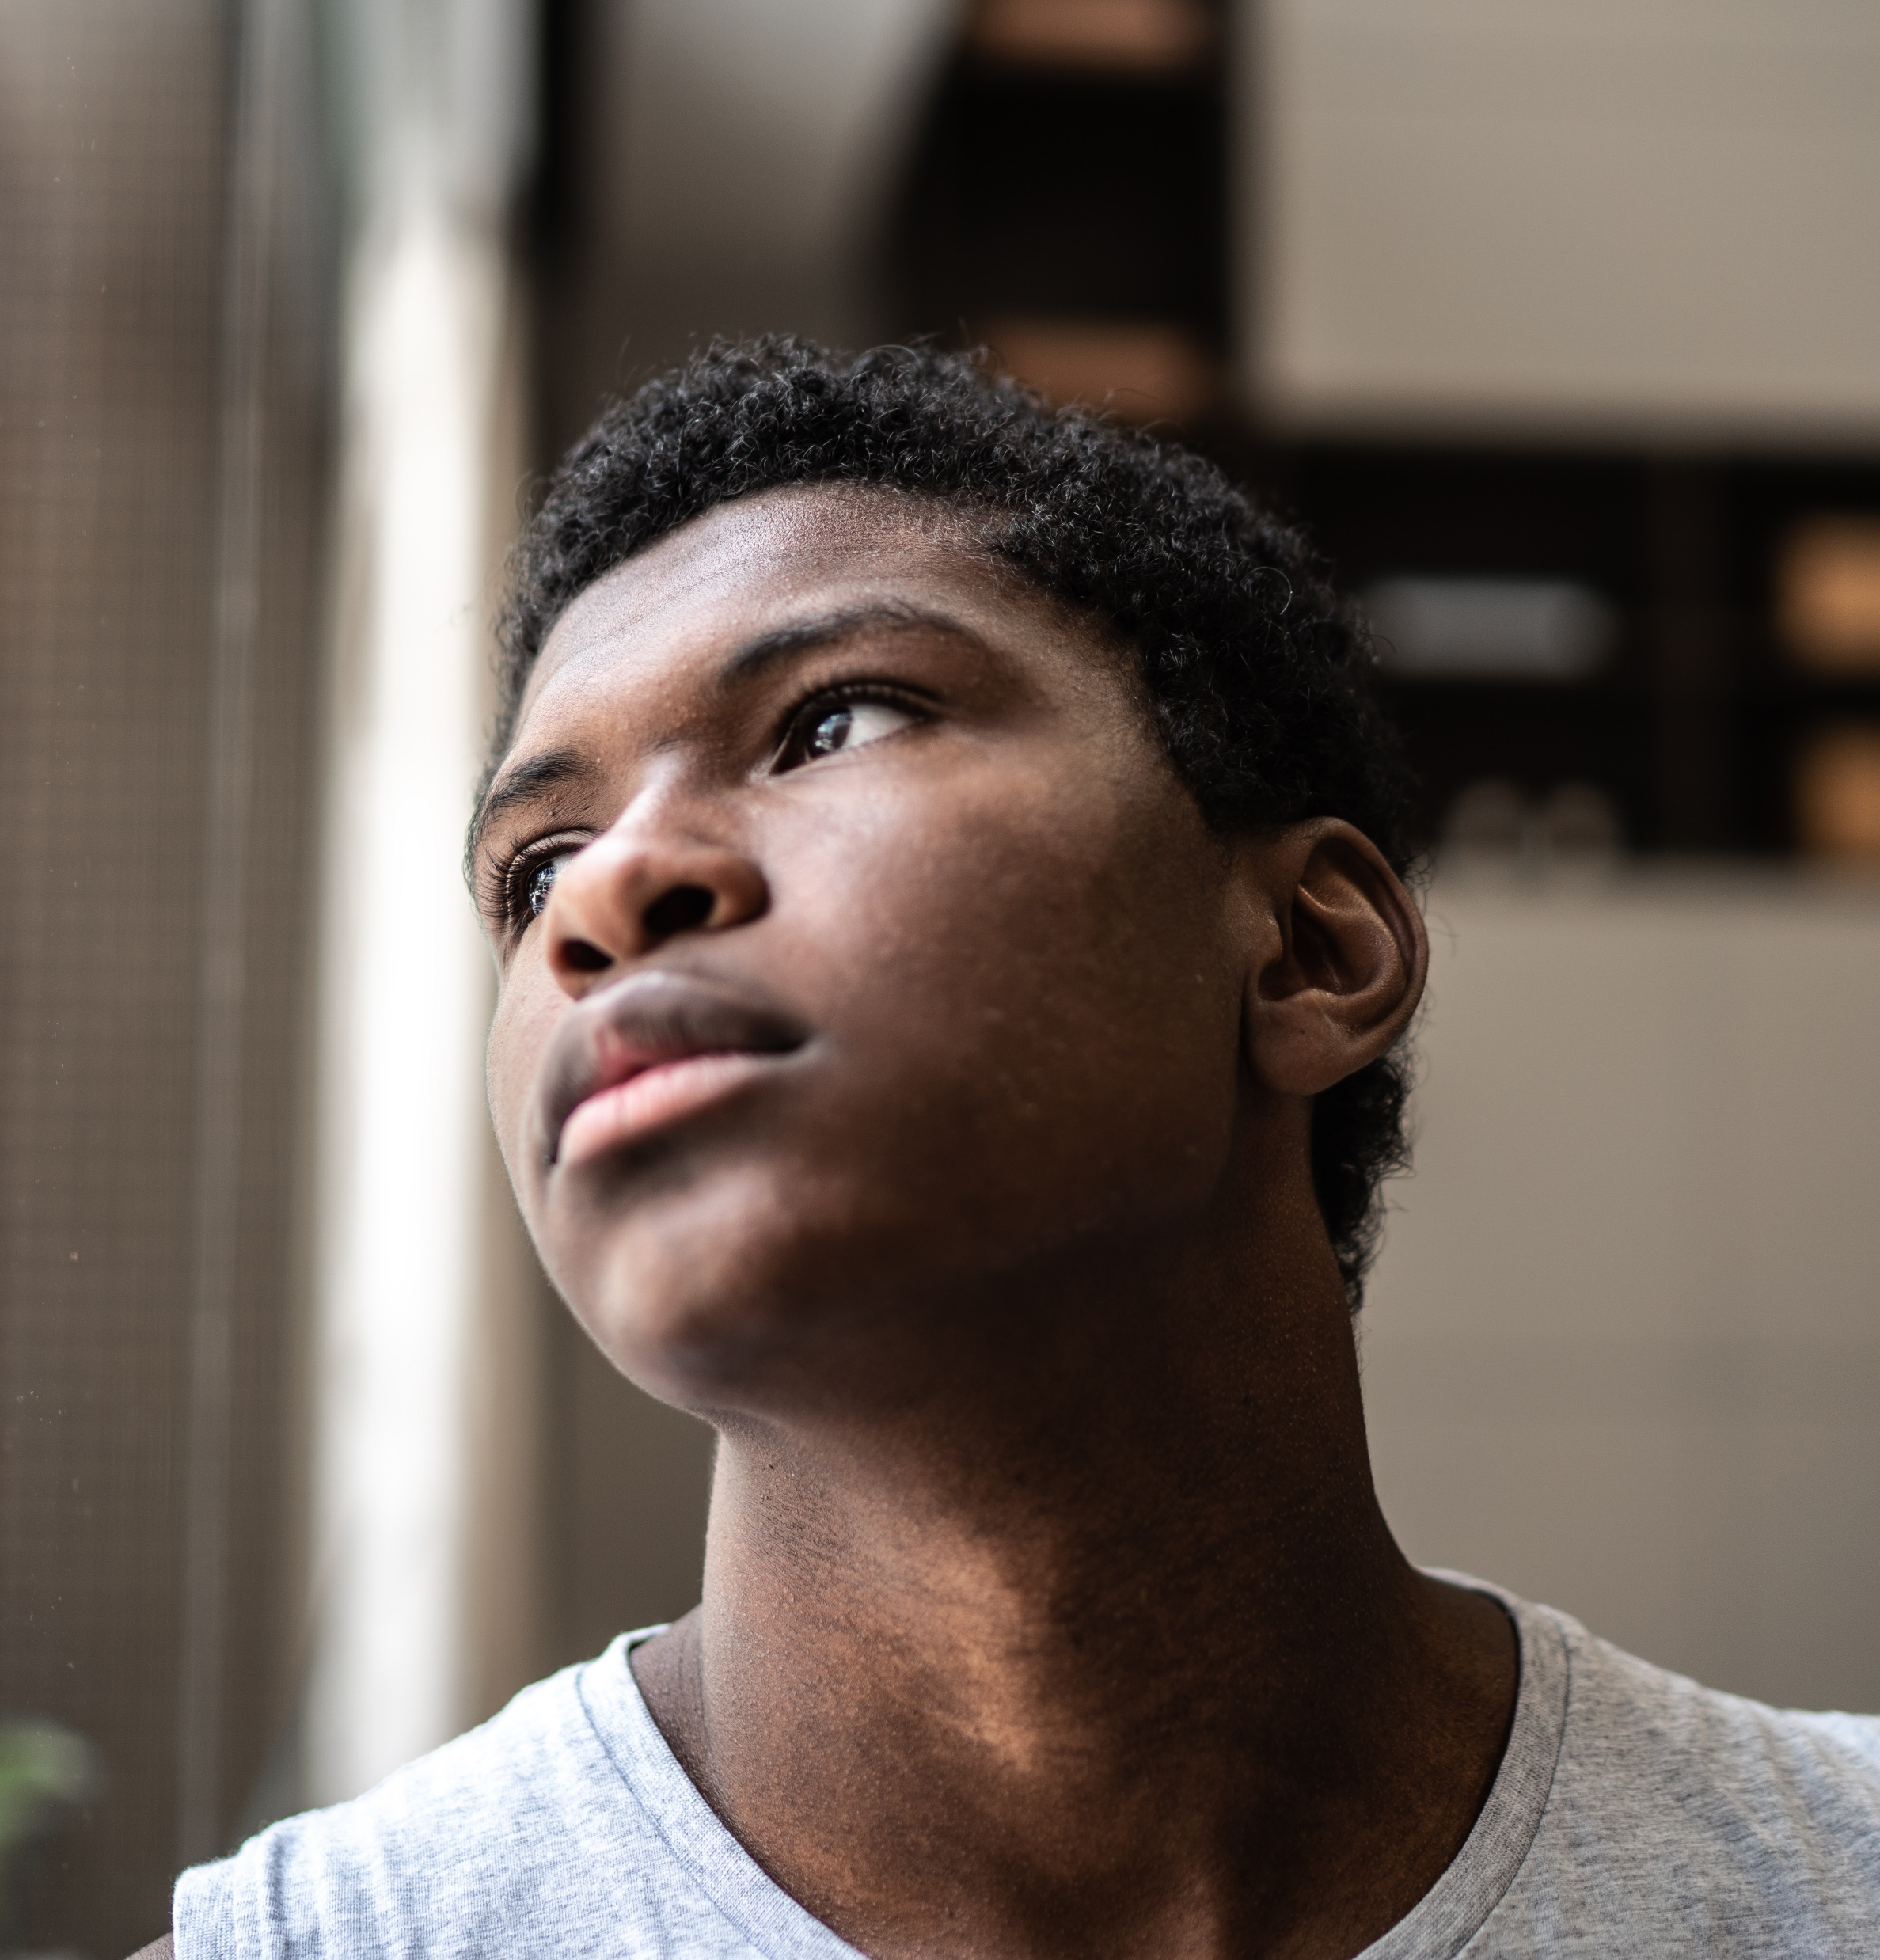
Which student do you think is having the easiest time? Which student do you think is having the most difficult time?
1. Zainab
Zainab
2. Femi
3. Hanna
4. Adam
What advice would you give to each student?

Slide 7
Task 3: Complete the sentences with the words in the box.
open-minded refugee feel left out stick together dye
disabled piercings relief lonely
get an awkward feeling welcoming feel out of place inside jokes
a) Mona left her country because of a war and now she is a ________ in Greece.
b) Mia wants to ________ her hair pink for the school party.
c) My classmates laugh at their ________, but I don’t understand them yet.
d) My friends and I always support each other and ________ when things are difficult.
e) After I moved to a new school, I felt very ________ because I was often alone.
f) I ________ when everyone is wearing the same style of clothes and I’m wearing something different.

Slide 8
Task 3: Complete the sentences with the words in the box.
open-minded refugee feel left out stick together dye
disabled piercings relief lonely
get an awkward feeling welcoming feel out of place inside jokes
g) It was a big ________ when the teacher cancelled the test!
h) The students in my class were very ________ and friendly on my first day at school.
i) Liam has two ________ in his ear, and he wants to get another one.
j) Sometimes, I ________ when my friends talk about a party that I didn’t go to.
k) I always ________ when I don’t know what to say in a conversation. My face goes red!
l) Our school built a new ramp so that ________ students can easily go to class.
m) My new teacher is really ________ and listens to everyone’s ideas in class.

Slide 9
Answers
open-minded refugee feel left out stick together dye
disabled piercings relief lonely
get an awkward feeling welcoming feel out of place inside jokes
refugee
a) Mona left her country because of a war and now she is a ________ in Greece.
b) Mia wants to ________ her hair pink for the school party.
c) My classmates laugh at their ___________, but I don’t understand them yet.
d) My friends and I always support each other and _____________when things are difficult.
e) After I moved to a new school, I felt very ________ because I was often alone.
f) I ______________when everyone is wearing the same style of clothes and I’m wearing something different.
dye
inside jokes
stick together
lonely
feel out of place

Slide 10
Answers
open-minded refugee feel left out stick together dye
disabled piercings relief lonely
get an awkward feeling welcoming feel out of place inside jokes
relief
g) It was a big ________when the teacher cancelled the test!
h) The students in my class were very ________ and friendly on my first day at school.
i) Liam has two ________ in his ear, and he wants to get another one.
j) Sometimes, I __________when my friends talk about a party that I didn’t go to.
k) I always ___________________when I don’t know what to say in a conversation. My face goes red!
l) Our school built a new ramp so that ________ students can easily go to class.
m) My new teacher is really _____________and listens to everyone’s ideas in class.
welcoming
piercings
feel left out
get an awkward feeling
disabled
open-minded

Slide 11
Talk with your partner:
Have you ever felt left out at school?
Have you ever felt out of place in a social situation?
Have you ever been friendly and welcoming to a new person?

Slide 12

Task 4: Listen to each teenager talking about their experience again. Choose the correct option for each question.
1. What was the most difficult thing about starting a new school for Zainab?
a) She found it difficult to communicate in English.
b) The lessons were much more difficult than in her last school.
c) The teachers didn’t help her very much.
d) People didn’t know her name.
2. Why did Zainab enjoy maths more than other subjects?
a) The teacher spoke her language.
b) Maths concepts are the same everywhere.
c) Her friend Georgia helped her with maths.
d) It was her favourite subject at her old school.
3. How did Zainab’s relationship with Georgia make a difference?
a) Georgia helped her with schoolwork and introduced her to teachers.
b) Georgia helped her make friends and improve her English.
c) Georgia spoke Zainab’s first language, making communication easier.
d) Georgia gave her English lessons.
1. Zainab

Slide 13

Task 4: Listen to each teenager talking about their experience again. Choose the correct option for each question.
1. What made Femi’s experience at the new school different?
a) He didn’t feel confident talking to people.
b) The students were friendlier than at his previous schools.
c) He found it harder to understand the lessons at this school.
d) The school was much larger, and students already had friendship groups.
2. How does Femi feel when he tries to talk to his classmates?
a) He becomes nervous because they speak too fast.
b) He feels nervous because he is very shy.
c) He feels alone because the conversations are about shared experiences.
d) He feels sad because they make jokes about him.
3. What did Femi try to do to feel less lonely?
a) He joined school clubs to meet new people.
b) He changed classes to find different friends.
c) He tried to sit with different groups outside of class.
d) He added his classmates on social media.
2. Femi

Slide 14

Task 4: Listen to each teenager talking about their experience again. Choose the correct option for each question.
1. How did Hanna feel before starting her new school?
a) She felt confident.
b) She felt angry.
c) She felt relaxed.
d) She felt scared.
2. How did the buddy system help Hanna?
a) She could meet a new group of friends.
b) It helped her understand where things are at school and make a new friend.
c) It helped her with her studies.
d) It helped her to get to know the teachers.
3. What does Hanna still find difficult?
a) Understanding the past funny stories her classmates share.
b) Understanding the lessons.
c) Finding a group to sit with during lunch breaks.
d) Participating in sports activities with her classmates.
3. Hanna

Slide 15
Task 4: Listen to each teenager talking about their experience again. Choose the correct option for each question.
1. What makes Adam feel uncomfortable at his new school?
a) People don’t like his personality very much.
b) The students are too friendly, and he doesn’t like talking so much.
c) He doesn’t like the other students.
d) The students look at him because of his style.
2. How does Adam describe his experience during lunch breaks?
a) He tries to sit with different groups to meet people.
b) He uses the time to study.
c) He focuses on his phone to stop feeling left out.
d) He talks to teachers about how to make friends.
3. What does Adam miss the most about his old school?
a) People at his old school didn’t judge his clothes and hair.
b) He could use his phone all the time.
c) His old teachers, who liked his unique style.
d) The smaller size of the school, which made it easier to meet people.
3. Adam

Slide 16
Discuss:
Have you ever been in a situation like the characters?
How did you feel, and what helped you?
If not, how would you feel in their situation?

Slide 17
Task 5: Work in groups to make a Welcome plan to help new students who join your school.
Step 1. Discuss:
What problems do the students have?
How could your school help students like Zainab, Femi, Hanna or Adam?
Step 2. What could your school do to make new students feel happy and included? Write a list of five ideas with your group.
Step 3. Change groups. Each person shares the five ideas from their previous group. With your new group, choose the three best ideas.

Slide 18
Task 5: Work in groups to make a Welcome plan to help new students who join your school.
Step 4. Write your Welcome plan on a poster. Give it a title and write down the 3 ideas. You can draw and use colours if you want.
Everyone is Welcome!
1. Join our buddy system. Each new student gets one buddy for the first month. The buddy shows them where to go and sits with them at lunch.
2. Join our Welcome Club. Every Wednesday, new students and old students play games and talk to each other after school.
3. Join our Cultural Day once a month. Everyone brings food, music, or games from their culture to share. This helps everyone learn about each other.

Slide 19
Task 5: Work in groups to make a Welcome Plan to help new students who join your school.
Step 5. Present your Welcome Plan to another group and explain why your ideas will help new students.

Slide 20
Reflection. Tell your partner:
3 emotions you felt when you listened to the teenagers
2 things you would do if a new student joined your class
1 thing you learnt

