Slide 1


Families

Slide 2
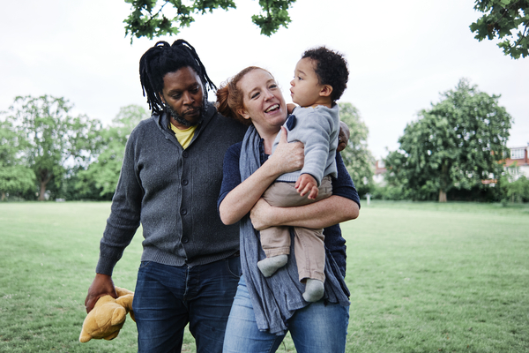
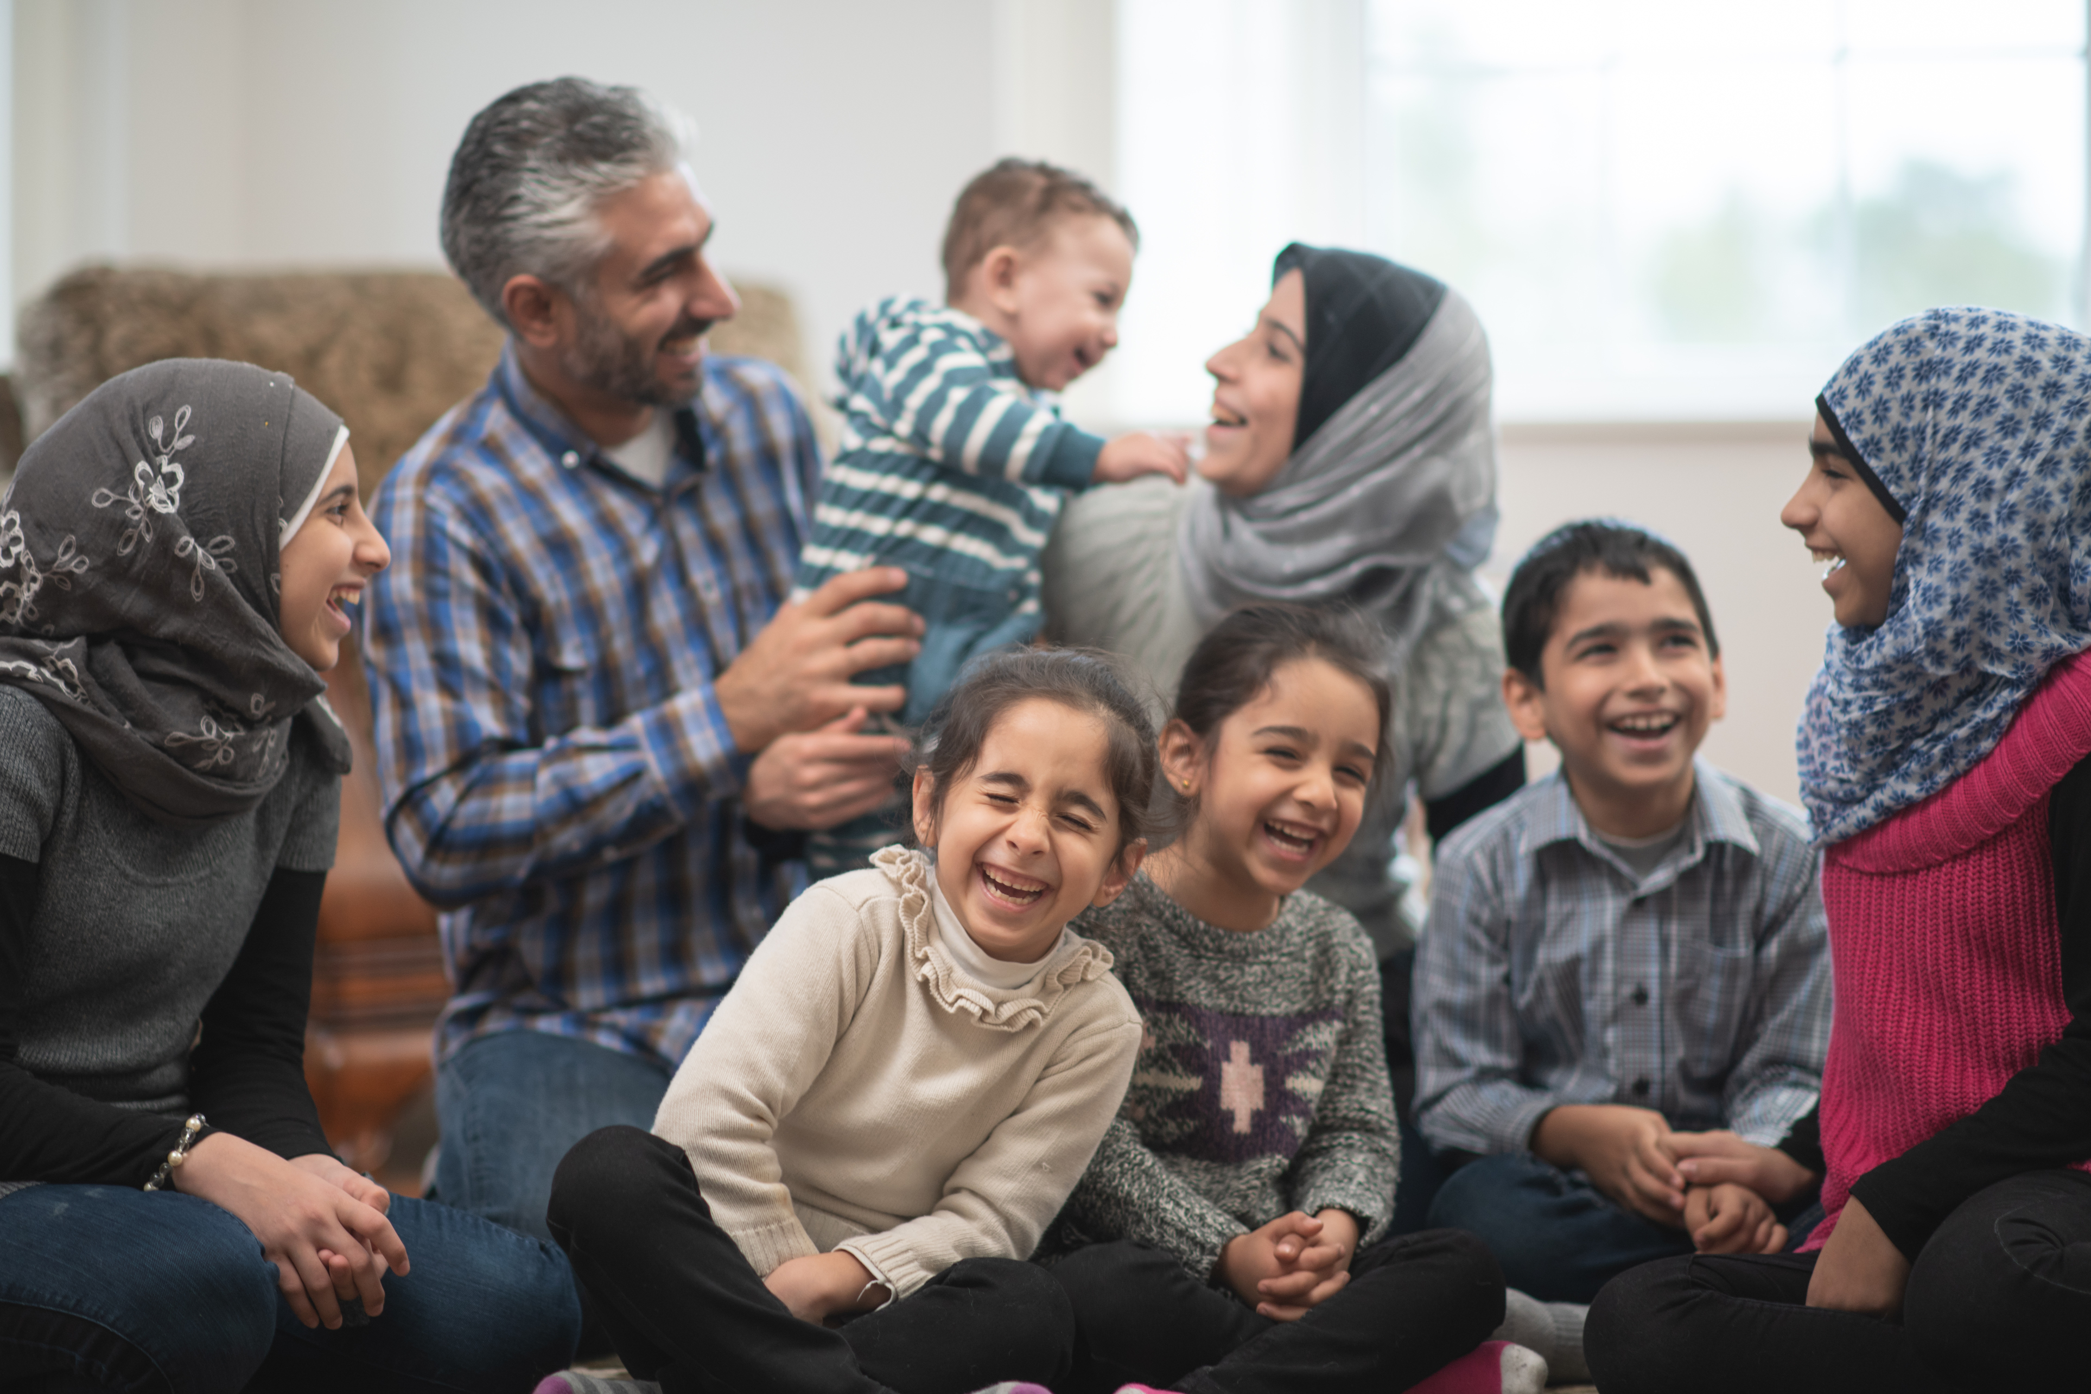
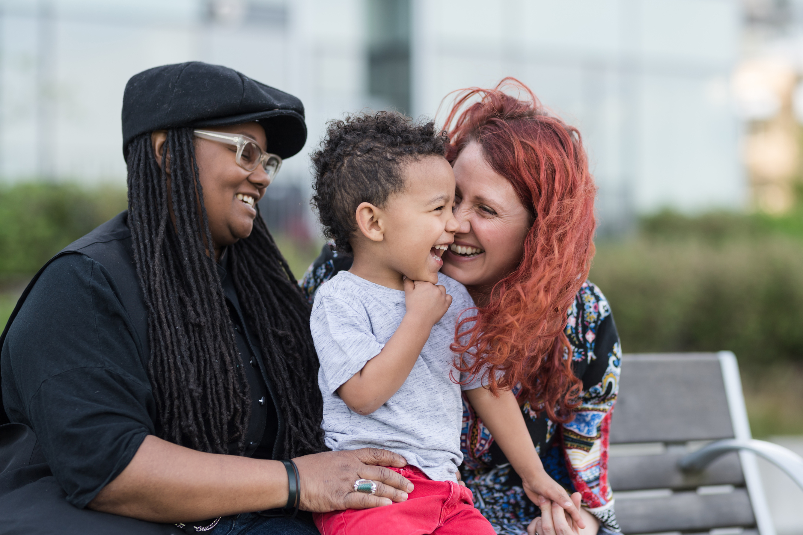
Look at the photos of different families. Describe each family.
1.
2.
The family in picture ___ is/has ...
3.
4.

Slide 3
Which family is most similar to yours? Why?
1.
2.
The family in picture 1/2/3/4, because ...
3.
4.

Slide 4
Ali and Samir talk about their families. Which family is Ali's and which family is Samir's? Write 'Ali' and 'Samir' in the correct box.
1. ________________________________________ | 2. ________________________________________
3. ________________________________________ | 4. ________________________________________
Ali
Samir

Slide 5
Are Ali's and Samir's families similar or different?
Ali's family
Samir's family

Slide 6
Listen to Ali and Samir talking about their families again. Write (A) next to the sentences that describe Ali, (S) next to the sentences that describe Samir and (B) next to the sentences that describe both.
Example: I walk my dog before going to school. (S)
I got up early today. ___
I have a lot of siblings. ___
I play sport with my family after school. ___
There's very little noise in my house. __
There's lots of work to do at home. ___
My dog is learning how to do tricks. ___
I want a dog. ___
(B)
(A)
(A)
(S)
(B)
(S)
(A)

Slide 7
Ali: What did you do today?
Samir: The same as usual, really. I got up early and walked my dog before school. How about you?
Ali: I got up early too. I helped my little brothers get ready for school. I made them breakfast and put their books in their bags. There's always so much to do with a big family!
Samir: Yeah! You have a lot of siblings, right?
Ali: Yeah, I have two brothers and four sisters! It's really busy at home. But after school, I teach my sisters how to play basketball, and that's really fun. What about you?
Samir: It's just me and my dad, so it's very quiet. That's why I got my dog, Bruno. He's family, too!
Ali: Awww. My house is never quiet. There's a lot of work to do but I like having a big family.
Samir: Yeah, it sounds fun! Bruno is a lot of work too, but I love him! He's like my best friend. I'm teaching him some new tricks.
Ali: That's so cool!! I want a dog, but we have too many people in the house!
Samir: Yeah. Well, you can always play with Bruno!
Ali: Thanks! And you can always play with my little brothers and sisters!
Samir: OK, it's a deal!

Slide 8
Put the words in the box into the correct sentences.
siblings walk tricks get up teaches deal
get up
a) I can never _______________ for school in the morning. I want to stay in bed.
b) In the morning, both my mums ___________ my dog so that he can get some exercise.
c) I have five brothers and three sisters. That's a lot of ________________!
d) I live with my grandfather, and he ___________ me lots of things about science and maths.
e) My dog can give me his paw, sit and roll over. He knows a lot of _________!
f) My dad said I can play computer games after I do my homework. It’s a good idea so I said,
'it’s a _________!'
walk
siblings
teaches
tricks
deal

Slide 9
There are all different types of families. Families can be the people we live with, our closest friends or animals. On the poster, draw and/or write the names of the people and animals who make your family.
Love makes a family!

Slide 10
There are all different types of families. Families can be the people we live with, our closest friends or animals. On the poster, draw and/or write the names of the people and animals who make your family.
My aunty
My cat
My half-brother
Love makes a family!
My grandparents
My best friend

Slide 11
Tell your partner about your family!
In my family, there's ...
In my family, we like to ...
Every day, we ...

