Slide 1
TeachingEnglish lessons
The Sustainable Development Goals
February 2022
www.teachingenglish.org.uk

Slide 2
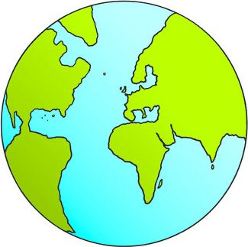
The Sustainable Development Goals
What are the biggest problems in the world today?
www.teachingenglish.org.uk

Slide 3
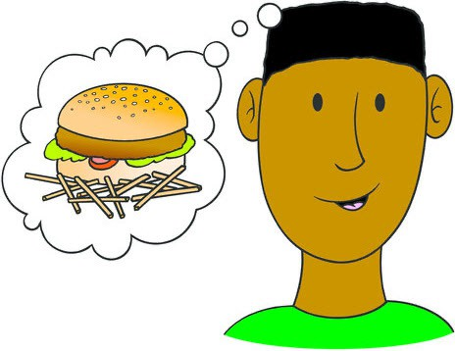
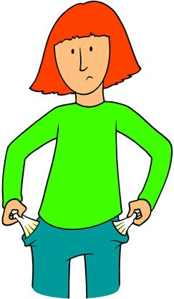
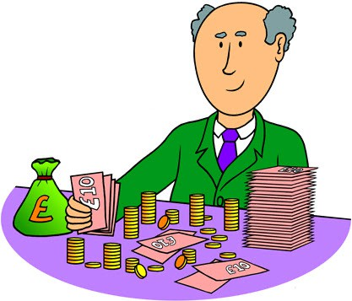
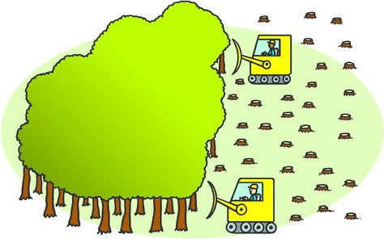
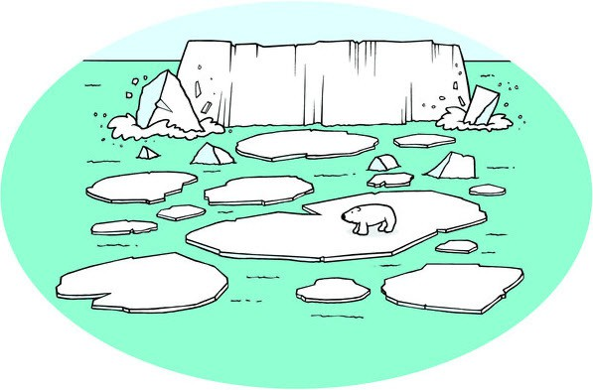
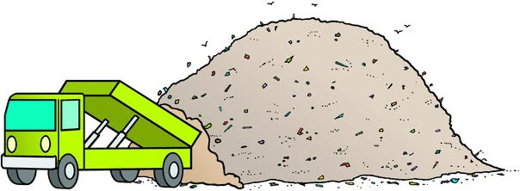
The Sustainable Development Goals
There are 17 goals. What do you think they are?
To make sure that …
To make sure that …
To make sure that …
www.teachingenglish.org.uk

Slide 4
The Sustainable Development Goals
What three goals do you think are really important? Put a star next to them.
Why are they important?
I chose Goal : because …
www.teachingenglish.org.uk

Slide 5
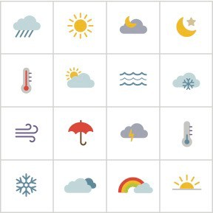
The Sustainable Development Goals
www.teachingenglish.org.uk

Slide 6
The Sustainable Development Goals
Design an icon for a goal!
Draw a square.
Draw your icon inside the square.
Write what goal it is and why you think it’s important.
Draw icon here
www.teachingenglish.org.uk

Slide 7
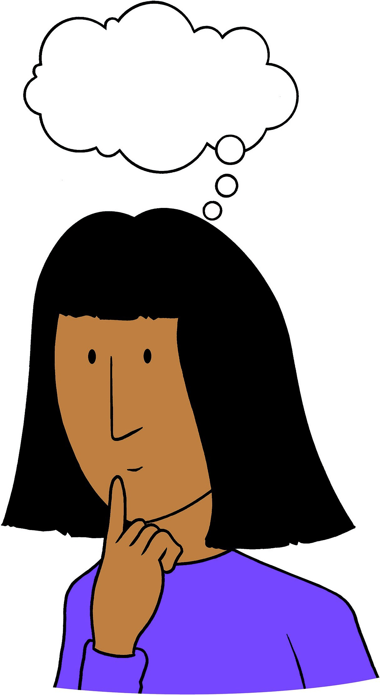
The Sustainable Development Goals
Guess the icons!
Look at your classmates’ icons.
Say what you see and guess the goal:
I think it’s money. Is it No poverty?
I think it’s . Is it ?
www.teachingenglish.org.uk

Slide 8
TeachingEnglish lessons
The Sustainable Development Goals
Thanks for coming!
www.teachingenglish.org.uk

