Slide 1
Tiny Cinderella Somewhere
TeachingEnglish lesson
April 2020

Slide 2
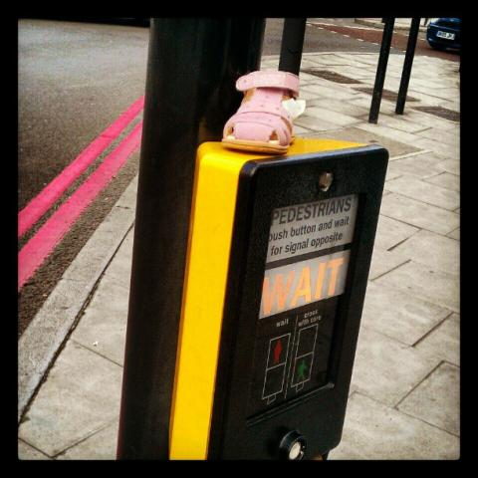
Tiny Cinderella Somewhere
Lead-in: Look at the photo. Write as many different words as you can related to it.
Include nouns, verbs and adjectives.

Slide 3
Tiny Cinderella Somewhere
Task 1: You are going to listen to the photographer talking about this photo.
Draw a 3x3 grid. Write a word you think you will hear in each square.
Now listen and cross off the words you hear.

Slide 4
Tiny Cinderella Somewhere
Task 2: Before you listen again, see what you can remember. Circle the correct answer for each statement T (true), F (false) or DK (don’t know).
1. He took the photo at the weekend. T / F / DK
2. He always goes to work by bus. T / F / DK
3. When he saw the shoe, he went home to get his mobile phone. T / F / DK
4. The little girl was going to school when she lost her shoe. T / F / DK
5. He asked the little girl a lot of questions. T / F / DK
6. He thinks it was a good idea to leave the shoe at the traffic lights. T / F / DK
Now listen and check your answers.

Slide 5
Tiny Cinderella Somewhere
Task 3: Read the questions the photographer asks. Invent the story.
Whose is the shoe and how did it get there?
Where was the little girl going to?
Does she live near here?
How did she lose the shoe?
Who found it?
Did she get her shoe back?
Did her parents go out again and look for it?

Slide 6
Tiny Cinderella Somewhere
Transcript
I took this photo in June 2012, in London. Um, it was quite early in the morning, and I was on the way to the college. I'm a teacher, I teach adults, ah, English, so obviously it was a weekday, but I don't remember if it was a Monday or a Thursday or... you know. And, um, I took it not far from where I live, in the south of London, um, at the traffic lights, near my usual bus stop, where I get the bus to work every day. I'm not exactly certain why I took the photo, it was a spontaneous thing, I didn't think about it really. I mean, I just saw the little shoe sitting there, pink and plastic, and it caught my attention. I had my mobile phone in my pocket, so... modern art.
It's something that I see every day with something that I don't see every day; it's something that's normal and something that's not very normal, that's more unusual – a child's shoe on the button for pedestrians at the zebra crossing, well, the traffic lights. And that's why I took it, why I took the photo. And I started to think about, you know, the story, the story behind it. Whose is the shoe and how did it get there? Where was the little girl going to? I imagine it was a little girl. Does she live near here? How did she lose the shoe? Who found it? And and then, did she get her shoe back? Did her parents go out again and look for it? I mean, it was easy to see it at the traffic lights. That was a good idea, it was a good place to leave it.
Anyway, I thought it'd be an interesting photo to talk about with my students. We sometimes use photographs to, um, start some story-telling activities, or to talk about what we did or saw at the weekend, that sort of thing. Do you ever do that?

Slide 7
Tiny Cinderella Somewhere
TeachingEnglish lessons
Thanks for attending the lesson

