Slide 1
Tattoo - possibilities
TeachingEnglish lesson
April 2020

Slide 2
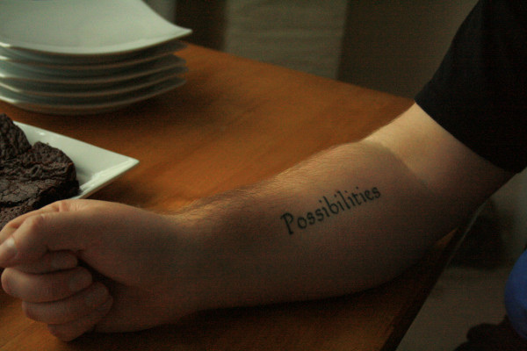
Tattoo - possibilities

Slide 3
Tattoo - possibilities
Read what the photographer says. Which words does she say?
I took this picture in March / May this year at my friend’s house in Bradford.
There were several of us there, I don’t know, maybe twelve or thirteen / fifteen people.
We all had pizza / pasta for lunch and then these great home-made brownies for dessert.
Adam is an interesting guy. He's worked as a DJ and a trainer / waiter.
Now he works for a housing / homelessness charity.
It says a lot about Adam and Lou. A lot about what kind of / what kind people they are.
He believes there are often / always possibilities.
We see a person who wants to / will never change, but Adam sees something else.
He believes this so strongly he has it written / painted on his skin.
Now listen and check your answers.

Slide 4
Tattoo - possibilities
Transcript
Stephanie
Well, I took this picture in May – in May? - yeah, this year at my friend's house in Bradford, in the North of England. There were several of us there, I don't know, maybe twelve or fifteen people, mostly old university friends of my husband's with their husbands, wives, partners, their children and other people, I dunno, friends, people. You know.
So we all had pasta for lunch, and then we had these great home-made brownies for dessert. Um, and you can actually see some of the brownies in the photo, look, on the plate behind Adam's arm.
Adam is an interesting guy. He's worked as a DJ, ah, and a trainer or monitor on a youth programme, um, a programme for young people – that's where I met him, in fact - and now he works for a ah, homelessness charity, um, a charity which finds emergency um you know, a bed and food for a few days, for, um, for people who would ….who would be on the streets, if nobody helped. And normally, with this charity, they stay in people's houses.

Slide 5
Tattoo - possibilities
Transcript
Stephanie: So if you, if you go to visit them, Adam and his wife Lou, they might have a stranger, someone they've never met before, actually staying in their house, sleeping there, like, as if it was a free hotel or something.
With a programme or a system like that, in general it's easier to think of the disadvantages rather than the advantages, maybe, the bad more than the good, but, well, I think it says a lot about Adam and Lou. A lot about what kind of people they are.
Interviewer: Yeah, yeah. I can see that, yeah. And what about the tattoo?
Stephanie: Ah yeah, the tattoo, yeah, sorry. Well, he has it because it expresses something Adam really believes in, I mean really, really believes in, both personally and spiritually as a religious person. He believes that there are always possibilities. Sometimes we look at another person, a homeless person or a person who has been in prison or, you know, and the only thing we can see is a situation with no way out, no solution. We see a person who will never change. But Adam, well, Adam can see something else, something different. He'll see hope and possibilities - always. And he believes this so strongly he has it written on his skin.

Slide 6
Tattoo - possibilities
TeachingEnglish lessons
Thanks for attending the lesson

