Slide 1
Summer love
TeachingEnglish lesson
April 2020

Slide 2
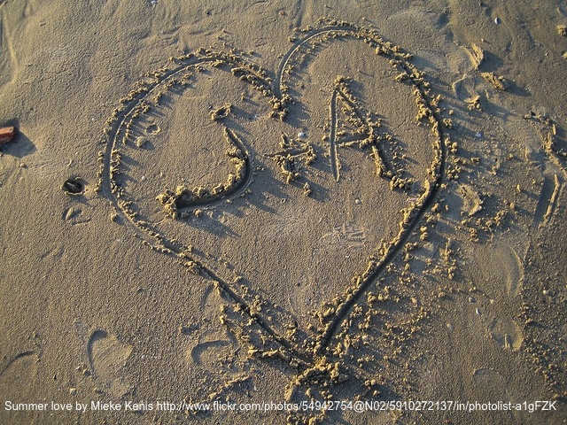
Summer love

Slide 3
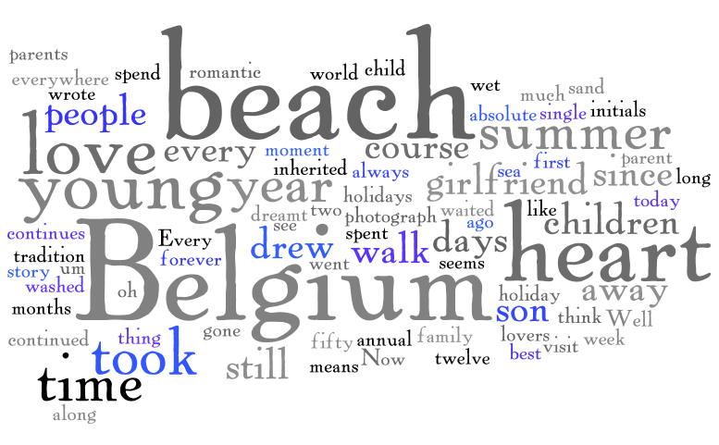
Summer love
Task 1: The words below are used to talk about the photograph of the hearts in the sand. Look at the words and try to answer questions 1-3.
Where do you think the photographer took the photo?
Why do you think the photographer took it?
What do you think has happened since?

Slide 4
Summer love
Listen to the recording and answer the questions.
Where did the photographer go for her summer holiday when she was a child?
Where does the photographer go now for her summer holiday?
Who does she take with her on holiday?
Who drew the heart in the sand?
What has happened since the photographer took the photo?

Slide 5
Summer love
Transcript: Summer love
Photographer: I am from Belgium, and when I was a child, our holiday at the beach in Belgium was the absolute best moment of the year, the thing we waited for and dreamt about for twelve months.
My parents first took us to the beach in Belgium in summer in 1958. I was very young, and since that time, and oh, it seems a long time ago, since that time, I have spent a few days at the beach in Belgium every year, every single year, so that it means more than fifty holidays!
Now I am the parent, I have my own children, and my children inherited that love for the beach, so this annual visit has continued as a tradition in my own family too, we still spend a few days or or a week or two at the beach here in Belgium in summer. Every summer.
And this photograph is of the beach, of course, in Belgium. I took it in 2010, I think. And the story? Well, my son went for a walk along the beach with his girlfriend, a romantic walk as young people do, young people in love, and like all young lovers all, um, everywhere in the world, they drew a heart. This heart. And in this heart they drew – or they wrote - their initials in the wet sand, as you can see - A and J.
But, as always, of course, the sea washed away the heart. It took it away, the heart was gone forever. But they – my son and his girlfriend – their love continues. They are still very much in love today.
Interviewer: Ah, what a romantic story!

Slide 6
Summer love
Choose a photo and imagine that you took it.
Write a story about the photo. Include information about:
Where / when the photo was taken
Why you took the photo
What has happened since you took the photo

Slide 7
Summer love
TeachingEnglish lessons
Thanks for attending the lesson

