Slide 1
A remote house in the west of Scotland
TeachingEnglish lesson
April 2020

Slide 2
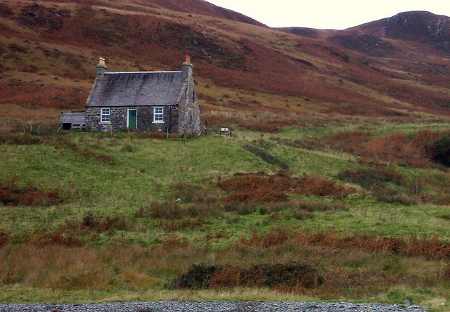
A remote house in the west of Scotland
Look at the photo. Would you like to live in this house? Why? Why not?
Write a list of advantages and disadvantages.

Slide 3
A remote house in the west of Scotland
You are going to listen to the woman who took the photograph of the house.
Why was the woman in the west of Scotland?
When was she there?
Where was she staying?

Slide 4
A remote house in the west of Scotland
The family stayed in a self-catering cottage on the coast – not this house!
What did the family do during their holiday?
Why did the woman take a photo of this house?

Slide 5
A remote house in the west of Scotland
Listen to the recording. What language is used to clarify the following words and expressions?
1. a cottage
a) a great little house
b) a cute little cabin
2. self-catering
a) You can cook and eat when you want and what you want.
b) You can provide all your own meals yourself.
3. It caught my eye.
a) It captured my interest.
b) It drew my attention.
4. remote
a) off-the-beaten-path
b) isolated, far away from everything
5. It appealed to me.
a) I liked it.
b) I was impressed by it.

Slide 6
A remote house in the west of Scotland
Transcript: A remote house in the west of Scotland
Carol: I took this photo during a family holiday we had on the coast, um, the west coast of Scotland. We were staying just south of a town called Oban, which is about, oh I don't know, about two hours north of Glasgow, Scotland's biggest city. And it was, oh, probably about eight years ago. Eight or nine.
We were staying in a self-catering cottage, a great little house it was, with a fantastic kitchen, and very comfortable.
Interviewer: Self-catering? Yeah?
Carol: Yes. We don't like having to look for restaurants all the time, it's not a good way to spend your holiday time. With self-catering, you can cook and eat when you want and what you want. And anyway, eating in a restaurant with a family of four people is, you know, it's very expensive in the UK.
Interviewer: Yes, that's true. Yeah.

Slide 7
A remote house in the west of Scotland
Carol: Anyway, we were on holiday, and we'd been spending time just, you know, relaxing and walking along the beaches, visiting the local villages and pubs and and, yes, just relaxing, and on this particular day we had rented a boat. There was just me, my husband and our two children, and they were about ten and twelve at the time.
And most of the photos I took that day were of us and the children trying to drive the boat and...and things like that, but I also took photos of the coast, the beaches, which are incredibly beautiful, and this house caught my eye, you know? It drew my attention, because it's so remote, so – well – alone and and, well, that quite appealed to me at the time. I liked it.
Interviewer: It really does look totally alone, doesn't it? Very, eh, isolated or...or far away from everything.
Carol: Yes, but that's what I like about it. It's good to be alone sometimes, isn't it? I mean, I wouldn't want to live there permanently but sometimes, you know, yes. Don't you agree?

Slide 8
A remote house in the west of Scotland
Choose a photo.
Write five words or phrases which you could use to describe the photo in column 1. Write synonyms or definitions in column 2.
Word or phrase | Synonym or definition
1. Ex: twin beds | two single beds in one room
2.
3.
4.
5.

Slide 9
A remote house in the west of Scotland
Imagine that you took your chosen photo.
Write a monologue or an article for a travel magazine / website about the photo. Include the following:
Where the photograph was taken
Why you were there
Why you took the photo
Don’t forget to include your words and synonyms / definitions!

Slide 10
A remote house in the west of Scotland
TeachingEnglish lessons
Thanks for attending the lesson

