Slide 1
One nation under CCTV
TeachingEnglish lesson

Slide 2
One nation under CCTV
Task 1: Listen to the first part of the recording. Answer these questions.
1. When was the photo taken?
2. Where was it taken?
3. Why did the photographer take the photo?
4. What does he like about the photo?

Slide 3
One nation under CCTV
Task 2: Listen to the first part of the recording again. What do you think is in the photograph? Make notes or draw the photo!

Slide 4
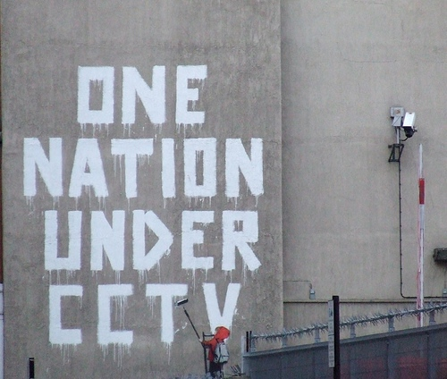
One nation under CCTV
Task 3: Compare the photo with the one you imagined. Use some of the words and phrases in the box.
both, the same as, too / also, like, similar to, more / less…than, bigger / shorter, rather than, but, however, instead, unlike, while, yet, differ
There’s a child in both the photo and my drawing.
I imagined a bigger child.
My drawing differs from the photo, because there isn’t a child.
There’s a child in the photo, yet there isn’t one in my drawing.

Slide 5
One nation under CCTV
Task 4: Discuss these questions.
The photographer says: ‘One nation under CCTV. That phrase is a play on words, it's like part of the United States Pledge of Allegiance.’ What is the ‘Pledge of Allegiance’?
Complete this phrase from the United States’ Pledge of Allegiance: One nation under __________. How is this similar to ‘One nation under CCTV?’
The photographer says this graffiti is ‘ironic’. Why?
Two people from the original graffiti are missing from this photo. Who are they?

Slide 6
One nation under CCTV
Transcript
Diarmuid: OK. The photo is of some graffiti by a British graffiti artist called Banksy, and you can find more graffiti by Banksy on his website, which is www.banksy.co.uk. Um, Banksy is unusual as a graffiti artist because he's made a lot of money from his graffiti.
I took this photograph two or three years ago in London. The children had a holiday from school, so my wife and I took them to London and, um, yeah, we were in London and we were walking along the street when I saw this picture, this graffiti on a wall. It's quite famous, so, um, and, um, I had seen it before, in books or, um, magazines, so I think I took the photograph as a souvenir of our holiday in London. You know, like a lot of people take photographs of, oh, for example, the Mona Lisa, when they go to, to an art gallery, um, to the Louvre art gallery in France, in, er, Paris.
I like this photograph because, um, I liked the, you know, the graffiti. I think it's quite good, you know, quite clever; well, Banky's graffiti usually are quite clever.
We can see a child, a graffitied child, and the child is painting some graffiti, and the child's graffiti says ‘One nation under CCTV’. CCTV, you know, it means these security cameras in the street everywhere. And, um, that's, um, ‘One nation under CCTV’, that phrase is a play on words, it's like part of the United States Pledge of Allegiance.

Slide 7
One nation under CCTV
Transcript
Interviewer: What’s a Pledge of Allegiance?
Diarmuid: OK, yeah. It's when you promise to be loyal to a country, to the flag and the president, you know, like if you change nationality or become a soldier or something. American children say it in school every morning before their classes.
Interviewer: Ah, yeah, yeah, I remember. OK, thanks.
Diarmuid: Um, yeah, so the American Pledge of Allegiance says, ‘One nation under, under God’, and of course God is like an eye or a camera that can see everything we do. It watches us and it can see if we are good, you know, or when we do ‘bad things’. And, and cameras in the street – CCTV - are very, very similar.
Of course, this graffiti is ironic. Graffiti is a crime, is a ‘bad thing’, but this child is here, painting the graffiti, and, ah, and the child is painting the graffiti right under the CCTV camera that you can see, top right.
What you can't see in the photo, but you can see, um, in the original graffiti, is that Banksy also painted two more people watching the child. They're not in the photo, but they're to the left. They're a policeman and a, and a passer-by, who have stopped to watch the child painting the graffiti.
Eh, so, yes, I took the photo to have a souvenir of our holiday in London. I quite like it. I think it's funny. I think a lot of Banksy's pictures are quite funny, but if you stop and think about them for a moment, then, you know, they give a criticism, or a critical interpretation of many of the things that we just accept as normal in our daily lives.

Slide 8
One nation under CCTV
TeachingEnglish lessons
Thanks for attending the lesson

