Slide 1
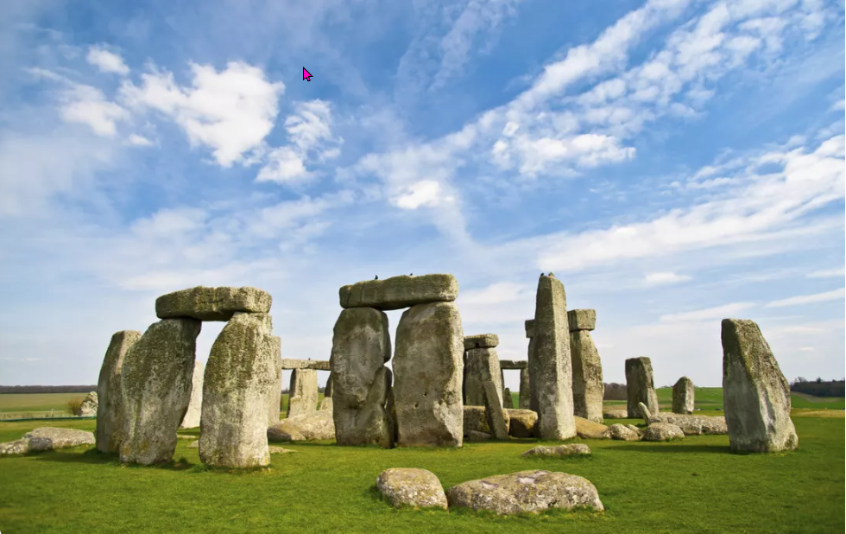
Heritage is great
https://www.teachingenglish.org.uk/

Slide 2
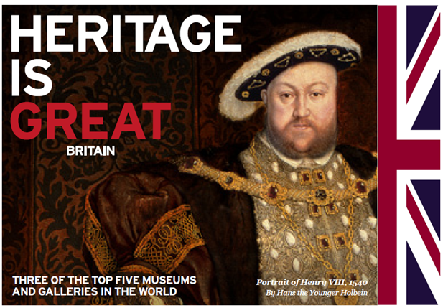
Who’s this?
https://www.teachingenglish.org.uk/

Slide 3
Vocabulary
People | Place names | New words
https://www.teachingenglish.org.uk/

Slide 4
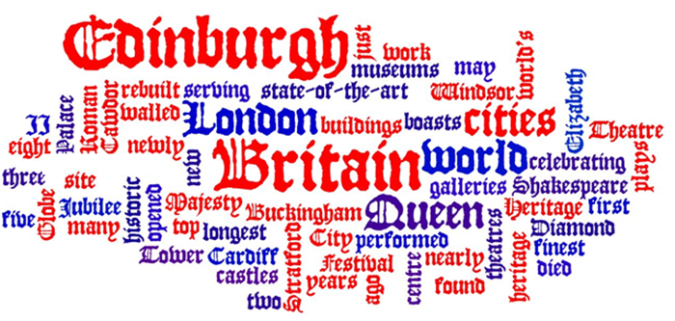
Word cloud
https://www.teachingenglish.org.uk/

