Slide 1
Yoga and relaxation
TeachingEnglish lessons

Slide 2
Yoga and relaxation
What do you know about yoga?
Which country does yoga come from originally?
What do we do when we do yoga?
Have you ever tried yoga?

Slide 3
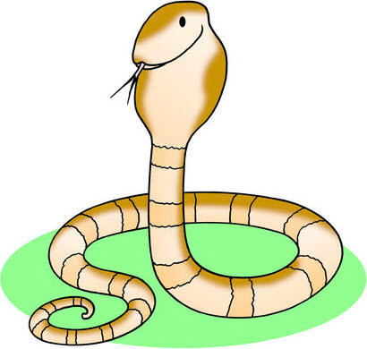
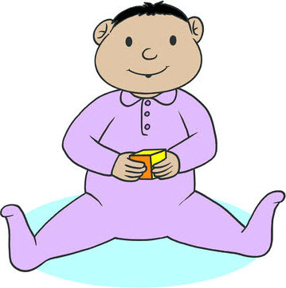
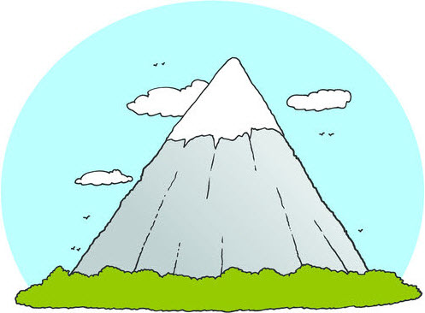
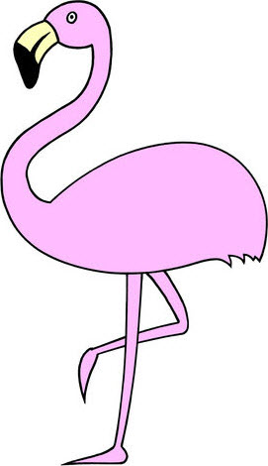
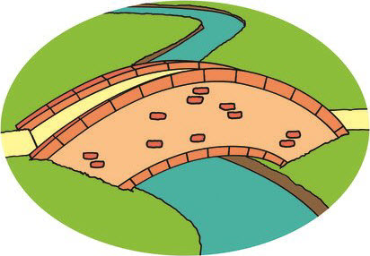
What’s the pose?
1
Lots of yoga poses have the names of animals or things from nature.
Look at the pictures. Can you guess the names of the poses?
Do you know the names of some other poses?
5
2
6
3
7
4
4

Slide 4
Let’s try!
Let’s do the Easy pose together.
Sit on the floor.
Check you can see me
Listen to my instructions and copy me.

Slide 5
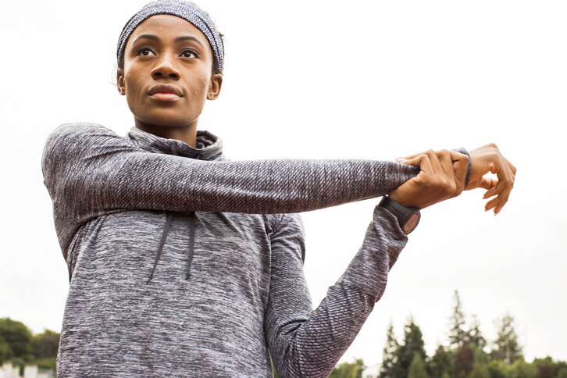
Yoga and relaxation
Now let’s warm up together before we do some more poses.
Stand up.
Check you can see me.
Listen to my instructions and copy me.

Slide 6
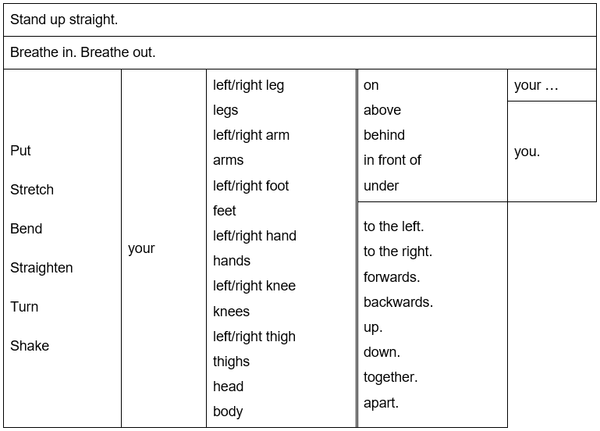
Make a sentence

Slide 7
Yoga and relaxation
Look at the picture that your teacher gave you.
Write instructions for this pose.
Check your instructions work.
Then tell another classmate or your class how to do it.

Slide 8
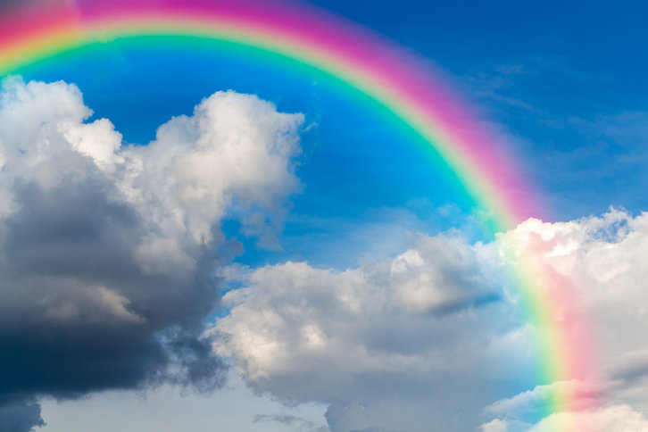
Yoga and relaxation
What can you see in the picture? At the end of a yoga class, people usually do a relaxation.
Sit or lie comfortably.
Close your eyes and relax.
Listen.
Imagine the story.

Slide 9
Yoga and relaxation
Draw a picture of the story you just heard or what you imagined as you listened.
When you’ve finished, describe your picture to another classmate or your class.
Ask them to close their eyes, relax and imagine your picture!
Use a slow, gentle voice.

Slide 10
Yoga and relaxation
TeachingEnglish lessons
Thanks for coming!

