Slide 1
World Bee Day
TeachingEnglish lessons

Slide 2
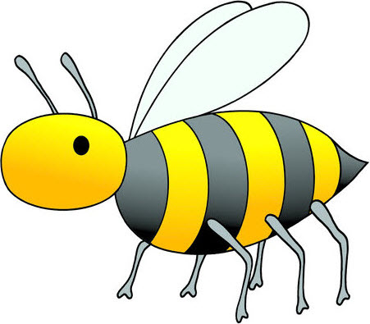
What is it?
How many words can you think of that are connected with bees?

Slide 3
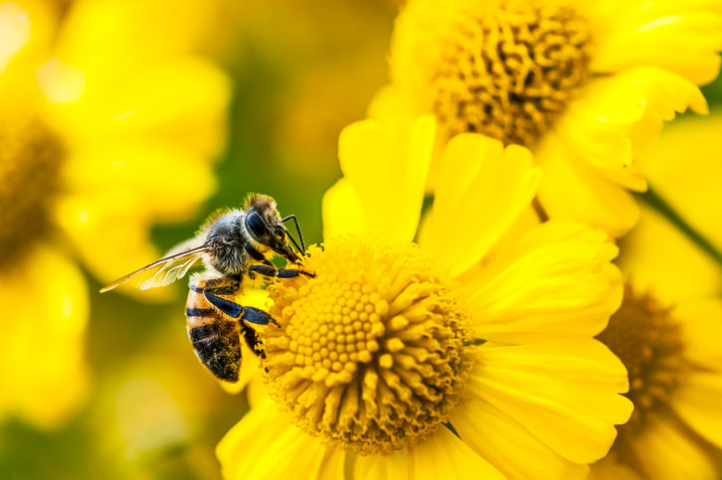
Bee words
Do you know these words?
pollen – a usually yellow powder you find on flowers
to pollinate – to take pollen from one flower to another flower, so that the new flower makes a fruit
a pollinator – something like an insect that carries pollen from one flower to another flower

Slide 4
Bee video

Slide 5
Bee video
a) We know there are ______ types of bees. | 2,000 / 20,000 / 22,000
b) Bees live on every continent except _________ | Africa / Asia / Antarctica
c) Bees___________________ called a ‘waggle’ to give directions and communicate. | sing a song / do a dance / play a game
d) You need to wear a bee suit to open _________ | a flower / a hive / your honey
e) Bees are important because they ________ most of the world’s plants. | pollinate / grow / eat
f) Bees travel from flower to flower, collecting pollen and nectar to make ____________ . | jam / juice / honey
g) They spread the pollen around, which fertilises the flowers so that they can make ___________ . | fruit / insects / honey
h) Most people think that bees are the most _________ pollinators in the world. | beautiful / intelligent / important

Slide 6
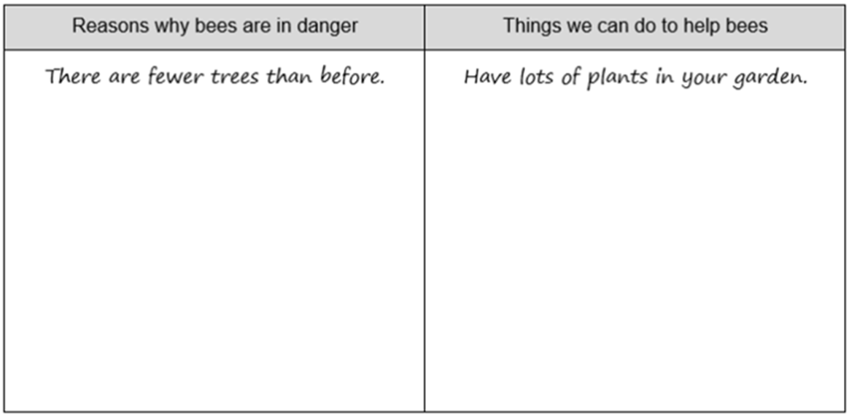
How to help bees

Slide 7
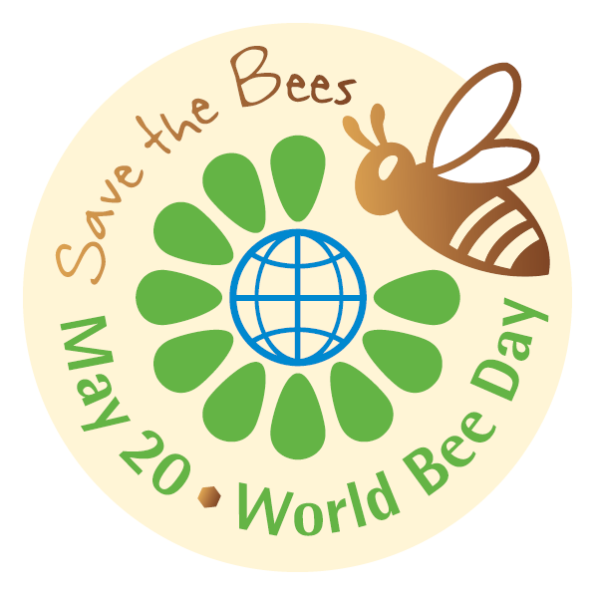
World Bee Day logo
What can you see on the logo for World Bee Day?
3
1
2
4

Slide 8
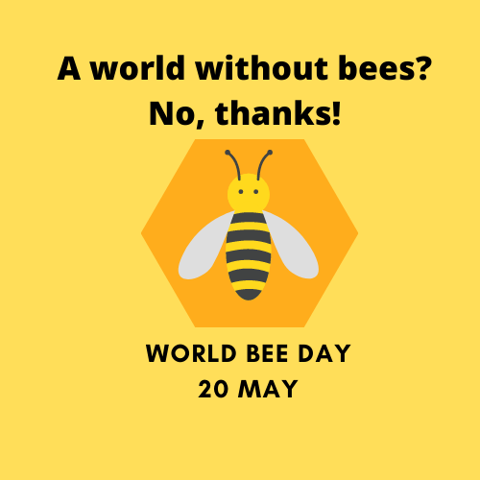
World Bee Day logo V2
Why do you think this person …
used this slogan?
put the name and date of the day?
chose a picture of a bee?
used yellow and black?
chose a hexagon shape?
Do you like the logo?

Slide 9
Design a World Bee Day logo
Think about the:
slogan
name and date of the day
pictures
colours
shapes.

Slide 10
Your logo
Show your logo to your classmates.
Tell them about it!
We used this slogan because _______.
We chose this picture because _______.
We used these colours because _______.
We chose this shape because _______.

Slide 11
World Bee Day
TeachingEnglish lessons
Thanks for coming!

