Slide 1
What’s the weather like?
TeachingEnglish lessons
May 2020

Slide 2
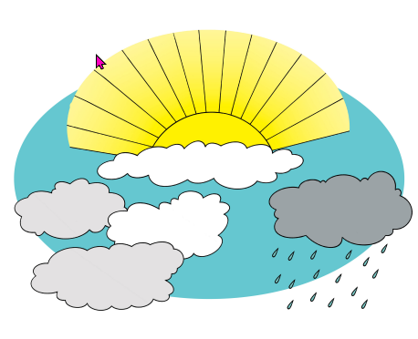
Weather rhyme
Whether the weather is warm,
whether the weather is ………,
we have to put up with the weather,
whether we like it or not.
https://learnenglishkids.britishcouncil.org/fun-games/tongue-twisters/whether-weather

Slide 3
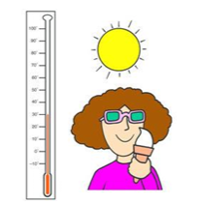
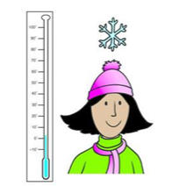
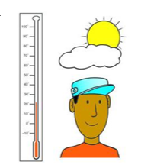
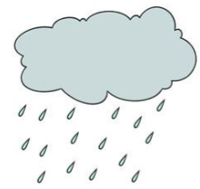
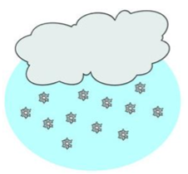
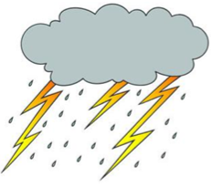
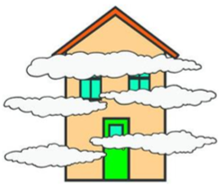
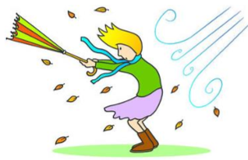
1. hot | 2. cold | 3. Warm | 4. rainy | 5. cloudy
6. windy | 7. snowy | 8. stormy | 9. foggy | 10. sunny

Slide 4
1. | 2. | 3. | 4. | 5.
6. | 7. | 8. | 9. | 10.

Slide 5
Weather game

Slide 6
What’s the weather like?

Slide 7
What’s the weather like?

Slide 8
What’s the weather like?

Slide 9
What’s the weather like?

Slide 10
What’s the weather like?

Slide 11
What’s the weather like?

Slide 12
What’s the weather like?

Slide 13
What’s the weather like?

Slide 14
What’s the weather like?

Slide 15
What’s the weather like?

Slide 16
What’s the weather like?

Slide 17
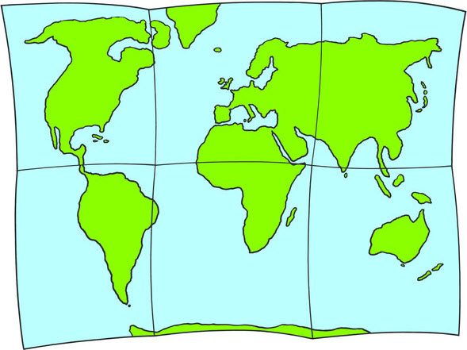
What’s the weather like?
Find out!
Listen for your country. Find out:
the capital city
what the weather’s like there

Slide 18
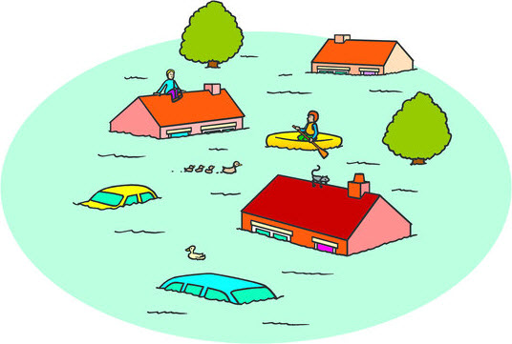
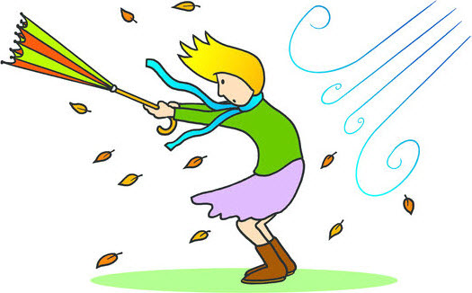
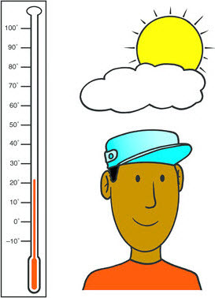
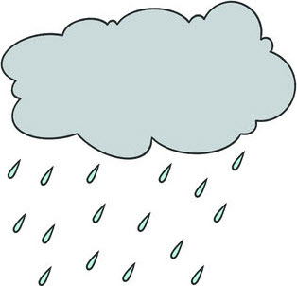
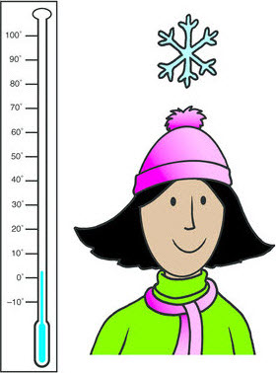
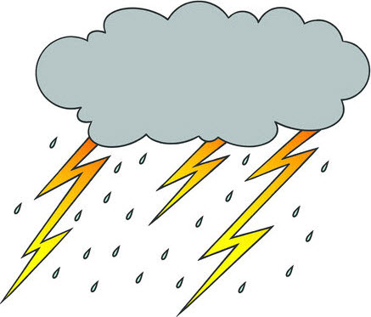
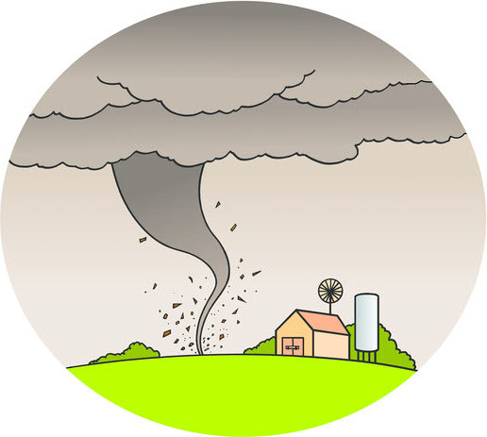
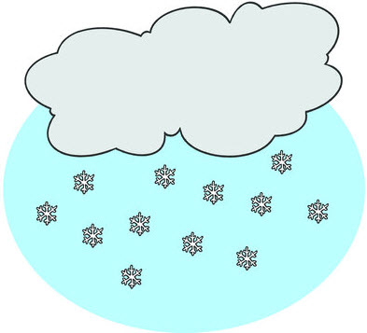
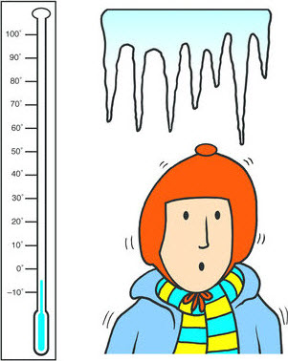
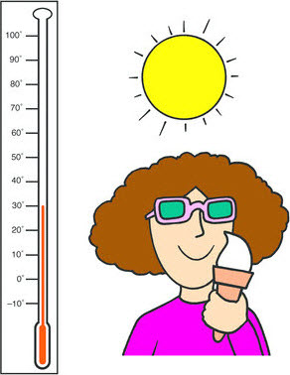
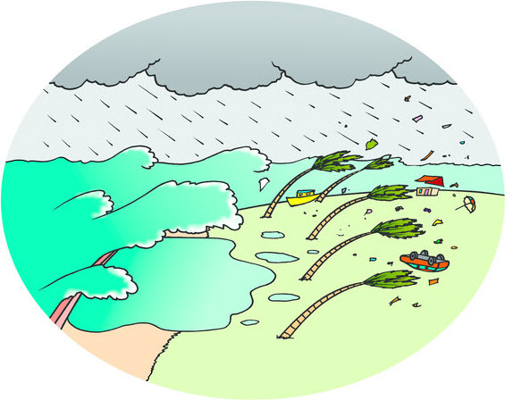
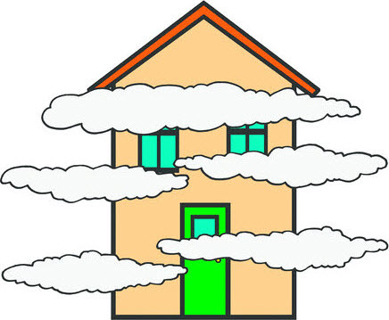
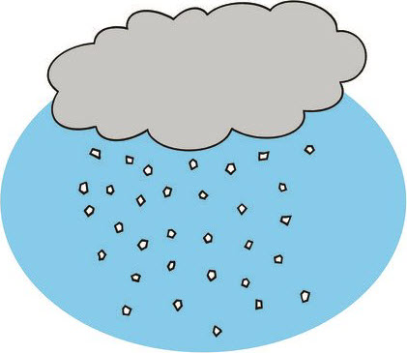
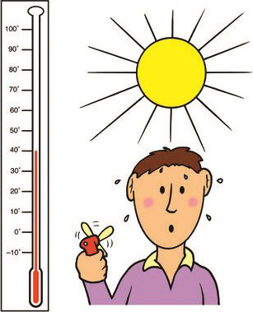
What’s the weather like?
What’s missing?

Slide 19
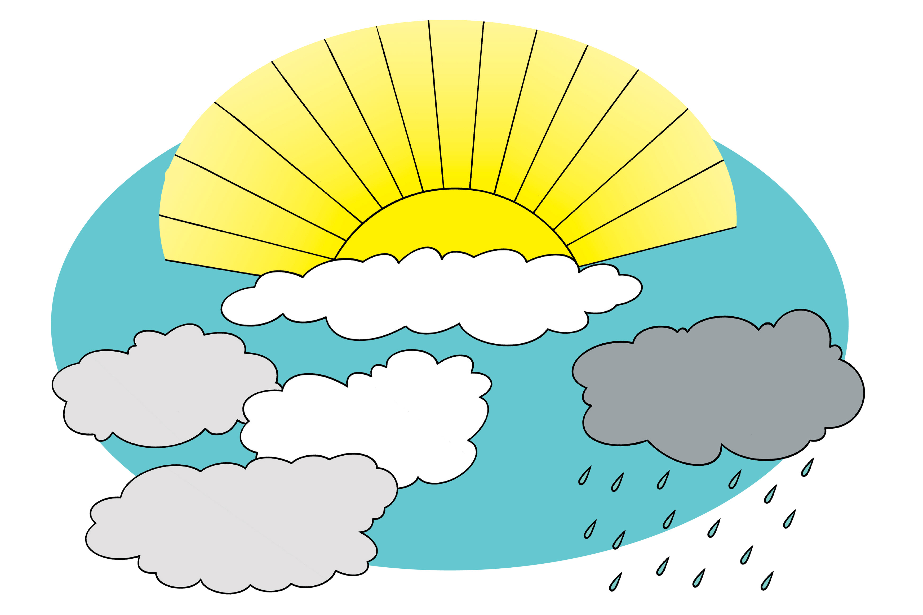
What’s the weather like?
Homework
Write a description of what you’d like to see out your window!

Slide 20
What’s the weather like?
TeachingEnglish lessons
Thanks for coming!

