Slide 1
What’s the weather like?
TeachingEnglish lessons
May 2020

Slide 2
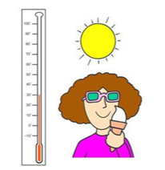
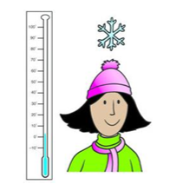
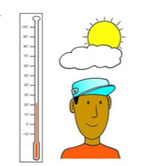
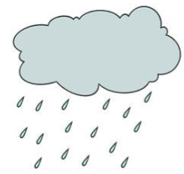
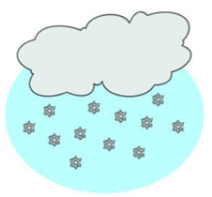
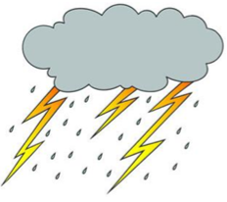
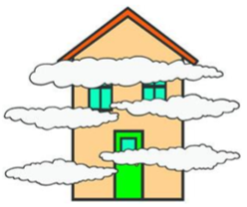
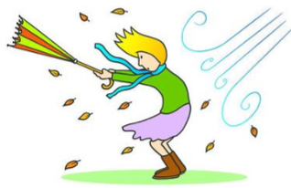
1. hot | 2. cold | 3. Warm | 4. rainy | 5. cloudy
6. windy | 7. snowy | 8. stormy | 9. foggy | 10. sunny

Slide 3
1. | 2. | 3. | 4. | 5.
6. | 7. | 8. | 9. | 10.

Slide 4
