Slide 1
What is enough?
TeachingEnglish lessons
January 2021

Slide 2
Do you agree or disagree?
I think English is fun
I think chocolate is horrible
Make a sentence and tell your teacher:
I think ______ is/are ______.
Does your teacher agree or disagree? Do the action!

Slide 3
Ways to agree or disagree
Agreeing:
Yes, you’re right.
I agree.
I think so too.
Disagreeing:
I don’t think so.
I’m not so sure.
Hmm, I think I disagree.

Slide 4
Gandhi’s message
Mahatma Gandhi said:
Earth provides enough to satisfy every man’s need but not every man’s greed.
What does ‘satisfy’ mean?
What does ‘greed’ mean?
What do you think Gandhi’s message was?

Slide 5
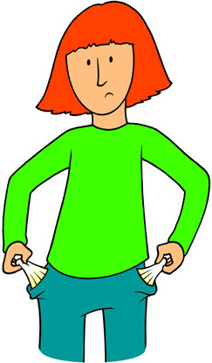
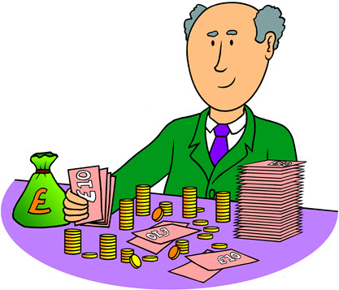
Poor and rich
What does ‘poor’ mean?
What does ‘rich’ mean?
What does ‘to have enough’ mean?

Slide 6
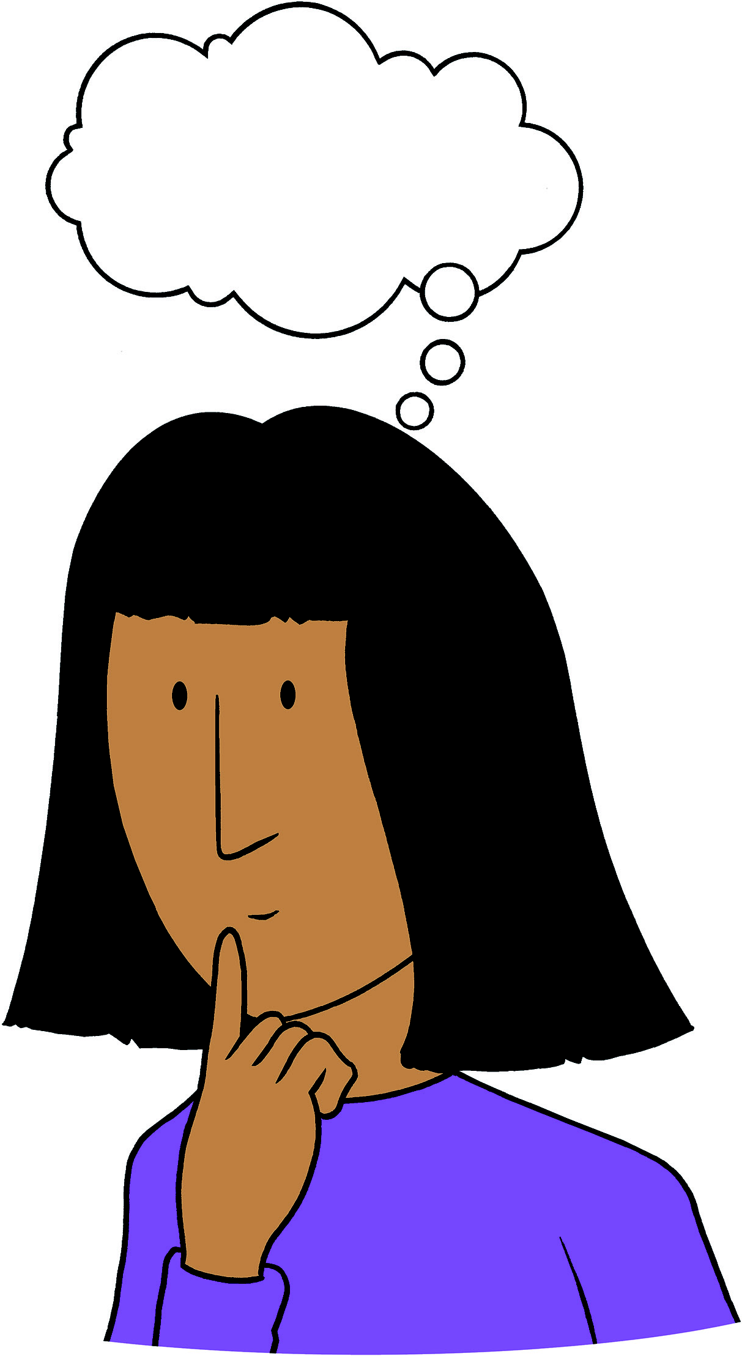
What do we need?
What don’t poor people have?
What do you have if you ‘have enough’?
What does everybody need that you can’t buy?

Slide 7
Poster preparation
what we think it’s fair that everybody has
basic things that everybody needs
what we think is extra

Slide 8
What is enough?
Look at your lists. Talk with your group and agree together.
Underline the basic things that everybody needs.
Circle what you think it’s fair that everybody has.
Star what you think is extra.
Can you remember the phrases for agreeing and disagreeing?
I think it’s fair that everybody has a computer.
I think a car is extra.
I think food and water are basic things that everybody needs.

Slide 9
What is enough?
TeachingEnglish lessons
Thanks for coming!

