Slide 1
https://www.teachingenglish.org.uk/

Slide 2
Listening
Listen to the words.
They all have the same meaning.
What do you think is the English word?
https://www.teachingenglish.org.uk/

Slide 3
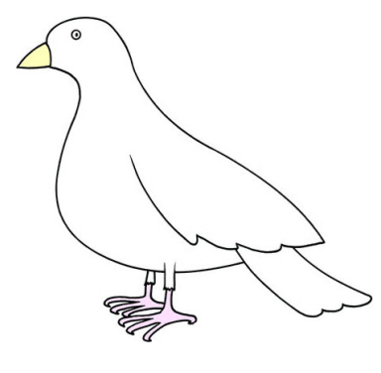
Working together
What rules help us work together peacefully in the classroom?
https://www.teachingenglish.org.uk/

Slide 4
Discussion
https://www.teachingenglish.org.uk/

Slide 5
Are you a peacemaker?
Your classmate uses your favourite eraser without asking!
Now it’s dirty and you are very unhappy about it.
What is a positive way to react?
What is a not-so-positive way to react?
How can you both solve this peacefully?
https://www.teachingenglish.org.uk/

Slide 6
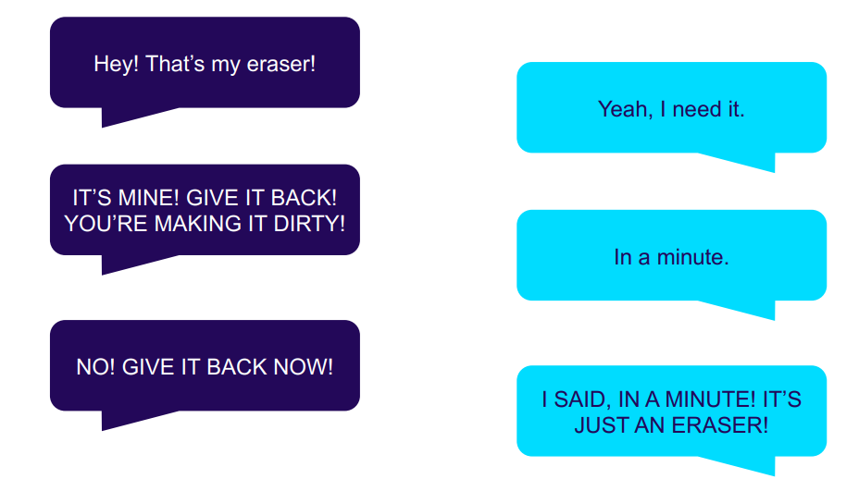
A bad situation
https://www.teachingenglish.org.uk/

Slide 7
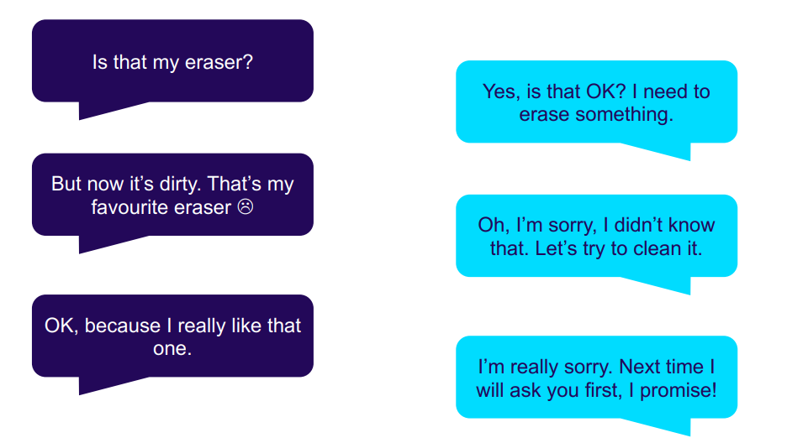
Being peaceful
https://www.teachingenglish.org.uk/

Slide 8
Making bad situations good
You are playing a game in class and you think your classmate is cheating.
Your brother or sister doesn’t let you change the channel to watch your favourite TV programme.
You told your best friend a secret and they told someone else.
https://www.teachingenglish.org.uk/

Slide 9
https://www.teachingenglish.org.uk/

