Slide 1
Well-being
TeachingEnglish lessons
August 2020

Slide 2
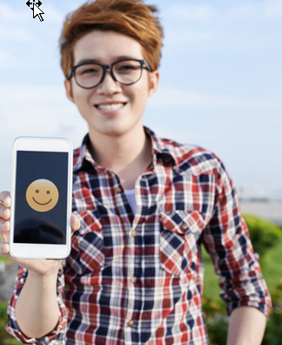
Emojis
What’s your favourite emoji?
Draw a picture of it and when your teacher tells you, show the class.
How many people have drawn the same emojis? What are they?
https://www.teachingenglish.org.uk/

Slide 3
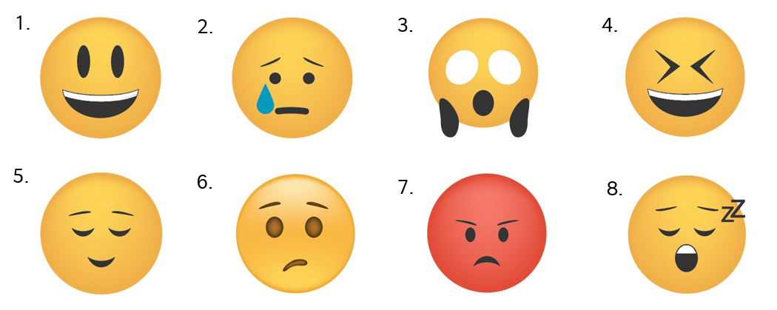
Describing emojis
What words can you think of to describe these emojis?
https://www.teachingenglish.org.uk/

Slide 4
How do you feel?
1. At the weekend I have to stay at home to help my family.
5. I can’t see my grandparents or my cousins.
2. My parents are too busy to help me with my homework
6. I can draw or play games after school.
3. I can watch T.V. or go online after school
7. My family has a lot of problems.
8. I can go to a party at the weekend.
4. I can chat to my friends after school.
https://www.teachingenglish.org.uk/

Slide 5
Happy box
It’s normal to feel scared, confused, angry or sad sometimes.
If these feelings don’t go away, it’s important to talk to an adult, like a parent or teacher.
A ‘happy box’ can help you feel calm when you feel these emotions.
What’s inside a ‘happy box’?
https://www.teachingenglish.org.uk/

Slide 6
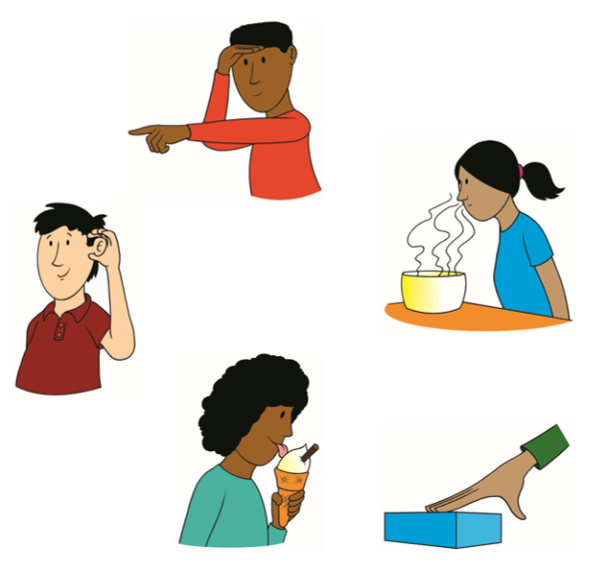
The five senses
The ‘happy box’ has something for each of the five senses:
sight
smell
hearing
taste
touch.
Now decide what you would put in your ‘happy box’. Include things for the five senses that help make you feel calm.
2
3
1
5
4
https://www.teachingenglish.org.uk/

Slide 7
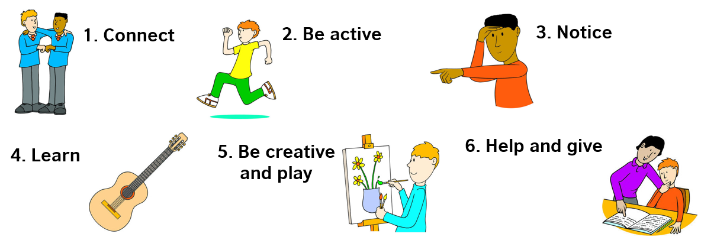
Well-being
Being happy and healthy is sometimes called ‘well-being’. Here are some ways to look after your well-being.
https://www.teachingenglish.org.uk/

Slide 8
Text
Match the activity to one or more ways to well-being.
Example: Play a board game with your family. 1, 5
Do a five-minute exercise video.
Open the window and listen. Write down everything you can hear.
Talk to your grandparents on the phone.
Do the washing-up after a family meal.
Plant some seeds.
Try a new recipe and cook some food for your family.
Make a quiz to do with your friends online.
Go for a walk.
Talk to your parents if you’re worried about something.
Practise your English on a website like LearnEnglish Kids.
https://www.teachingenglish.org.uk/

Slide 9
My journal
Write and draw some of the things you did today and how you felt.
Who did you talk to, write to or message? I phoned my mother | What did you do to be active? I walked to school
What did you notice around you? Flowers in a garden | What did you learn? I read about dolphins
What did you make or play? I made my lunch. | What did you do to help? I helped my friend by carrying some books
What was the best thing about today? Talking with my friend | How did you feel today? Draw some emojis!
https://www.teachingenglish.org.uk/

