Slide 1
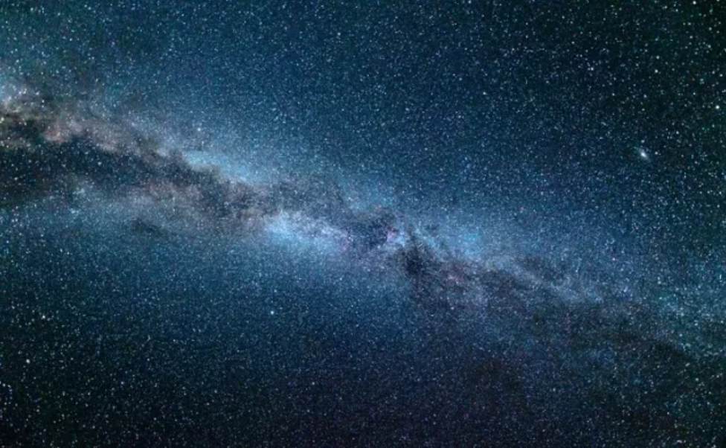
Star stories
https://www.teachingenglish.org.uk/

Slide 2
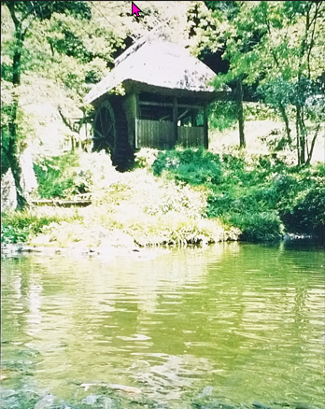
A simple life
What do you know about the lifestyle of indigenous people?
https://www.teachingenglish.org.uk/

Slide 3
A simple life - ideas
They grow their own food, fish and hunt
They build their own houses and make their own clothes, They don’t use cars
They are knowledgeable about the land they live on
They understand the seasons and what they have available
https://www.teachingenglish.org.uk/

Slide 4
Looking at the stars
What do you see when you look at the stars?
https://www.teachingenglish.org.uk/

Slide 5
Useful vocabulary
Australia
South America
the Milky Way
a star constellation
a dark constellation
the Aborigines
the Incas
an emu
a snake
https://www.teachingenglish.org.uk/

Slide 6
Matching
Australia South America the Milky Way a star constellation a dark constellation the Aborigines the Incas an emu a snake | 1) our galaxy in the universe 2) a country in the Southern Hemisphere 3) a reptile that hasn’t got legs 4) a pattern in the sky where there are no stars 5) an ancient civilization of South America 6) a big bird that cannot fly 7) a continent which is mostly in the Southern Hemisphere 8) the indigenous people of Australia 9) a pattern of stars in the night sky
https://www.teachingenglish.org.uk/

Slide 7
Matching
Australia (2) South America (7) the Milky Way (1) a star constellation (9) a dark constellation (4) the Aborigines (8) the Incas (5) an emu (6) a snake (3) | 1) our galaxy in the universe 2) a country in the Southern Hemisphere 3) a reptile that hasn’t got legs 4) a pattern in the sky where there are no stars 5) an ancient civilization of South America 6) a big bird that cannot fly 7) a continent which is mostly in the Southern Hemisphere 8) the indigenous people of Australia 9) a pattern of stars in the night sky
https://www.teachingenglish.org.uk/

Slide 8
Reading – pt 1
A group of stars make a pattern called a constellation. People saw many different objects in the constellations, for example, animals like fish, birds , lions, dogs and bears. The animals move in the sky because the Earth is always turning.
The Milky Way looks white in the night sky because we can see many stars in it. Because it is white, the Aborigines of Australia and the Incas of South America looked at the dark spaces to find the patterns. These patterns are called dark constellations. In Australia, Aborigines show their children the Emu in the Sky. In March, April and May, the emu is lying down with two eggs next to her. She is the mother, and this is the when the eggs are good to eat. People take the eggs, but they leave some for the emus.
https://www.teachingenglish.org.uk/

Slide 9
Reading – pt 2
In June and July, the emu is looking down. The emu is now the father, and the eggs are going to hatch. Now people start to leave the eggs because the babies are growing inside them. Because of the Emu in the Sky, the people know when to take the emu eggs and when to leave them. Children also learn that the father is the one who looks after the babies.
The Incas saw a big snake in the dark part of the Milky Way. In August, the head of the snake appears. In November and December, the whole snake is in the sky. This is also when the snakes come out from the Andes mountains. In February the snake in the sky starts to disappear. The snakes on Earth go back to the mountains at the same time that the big snake in the sky disappears.
https://www.teachingenglish.org.uk/

