Slide 1
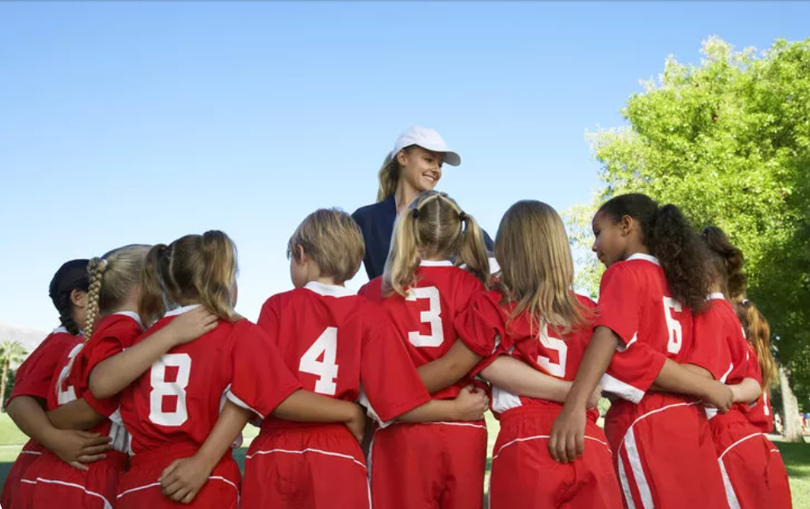
Sport
https://www.teachingenglish.org.uk/

Slide 2
Sports alphabet
Athletics | Hockey | Orienteering | Volleyball
Baseball | Ice hockey | Ping pong | Water polo
Cycling | Judo | Rowing | Yachting
Diving | Long jump | Swimming | Zorb football
Football | Motorsport | Taekwondo‎
Golf | Netball | Unicycling
Missing letters: E; K; Q; X
https://www.teachingenglish.org.uk/

Slide 3
1. | 2. | 3. | 4.
5. | 6. | 7. | 8.
9. | 10. | 11. | 12.
13. | 14. | 15. | 16.
https://www.teachingenglish.org.uk/

Slide 4
https://www.teachingenglish.org.uk/

