Slide 1
Nature photography
TeachingEnglish lesson

Slide 2
Nature photography
Task 1: Check the meaning of the words below. Decide if they relate to how something looks (A), sounds (B), feels (C) or smells (D). Some words may go under more than one heading.
sweet (flower) | calm (breeze) | dull (sky) | earthy (wood/wet grass)
smooth (stone) | bright (morning/cloud) | rough (edges) | gentle (sound/breeze)
fresh (aroma) | fragrant (flower) | humming (traffic) | lively (birdsong)
salty (water/air) | sharp (cactus) | raucous (bird) | crisp (air/morning)
uneven (rock) | monotonous (hum) | misty (sky) | vivid (colours)
shallow (pond) | faint (colour/scent) | dripping (water) | strong (scent)

Slide 3
Nature photography
Task 2: Follow the instructions for your outing.
Take your camera/phone, a pen and a notebook. Go for a short walk.
Look at five natural things (e.g. the sky, clouds, flowers, leaves). You can look up, in and under things too. Describe them briefly in your notebook.
Listen to four sounds around you with your eyes closed. What’s the loudest sound you can hear? The softest sound? Which sounds were created by the elements? Open your eyes and describe the sounds in your notebook.
Touch and describe the texture of three natural things around you (e.g. a rough stone, a soft petal). Your eyes can be open or closed while you feel the objects, but choose safe objects!
Smell and describe two natural things around you.
Take at least six photos of any nature that you experienced. Experiment as much as you like!
Bring the photos and your notebook to class.

Slide 4
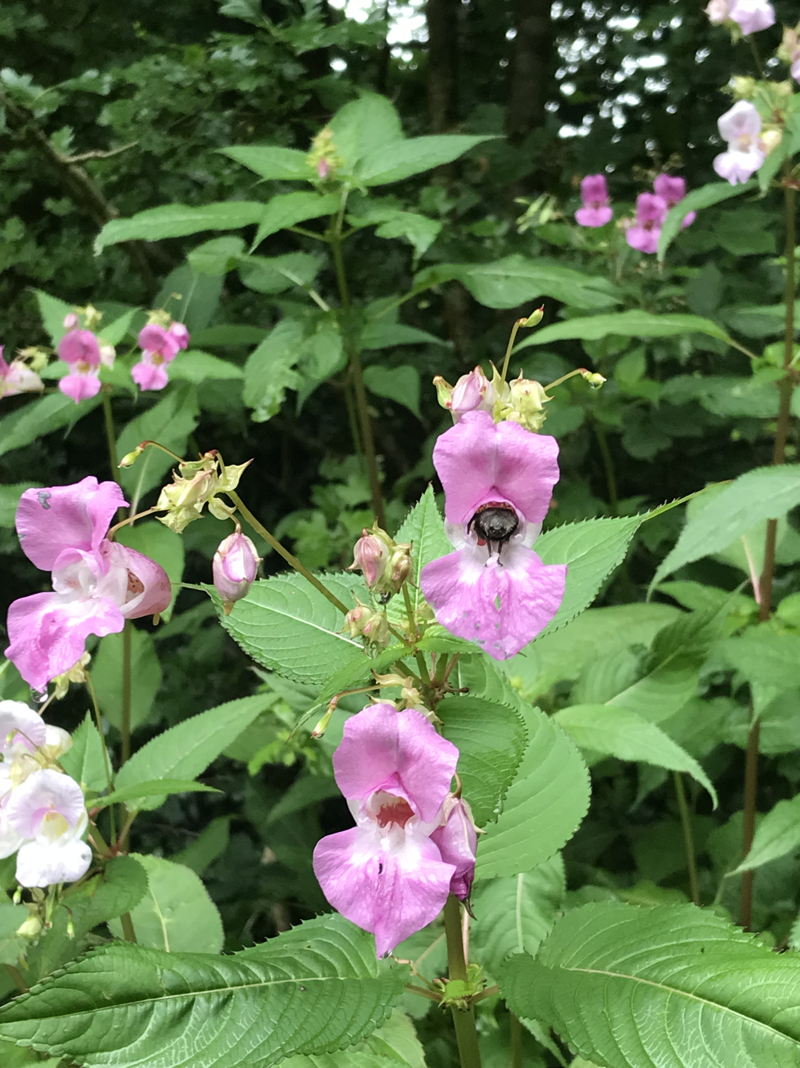
Nature photography
It was at the side of the sports field.
Task 3: Talk about your photos.
Where was it?
It had a strong smell. It was quite sweet – a bit like peaches!
What did it smell like?
The petals were soft. The leaves were rougher.
What did it feel like?
What could you hear?
I could hear a bee buzzing. Can you see it inside the flower?

Slide 5
Nature photography
TeachingEnglish lessons
Thanks for attending the lesson

