Slide 1
Movember
TeachingEnglish lesson

Slide 2
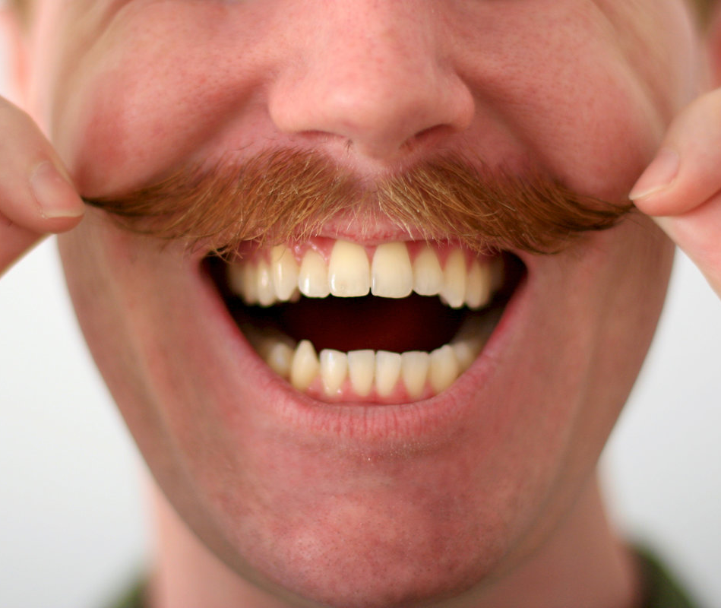
Movember
What sort of charity might this picture relate to?

Slide 3
Movember
Task 1: Match the words and definitions.
1. join in (phrasal verb) | a. give something (e.g. money) to help achieve something
2. sponsor (verb) | b. wear special clothes
3. contribute (verb) | c. an organised action to achieve a goal
4. dress up (phrasal verb) | d. provide money for an activity, or a person doing an activity
5. campaign (noun) | e. products that have an official brand (e.g. a logo)
6. shave (verb) | f. happening once every year
7. annual (adjective) | g. take part in an activity with other people
8. merchandise (noun) | h. cut the hair off your face

Slide 4
Movember
Have a good look around you. Do you notice that more men have moustaches? It may be because it's Movember! Read more about this unusual charity event here.
It’s Movember!
No, it’s not a spelling mistake. Moustache + November = Movember! Every year in November millions of men around the world grow moustaches to raise money for charity and to help people learn about men’s health issues such as certain types of cancer and mental health.

Slide 5
Movember
What happens in Movember?
A man who wants to participate in the Movember event starts with a clean face on November 1st and then he grows a moustache for the next 30 days. A man who doesn’t shave for Movember is called a ‘Mo Bro’ (short for Moustache Brother!). He signs up on the official website, Movember.com, and he asks his family and friends to sponsor him. If you sponsor a Mo Bro you agree to give him money if he keeps his moustache until November 30th. As well as collecting money for cancer and mental health charities, the idea is that the new moustaches will help to start conversations that help people to learn more about men’s health. A typical Movember conversation might go like this:
- You’re growing a moustache, aren’t you?
- Yes, I am. Would you like to know why?
- Yeah. Why?
- I’m a Mo Bro.
- A what?
- A Mo Bro. I’m growing a moustache to raise money for health charities. Have you heard of Movember?

Slide 6
Movember
Is Movember just for men?
What do you call a woman who contributes to the Movember event? A Mo Sista (‘sister’) of course! Mo Sistas can also sign up and join in by raising money and awareness. Mo Sistas can choose to move for mental health by running or walking 60 kilometres during the month, or they can host a Movember event to raise money. These might be gaming tournaments, quiz nights, talent shows, photo contests – with everyone dressing up and prizes for the best (or worst) moustache of course! Mo Bros and Mo Sistas can organise their own challenges, or attend an organised event, such as a sponsored run or bike ride. All they need to do is find one on the website. And anyone can buy charity merchandise, such as T-shirts, tote bags and stickers from the official online Movember store.
Going global
Movember started with 30 men in Melbourne, Australia in 2003. Just ten years later, more than four million men and women from 21 countries had participated in this annual event. By 2022, the number of people who had joined in rose to nearly 7 million, and money had been provided for more than 1,320 men’s health projects worldwide. These projects include supporting mental fitness in young athletes, finding new therapies for cancer and providing training courses for therapists.

Slide 7
Movember
Task 2: Decide if the sentences are true (T) or false (F).
A man who grows a moustache for Movember must keep it until November 30th. T / F
A Mo Bro is a man who shaves off his moustache on November 1st. T / F
During Movember, people raise money for cancer charities only. T / F
Movember is only for men. T / F
It’s also possible to raise money by running or walking. T / F
Men and women organise parties to raise money. T / F
Men first started growing moustaches for Movember in London. T / F
More than 1,320 health projects have received money from Movember. T / F

Slide 8
Movember
Task 3: Discuss the following questions.
Is Movember a good way to raise money for charity? Why or why not?
What similar events have you heard about?
Why is it important to inform people about cancer and mental health?
Have you ever done anything for charity? What did you do?
Have you ever sponsored anyone for charity?
If you had a large amount of money to give to charity, which charity would you give it to?

Slide 9
Movember
TeachingEnglish lessons
Thanks for attending the lesson

