Slide 1
Learning at home
TeachingEnglish lessons
June 2020

Slide 2
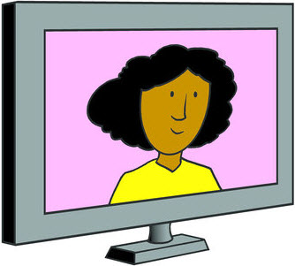
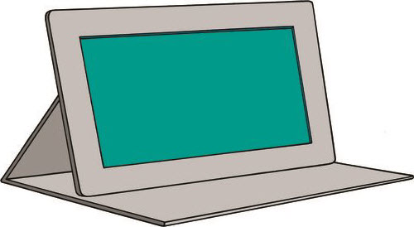
Learning at home
How many words can you think of connected to learning at home?

Slide 3
Learning at home
Who read about Ali?
What do you remember?

Slide 4
Learning at home
Ali, 10
I like learning at home. I have online lessons every day and it’s great to see my friends on the screen. My favourite lesson is English because we talk a lot. I also like PE. We watch the teacher and we copy her, and sometimes we dance or do yoga. That’s really fun! Sometimes the internet connection is not very good or we have problems speaking to each other. We also usually need to do our homework online and my eyes feel really tired at the end of the day.

Slide 5
Learning at home
Who read about Nina?
What do you remember?

Slide 6
Learning at home
Nina, 12
Online lesson are OK. My mum and stepdad need to use our computer and laptop for their work, so I use a tablet and my older sister uses our old laptop. But we don’t have enough space for everybody at home and I have to share a desk with my sister in our bedroom. I can’t concentrate and sometimes my teacher gets cross with me. What I like most about online lessons is break time when my classmates and I can write messages to each other in the chat.

Slide 7
Learning at home
Who read about Petra?
What do you remember?

Slide 8
Learning at home
Petra, 11
Learning from home is different from school. Our teacher makes videos for us to watch and we have to answer some questions about them. The videos are really interesting and we can watch them when we want. We can also write messages to our teacher on a special website if we don’t understand something. I use my dad’s smartphone because we don’t have a laptop and sometimes I can’t see the video very well because the screen’s very small. My sister and brother need to use my dad’s smartphone too and we fight a lot about that!

Slide 9
Learning at home
Who read about David?
What do you remember?

Slide 10
Learning at home
David, 9
Learning from home is difficult for me and I really miss my school and seeing my friends. We don’t have any online lessons. My teacher sends my dad lots and lots of worksheets and activities for me. My dad gives them to me but he doesn’t really explain what I need to do. I can’t always finish all the work. I also talk with my teacher on the phone sometimes. She is very kind and I like talking to her but soon she needs to go and talk to another classmate.

Slide 11
Learning at home
Who read about Alex?
What do you remember?

Slide 12
Learning at home
Alex, 10
Where I live, we have school lessons on TV! It’s really funny to have lessons like that because normally I’m not allowed to watch so much TV! My teacher makes worksheets about the lessons and my mum collects them from the school because we don’t have a printer. She doesn’t always have time to collect them though. I really like watching the lessons because the teachers on TV make the lessons really exciting. My favourite lesson is science because they show cool experiments. But sometimes the worksheets are really difficult and I don’t know how to do them.

Slide 13
Learning at home
Who read about Salma?
What do you remember?

Slide 14
Learning at home
Salma, 9
Where I live, my mum and dad have to be my teachers! I like spending more time with my parents and also my little brother. They are teaching us some English and maths, but they don’t really know what other things to teach us. They also have to do their jobs and they sometimes get phone calls or have to go to online meetings when it’s our lesson time. When that happens I just play with my brother. I also like having more free time to read my books but it’s easy to get bored.

Slide 15
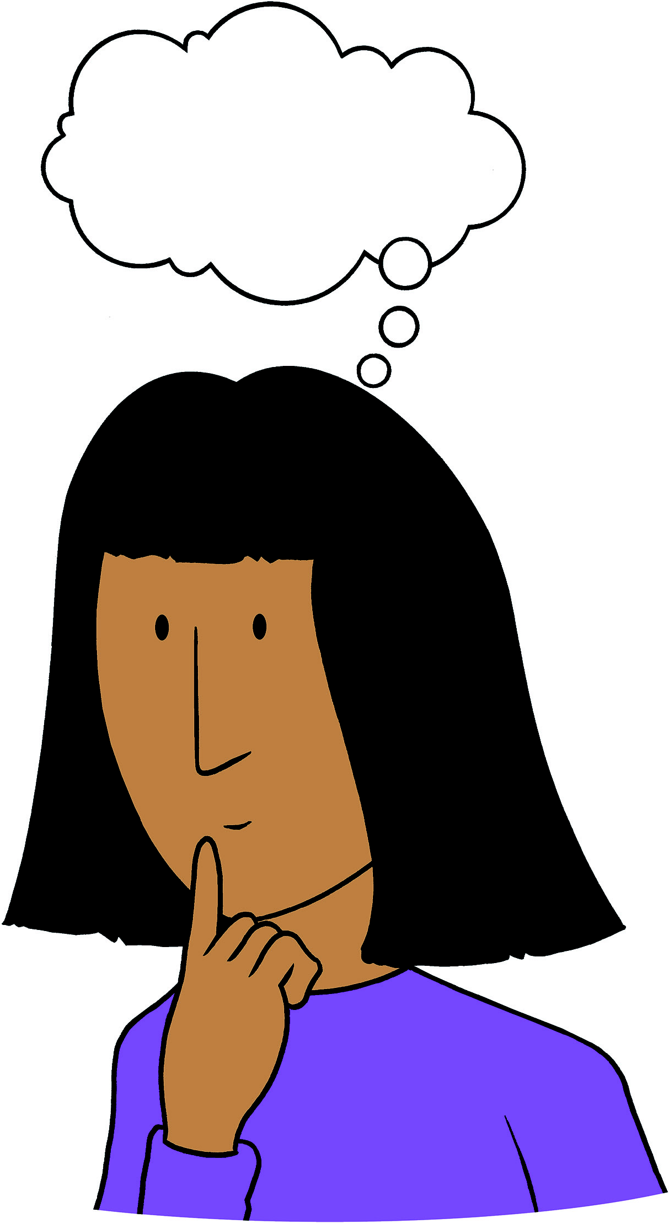
Learning at home
Listen to the teacher!
Do you agree? Is it the same for you?
Do you partly agree? Is it partly the same for you?
Do you disagree? Is it different for you?

Slide 16
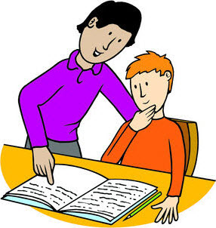
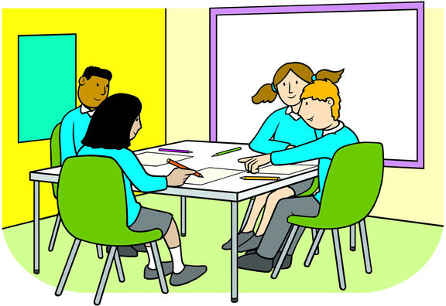
Learning at home
Make a poster!
What are good things about learning at home?
What’s difficult about learning at home?
What are some tips for learning at home?
What’s different about learning at home compared to school?

Slide 17
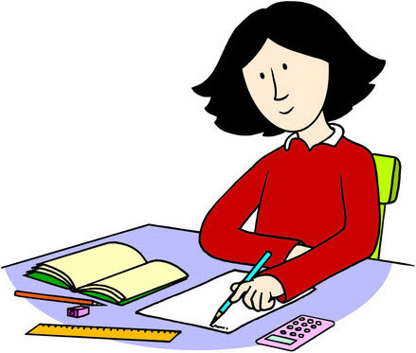
Learning at home
Homework
Write a text about what learning at home is like for you.

Slide 18
Learning at home
TeachingEnglish lessons
Thanks for coming!

