Slide 1
Cities and migration
TeachingEnglish lesson

Slide 2
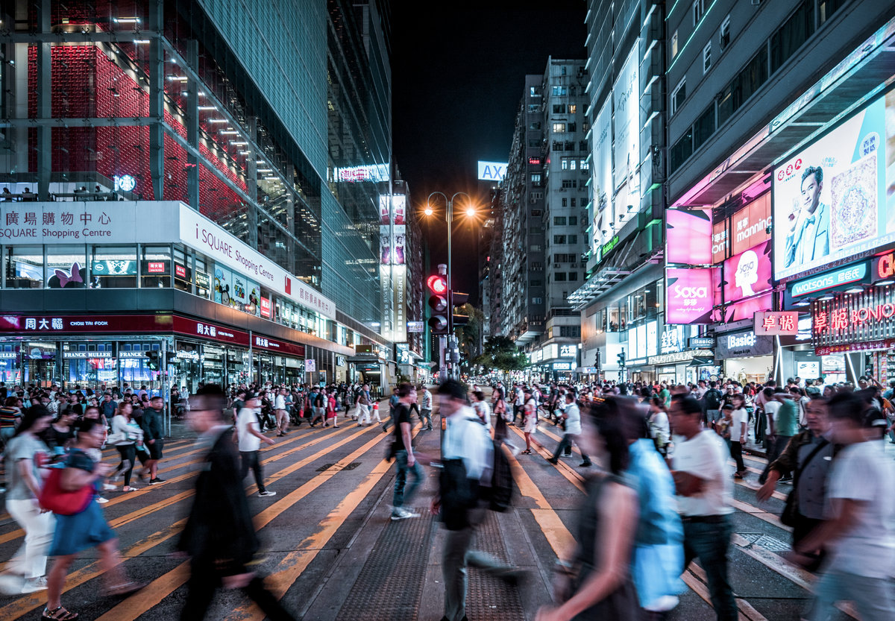
Cities and migration
Lead-in: Would you like to live in this city? Why? Why not?

Slide 3
Cities and migration
Task 1: Read the text. What are ‘magnets’? What is ‘glue’?
Magnets and Glue
Cities have to be competitive in the global economy. Cities which are not competitive decline – they begin to lose population. To be competitive, they have to attract skills and talent from all over the world. The most successful cities attract the best skills and talent, and become even more successful.
Harvard Business Professor Rosabeth Moss Kanter coined two terms to express this idea: magnets and glue. Magnets are the elements of a city which attract people and investment. Glue is what keeps people in the city, what convinces them to stay in that city. Both magnets and glue are fundamental if a city wants to grow and thrive.

Slide 4
Cities and migration
Task 2: Are these examples of ‘magnets’ or ‘glue’? Listen to the interview.
1. educational opportunities
2. availability of jobs
3. access to community activities
4. affordable housing
5. presence of other migrants
6. possibility of setting up own business
7. a variety of job opportunities
8. a city’s reputation
9. cultural and recreational activities

Slide 5
Cities and migration
Task 3: Work in groups. Take turns to give definitions of these words. The first person to say the correct word wins a point.
growing declining feature urban area competitive talent affordable availability growth migrant worker opportunities skills investment global economy magnet glue knowledge reputation accessible events

Slide 6
Cities and migration
Transcript
A radio interview with an American expert on population movement. I = Interviewer E = Expert
I: Here we are with Dr Marylyn, a professor at the local university and an expert in population movement. Dr Marylyn, you talk about ‘magnets’ and ‘glue’ - things that attract migrants to cities, and things that keep them there. Can you explain what you mean by these terms?
E: Yes, of course. Well, basically, we begin with the idea that important international cities have to be competitive in the global economy. Cities which are not competitive decline –they begin to lose population. To be competitive, they have to attract skills and talent from all over the world. The most successful cities attract the best skills and talent, and become even more successful. The magnets are what attract people to these cities.
I: Yes, that makes sense. So what attracts people to these cities? What are the magnets?
E: Well, probably the most important magnet is the availability of jobs. Cities that offer lots of job opportunities, and a wide variety of jobs, attract a lot of migrants.

Slide 7
Cities and migration
Transcript
I: And what other magnets are there?
E: Well, knowledge of a city is important. If a city has an international reputation – London, New York, Paris, Moscow – you’ve seen them on TV, you’ve heard of them, you’ve seen them in newspapers and magazines – they give the impression of being safe, accessible, open cities. This is why cities organise international events like the Olympics, EXPOs, cultural festivals and international trade fairs.
I: And I suppose that a big, migrant population attracts other migrants.
E: That’s right. Having a big migrant population is in itself an attractive feature of a city. Foreign people are happier in a place where there are lots of foreign people. It’s also true that people feel more secure in cities where there are lots of people from their own countries. It gives them access to their home culture – shops, family and friends, cultural events.

Slide 8
Cities and migration
Transcript
E: And what about glue?
I: Well, going back to what we said before – that successful cities need the skills and talents of migrant workers. Well, if the magnets attract them, the glue convinces them to stay – and this is what is really important.
I: So what kind of thing encourages people to stay in a place? What’s the glue?
E: Well, cities that want to retain migrants need to pay attention to the quality of life on offer. People need to have their aspirations fulfilled.
I: Yeah.
E: People need affordable housing in nice areas, educational opportunities for themselves and their children, cultural and recreational activities. They need access to social and community activities, to belong to the community. They need access to the job market in terms of visas and legal permits. They need to be able to set up their own business if they want. These are the glue factors. Other factors like... (fade out)

Slide 9
Cities and migration
TeachingEnglish lessons
Thanks for attending the lesson

