Slide 1
The main events of the First World War
based on material from the Imperial War Museum, London

Slide 2
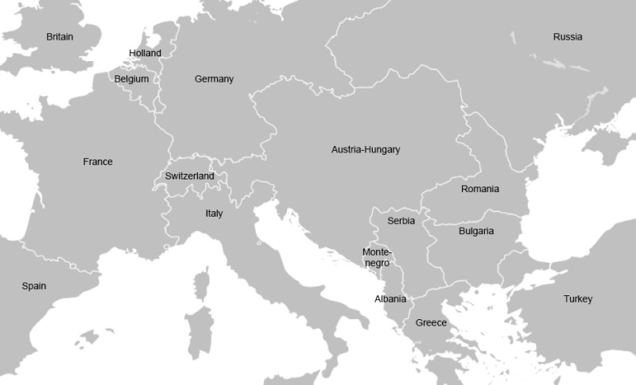
Warmer – alliances in the First World War
Look at the map from the times of the First World War in Europe. Which countries sided with Britain, and which sided with Germany?
Answers
Britain’s allies included
Serbia
Russia
France
Belgium
(also Japan and the USA)
Germany’s allies included
Austria-Hungary
Turkey

Slide 3
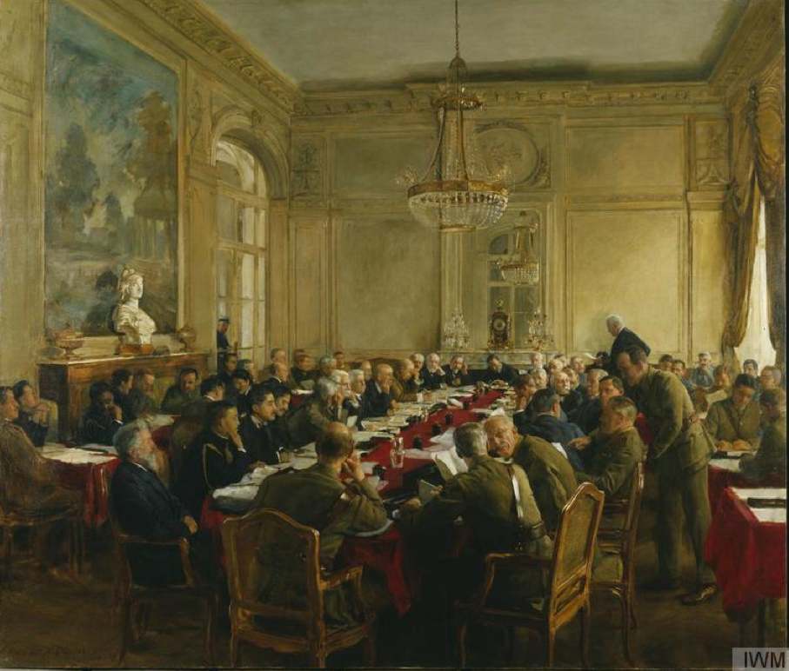
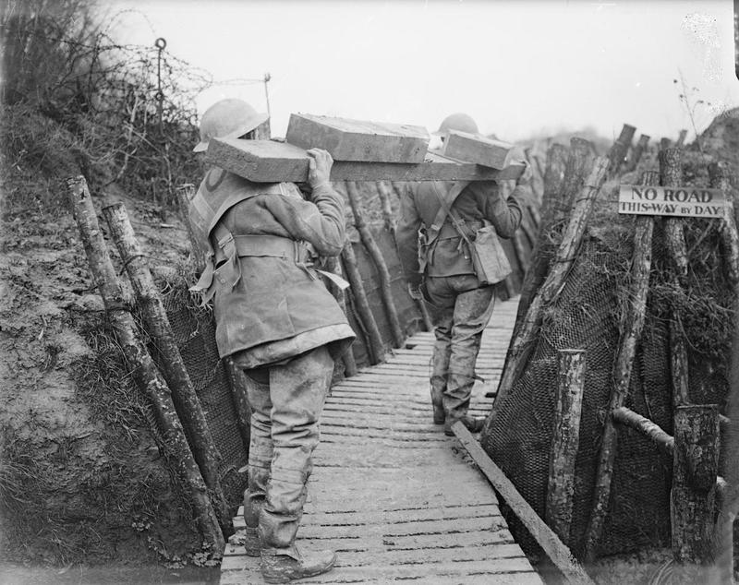
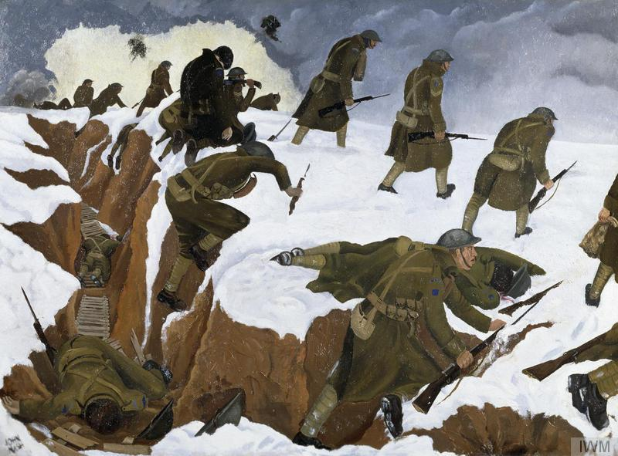
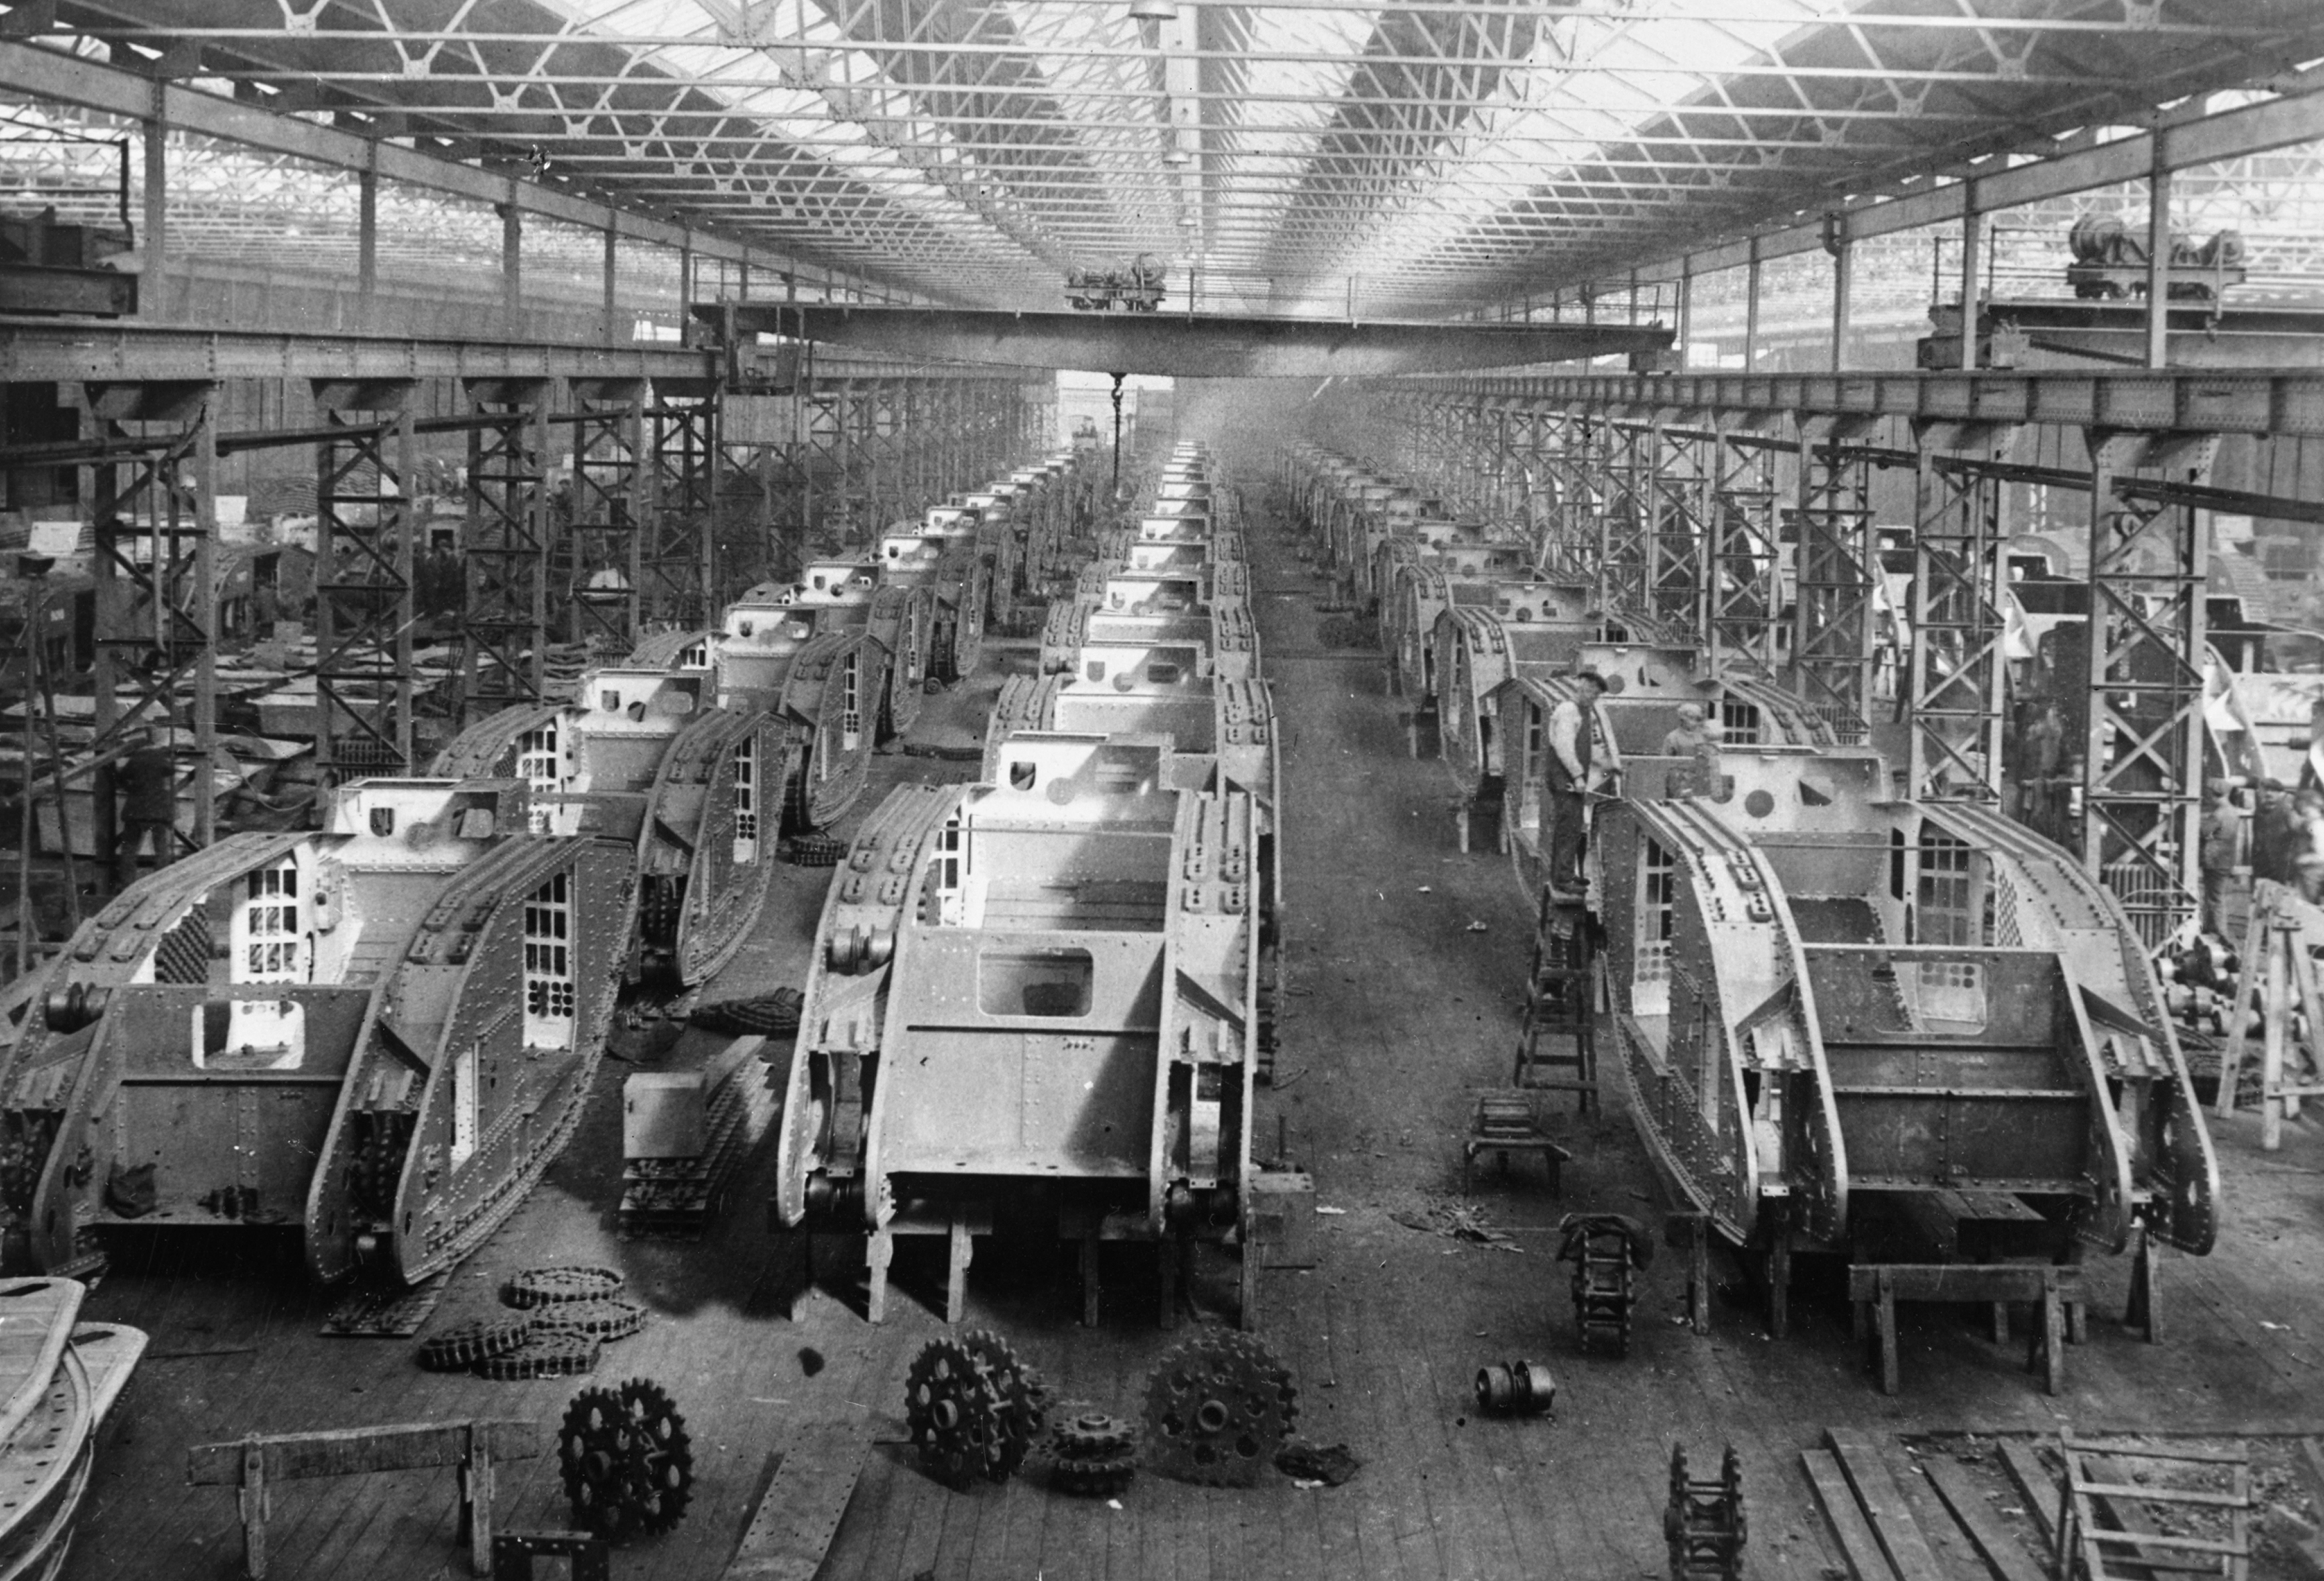
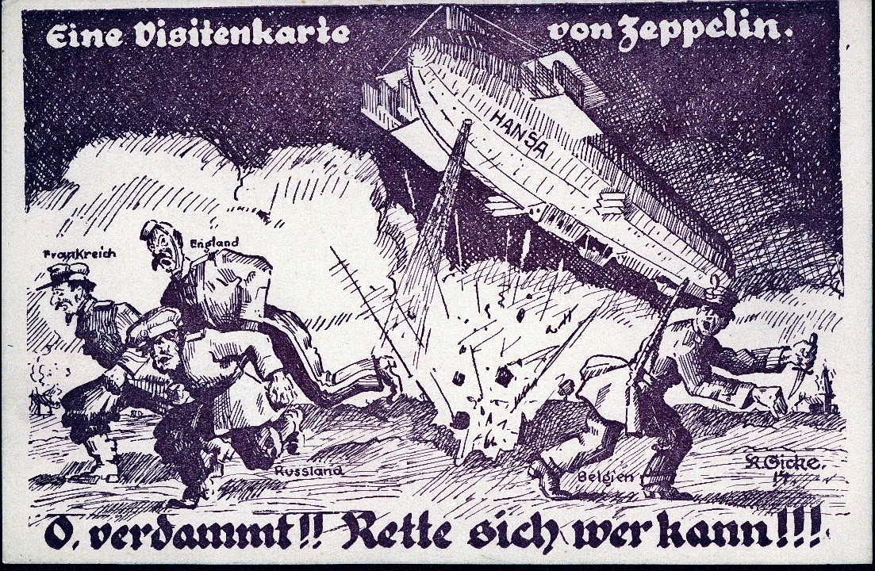
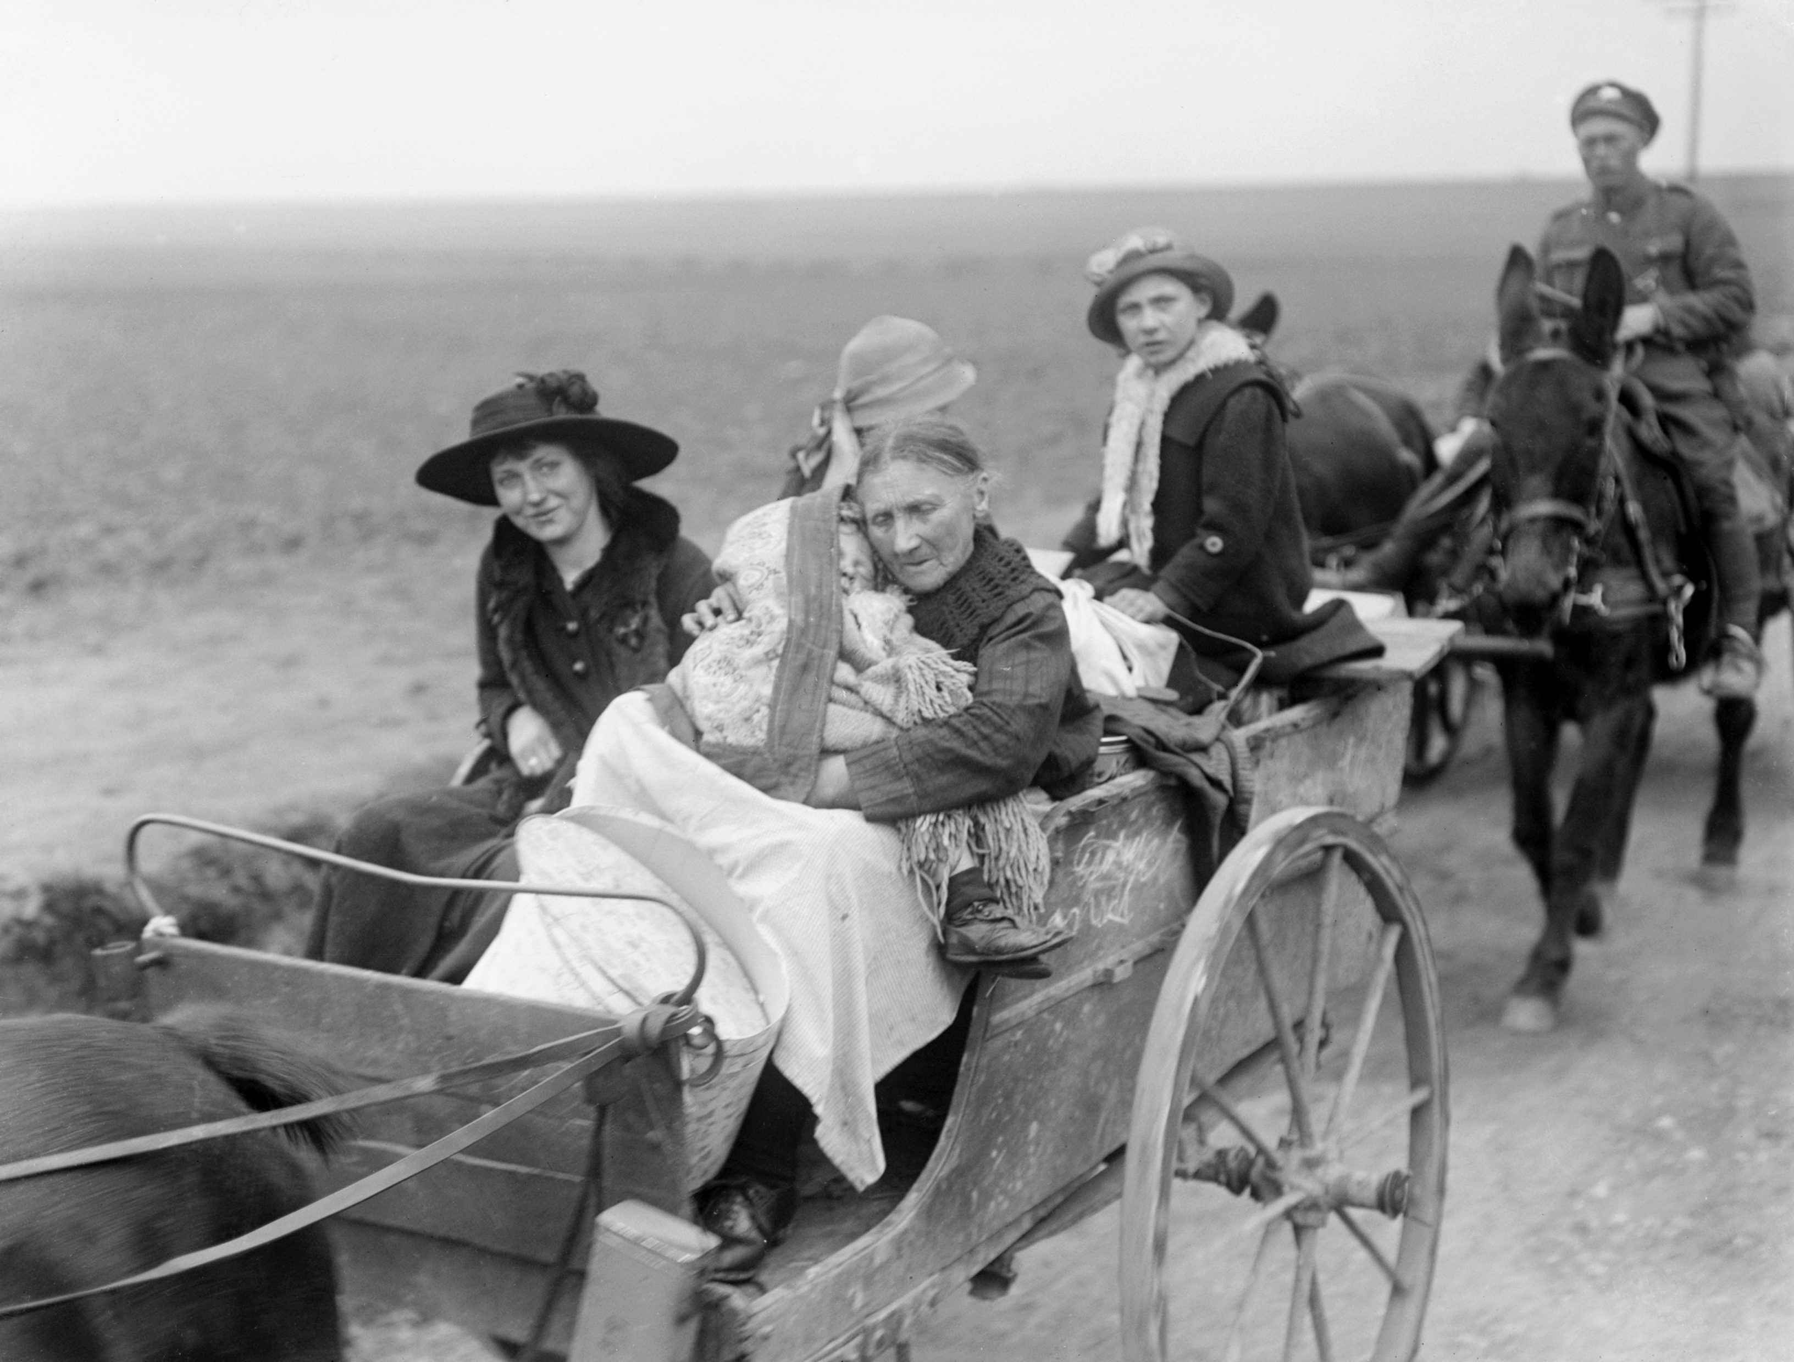
Task 1 – discussing pictures
Look at the pictures. Find the following:
Zeppelin refugees troops tanks trenches armistice
^{© IWM (Art.IWM ART 4208)}
^{© IWM (Q 5092)}
^{© IWM (Art.IWM ART 1656)}
^{© IWM Q048212}
^{Europeana}
^{© IWM 010898}

Slide 4
Task 1 – discussing pictures
Suggested answers
armistice trenches troops
^{© IWM (Art.IWM ART 4208)}
^{© IWM (Q 5092)}
^{© IWM (Art.IWM ART 1656)}
tanks Zeppelin refugees
^{© IWM Q048212}
^{Europeana}
^{© IWM 010898}

