Slide 1
What not to say to someone who stammers
https://www.teachingenglish.org.uk/

Slide 2
Task 1 - What is stammering?
Read this information. Does anything surprise you?
Stammering (sometimes referred to as ‘stuttering’) means that when you speak you get stuck on certain words or sounds, or that you repeat sounds. It usually starts in early childhood, but some people grow out of it. There is no one reason why people stammer, but recent research suggests that it is genetic. Around one person in every hundred stammers.
Do you ever stammer or know anyone that stammers?
How do you think you should respond when someone stammers?
https://www.teachingenglish.org.uk/

Slide 3
Joe’s story
https://www.teachingenglish.org.uk/

Slide 4
Task 1: Expressing preferences
https://www.teachingenglish.org.uk/

Slide 5
Task 2: Expressing preferences
prefer rather sooner wish
1. Subject + would + 1)_______ + object + full infinitive (+ 2)_______ + than + bare infinitive)
I’d 3)_______ you (not) to arrive early.
I’d 4)______ you to arrive early 5)_______ than be late.
https://www.teachingenglish.org.uk/

Slide 6
Task 2: Expressing preferences
prefer rather sooner wish
2. Subject + would + 6_______ or 7________ + object + past tense or Subject + would + 8_______ + bare infinitive.
I’d 9______ you didn’t do that. / I’d 10_______ you didn’t do that.
I’d 11_______ not do that.
3. Subject + 12______ + object + would(n’t) + bare infinitive
I 13_____ he wouldn’t leave his socks on the floor.
https://www.teachingenglish.org.uk/

Slide 7
Task 3: Grammar practice
1 Please don’t shout. YOU
I’d rather __________________________________
2 I don’t want him to buy me presents all the time. SOONER
I’d _____________________________________
3 Lucy would rather go to the cinema than the theatre. RATHER
Lucy would prefer ___________________________________________
4 I’d really rather you didn’t whistle all the time. WOULDN’T
I ____________________________________
5 I really fancy eating Chinese food tonight. PREFER
I’d ___________________________________
6 They would sooner you didn’t use your mobile at the dinner table. WISH
They __________________________________
7 I don’t really want to go out tonight. RATHER
I’d _____________________________________
https://www.teachingenglish.org.uk/

Slide 8
Task 3: Grammar practice
1 Please don’t shout. YOU
I’d rather you didn’t shout.
2 I don’t want him to buy me presents all the time. SOONER
I’d sooner he didn’t buy me presents all the time.
3 Lucy would rather go to the cinema than the theatre. RATHER
Lucy would prefer to go to the cinema rather than (go to) the theatre.
4 I’d really rather you didn’t whistle all the time. WOULDN’T
I wish you wouldn’t whistle all the time.
5 I really fancy eating Chinese food tonight. PREFER
I’d prefer to eat Chinese food tonight.
6 They would sooner you didn’t use your mobile at the dinner table. WISH
They wish you wouldn’t use your mobile at the dinner table.
7 I don’t really want to go out tonight. RATHER
I’d rather not go out tonight.
https://www.teachingenglish.org.uk/

Slide 9
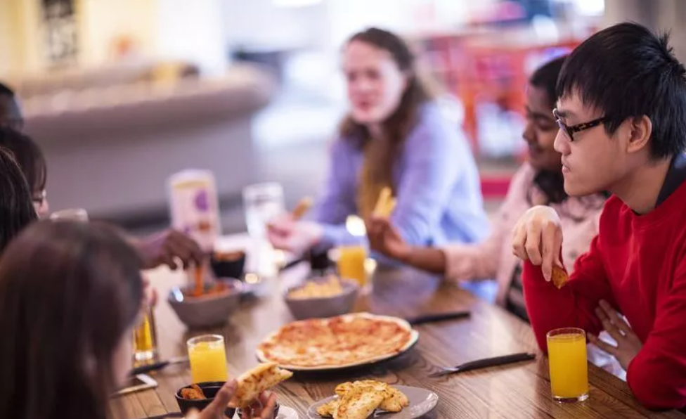
Task 4: Annoying habits
Make a list of 5–10 things other people sometimes do that you find annoying.
For example, interrupting you when you’re speaking.
https://www.teachingenglish.org.uk/

Slide 10
Task 4: Describing annoying habits
I’d rather you didn’t interrupt me when I’m speaking
I’d prefer you not to interrupt me when I’m speaking.
https://www.teachingenglish.org.uk/

