Slide 1
Soldiers from the Caribbean

Slide 2
© IWM (Q 1201)
Look at the picture. What can you see?
Where do you think the men are from?
Do you think they fought for the British or German side in the First World War?
Notes:
Look at the picture. What can you see? (Huts, soldiers, rifles/guns, a cart.)
Where do you think they are from? (West Indies.)
Do you think they fought for the British or German side in World War I? (British – West Indies was a colony.)

Slide 3
© IWM (Q 4099)
What can you see?
What were trenches used for?
Who do you think made the trenches?
Notes:
What can you see? (A trench, some sand bags, a soldier.)
What were trenches used for? (To protect soldiers from enemy attack.)
Who do you think dug/made the trenches? (Soldiers/army labourers – don’t give students a definitive answer as they’ll find out in reading.)

Slide 4
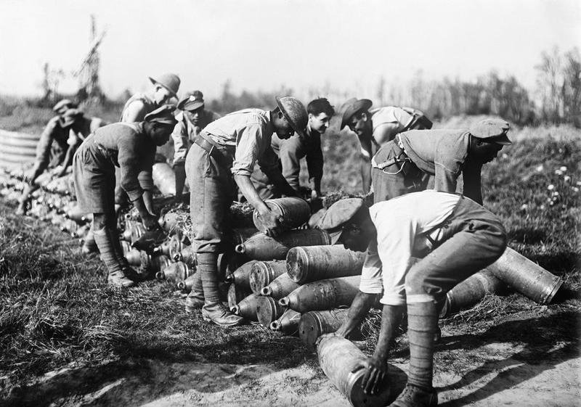
© IWM (E(AUS) 2078)
What can you see?
Do you think this work was easy?
How safe do you think this work was? Why?
Notes:
What can you see? (Soldiers, West Indian soldiers carrying/lifting ammunition/bombs/weapons.)
Do you think this was an easy job?
Do you think it was safe/interesting?
Why (not)?

