Slide 1
M Z P A P Y R U S K P A P E R W X V P A R C H M E N T V Q Y Z S L A T E W A L L S Q W A X
Recording the Magna Carta
Answers to Task 1

Slide 2
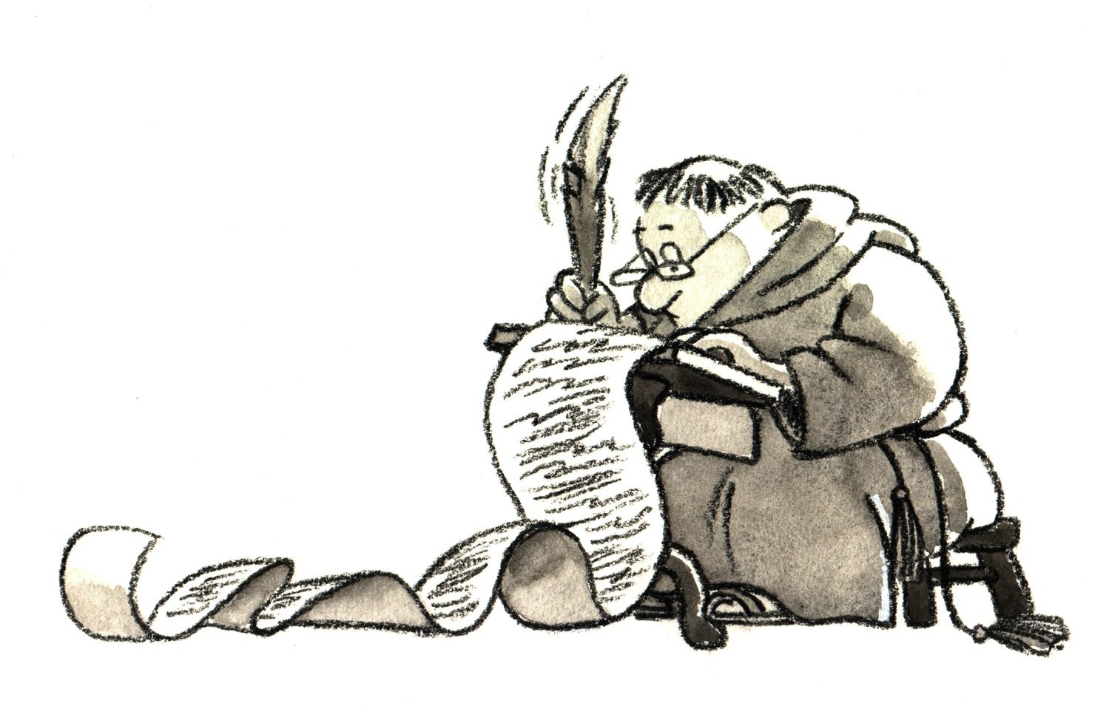

Slide 4
