Slide 1
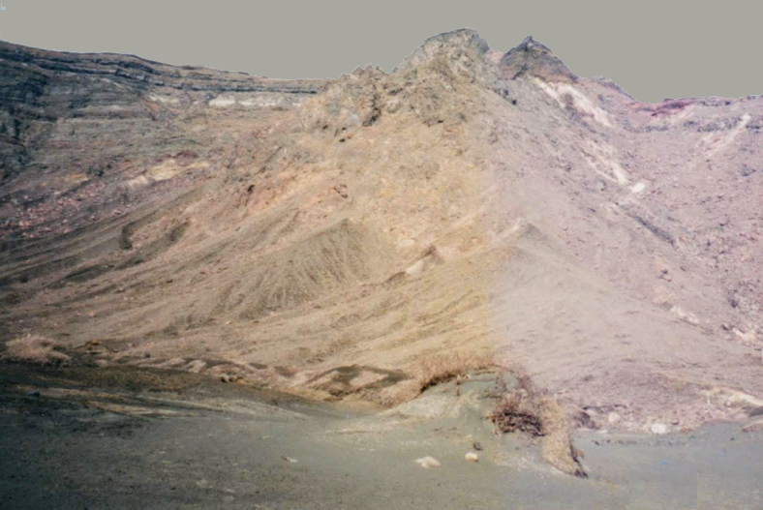
Life on other planets
https://www.teachingenglish.org.uk/

Slide 2
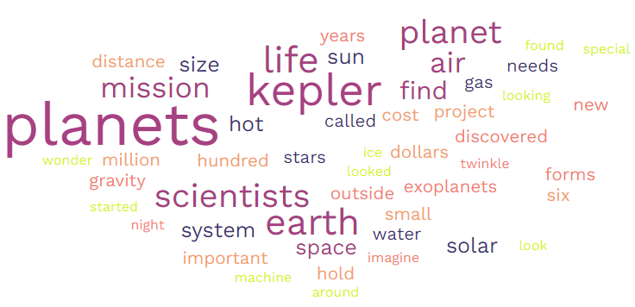
Word cloud
https://www.teachingenglish.org.uk/

Slide 3
Task 2
1 The Kepler space telescope | a) are not in our solar system.
2 Kepler has found five planets that | b) does not have enough air.
3 A planet can support life if it | c) has too much air.
4 A very small planet | d) is looking for other planets.
5 An extremely big planet | e) has water and air.
https://www.teachingenglish.org.uk/

Slide 4
Important numbers
What do these numbers relate to in the text?
600, 000,000
2018
5
2009
https://www.teachingenglish.org.uk/

Slide 5
Space exploration
What other things do you know about space exploration?
Is it a good idea to spend $600 million on space exploration?
Why does NASA want to find habitable planets?
https://www.teachingenglish.org.uk/

Slide 6
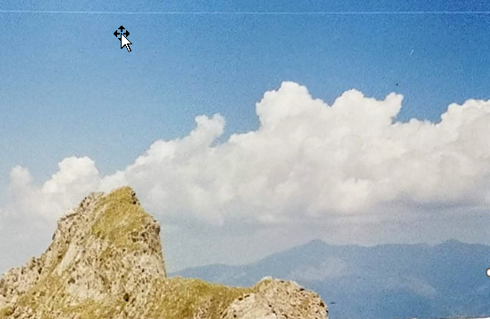
Kepler version 2
Imagine that 2 months ago a new Kepler mission found life on a distant planet.
NASA wants to send some objects representing Earth to the new planet. Add 5 more items to NASA’s list of objects
an encyclopaedia
a computer
photographs of world leaders
a bottle of sea water
https://www.teachingenglish.org.uk/

