Slide 1
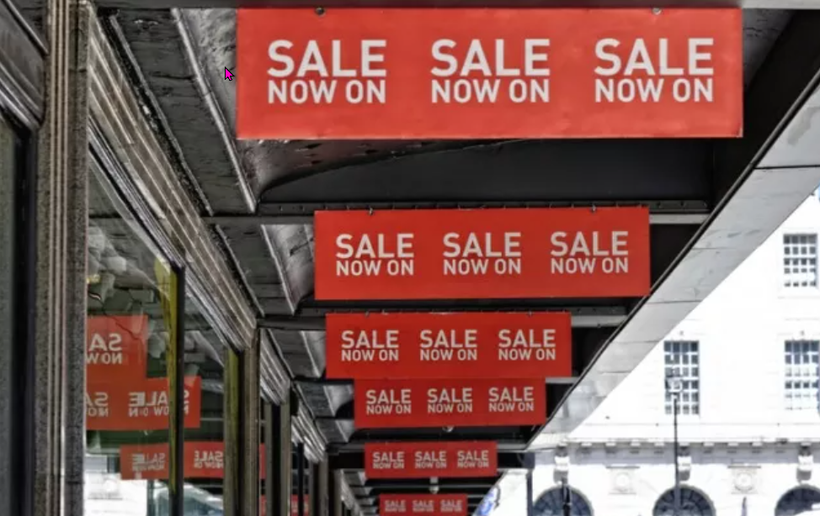
Shopping and Sales tricks
https://www.teachingenglish.org.uk/

Slide 2
Shopping and Sales tricks
In pairs or groups, think of a store you know well or often visit. Answer the questions.
• Where is the checkout counter?
• Does the store play any background music? What kind of music?
• Is there a window display? What’s usually in it?
• In which part of the store can you find the discounts and special deals?
https://www.teachingenglish.org.uk/

Slide 3
Shopping and Sales tricks – Task 1
In pairs or groups, think of a store you know well or often visit. Answer the questions.
• Where is the checkout counter?
• Does the store play any background music? What kind of music?
• Is there a window display? What’s usually in it?
• In which part of the store can you find the discounts and special deals?
https://www.teachingenglish.org.uk/

Slide 4
Shopping and Sales tricks – Task 3
• Layout and location of products How do they affect you? Give examples of common tricks that stores use and describe what they make you do.
• Tricks of the senses Which techniques use a sense to tempt you? Give examples and say why stores use them.
• Tricks of the mind Which tricks affect the way you think or react? Do any cause associations in your mind? Give some examples and explain the purpose of them.
https://www.teachingenglish.org.uk/

Slide 5
Shopping and Sales tricks – Task 3 Answers
1. Techniques about location/layout: 4, 7, 10, 11, 12
2. Tricks of the senses: 1, 2, 6, 8
3. Tricks of the mind: 2, 3, 5, 6, 8, 9
https://www.teachingenglish.org.uk/

Slide 6
Examples of cause and effect
Cause | Effect
Appealing to all five senses (smell, taste, touch) | Tempts customers to buy things
Slow background music | Makes people relax and spend more time in the shop (potentially buying more)
Prices ending in ".99" | Customers perceive them as cheaper than a whole number price
Fitting rooms at the back | Customers walk past more products on the way there
Sales and discounts | Create a sense of urgency and convince customers they're saving money (leading to purchases)
Displays and attractive items | Make customers want to enter the shop
Small items near checkout | Customers are tempted to buy them as impulse purchases while waiting
Red "Sale" signs | Grab customers' attention faster
Large entrances | Make the shop appear bigger and more inviting
Confusing layouts | Lead customers to wander around and see more products
Double deals (paired items) | Encourage customers to buy more than one item
Profitable items at eye level | Customers are more likely to see and purchase them
https://www.teachingenglish.org.uk/

Slide 7
Language of cause and effect
Language that implies cause or effect
Because: "Senses appeal to all five senses, because senses tempt you to buy things." (Cause: appealing to senses. Effect: tempts customers) So that: "The fitting room is usually at the back of clothing shops, so that you pass more products on the way there." (Cause: fitting room location. Effect: customers see more products) Makes: "Slow background music makes people relax and spend longer in the shop!" (Cause: slow music. Effect: customers relax and spend more time)
https://www.teachingenglish.org.uk/

Slide 8
Your project
Work in pairs or groups and design your own store. Use some techniques you learned about.
• Decide what kind of store you want.
• Brainstorm products that you will sell.
• Plan the layout of the store. Use these ideas to help you:
entrance / doors / windows / checkout counter / special counters / fitting room / bathrooms
• Decide on some techniques you’ll use to help you sell more. Use these ideas to help you:
background music / lighting / window displays / sales and discounts / prices / double deals / cheap and expensive items / mirrors
• Using technology or poster paper, draw a final design and prepare to explain it to the class
https://www.teachingenglish.org.uk/

