Slide 1
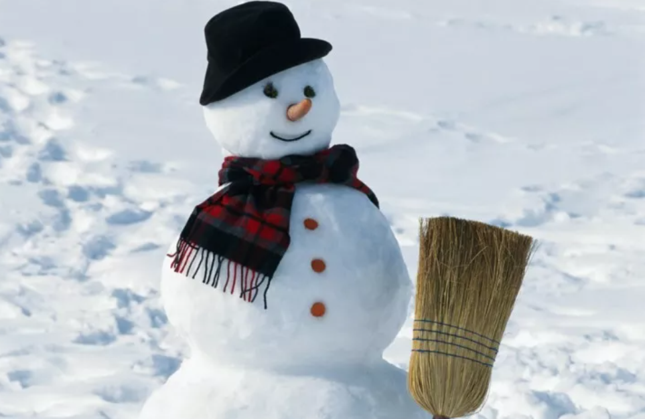
https://www.teachingenglish.org.uk/

Slide 2
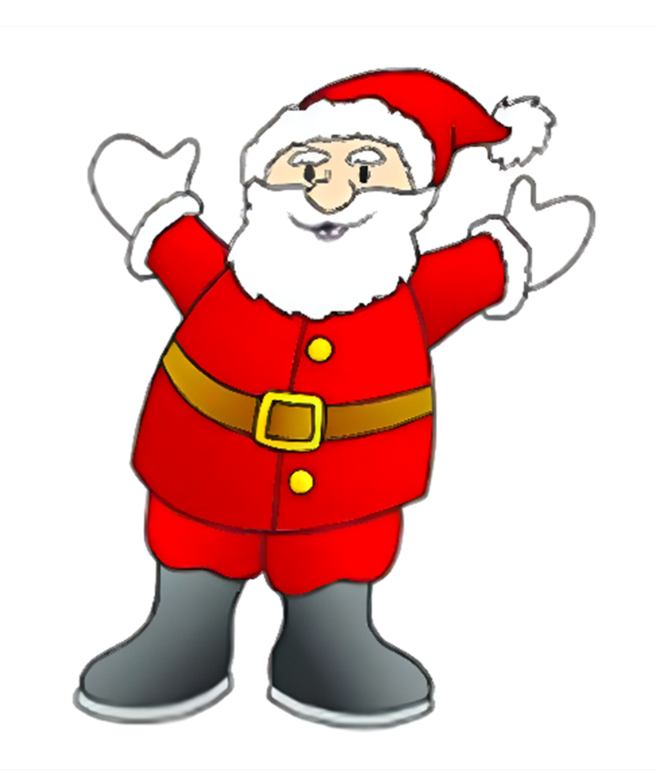
Santa Claus, Santa Claus, Santa Claus is here. Bringing toys, For girls and boys, And lots of Christmas cheer.
https://www.teachingenglish.org.uk/

Slide 3
https://www.teachingenglish.org.uk/

Slide 4
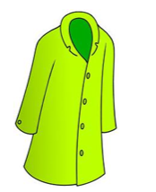
coat
https://www.teachingenglish.org.uk/

Slide 5
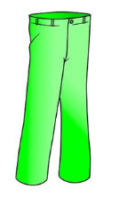
trousers
https://www.teachingenglish.org.uk/

Slide 6
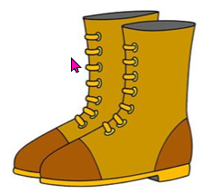
boots
https://www.teachingenglish.org.uk/

Slide 7
glove
https://www.teachingenglish.org.uk/

Slide 8
hat
https://www.teachingenglish.org.uk/

Slide 9
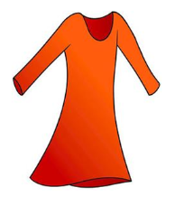
dress
https://www.teachingenglish.org.uk/

Slide 10
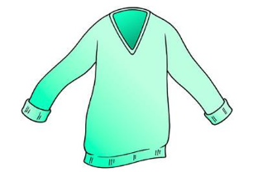
jumper
https://www.teachingenglish.org.uk/

Slide 11
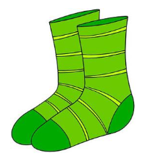
socks
https://www.teachingenglish.org.uk/

Slide 12
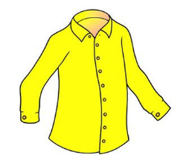
shirt
https://www.teachingenglish.org.uk/

Slide 13
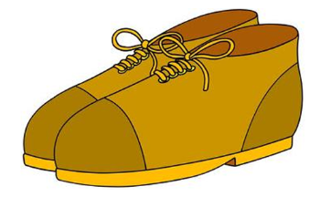
shoes
https://www.teachingenglish.org.uk/

Slide 14
hat
glove
coat
belt
trousers
boot
https://www.teachingenglish.org.uk/

Slide 15
trousers
belt
coat
glove
boot
hat
https://www.teachingenglish.org.uk/

Slide 16
This is Santa!
He’s got white gloves
https://www.teachingenglish.org.uk/

