Slide 1
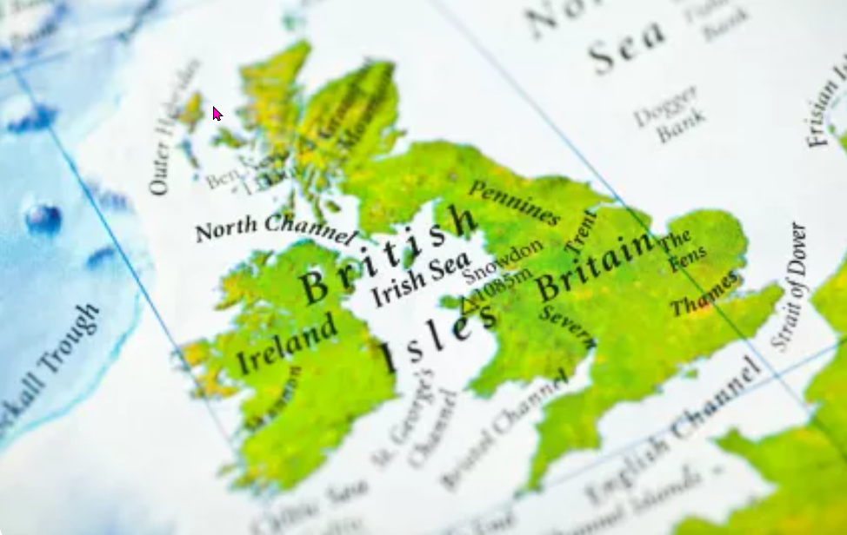
Northern Ireland
https://www.teachingenglish.org.uk/

Slide 2
UK or British Isles? What’s what?
1) What is ‘The UK’ short for?
2) Which countries make up Great Britain?
3) Which country is part of the UK but not part of Great Britain?
4) What are the capital cities of the countries that make up the UK?
5) Which countries make up the British Isles?
https://www.teachingenglish.org.uk/

Slide 3
UK or British Isles? What’s what?
What is ‘The UK’ short for?
b) The United Kingdom of Great Britain and Northern Ireland.
Which countries make up Great Britain?
a) Wales, Scotland and England.
Which country is part of the UK but not part of Great Britain?
e) Northern Ireland
What are the capital cities of the countries that make up the UK?
c) Cardiff, Edinburgh, London and Belfast.
Which countries make up the British Isles?
d) The United Kingdom and the Republic of Ireland.
https://www.teachingenglish.org.uk/

Slide 4
Colloquialisms of Northern Ireland
Q: How was the craic? A: The craic was mighty! - Did you have a good time? Yes!
Greeting: How are yours?
Even the dogs on the street know it – relating to something that is common and apparently is a Belfast only expression.
‘bout ye? – How are you?
foundered – cold
scundered – embarrassed
yer man – that man
grand – good, OK
wee – little (also used in Scotland)
aye – yes (again, also used in Scotland)
stickin’ out – really good
https://www.teachingenglish.org.uk/

Slide 5
Ulster fry
In Northern Ireland they have a special dish known as the Ulster Fry. You can eat it for lunch, supper or breakfast. Have a look at the ingredients:
• Bacon
• Eggs
• Sausage
White pudding
• Tomatoes
• Mushrooms
Black pudding
• Potato bread
• Soda bread
All of the ingredients are fried, including the bread, and it is usually accompanied by cups of tea.
• Would you like to try the Ulster fry? Why / why not?
• What did you have for breakfast / lunch this morning?
• What are the typical dishes from your country?
https://www.teachingenglish.org.uk/

