Slide 1
THE OUTBREAK OF WAR

Slide 2
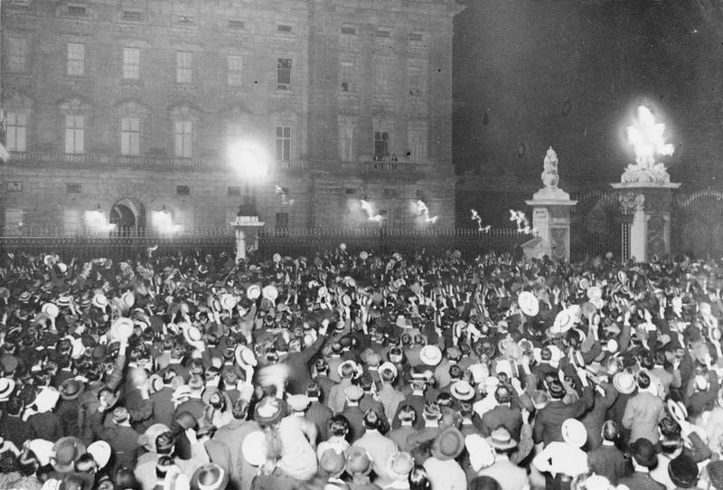
© IWM
PICTURE 1 © IWM (Q 65496)
Notes:
Crowds outside Buckingham Palace, London (home of the British royal family) on the day when war was declared in 1914
Q_65496 © IWM

Slide 3
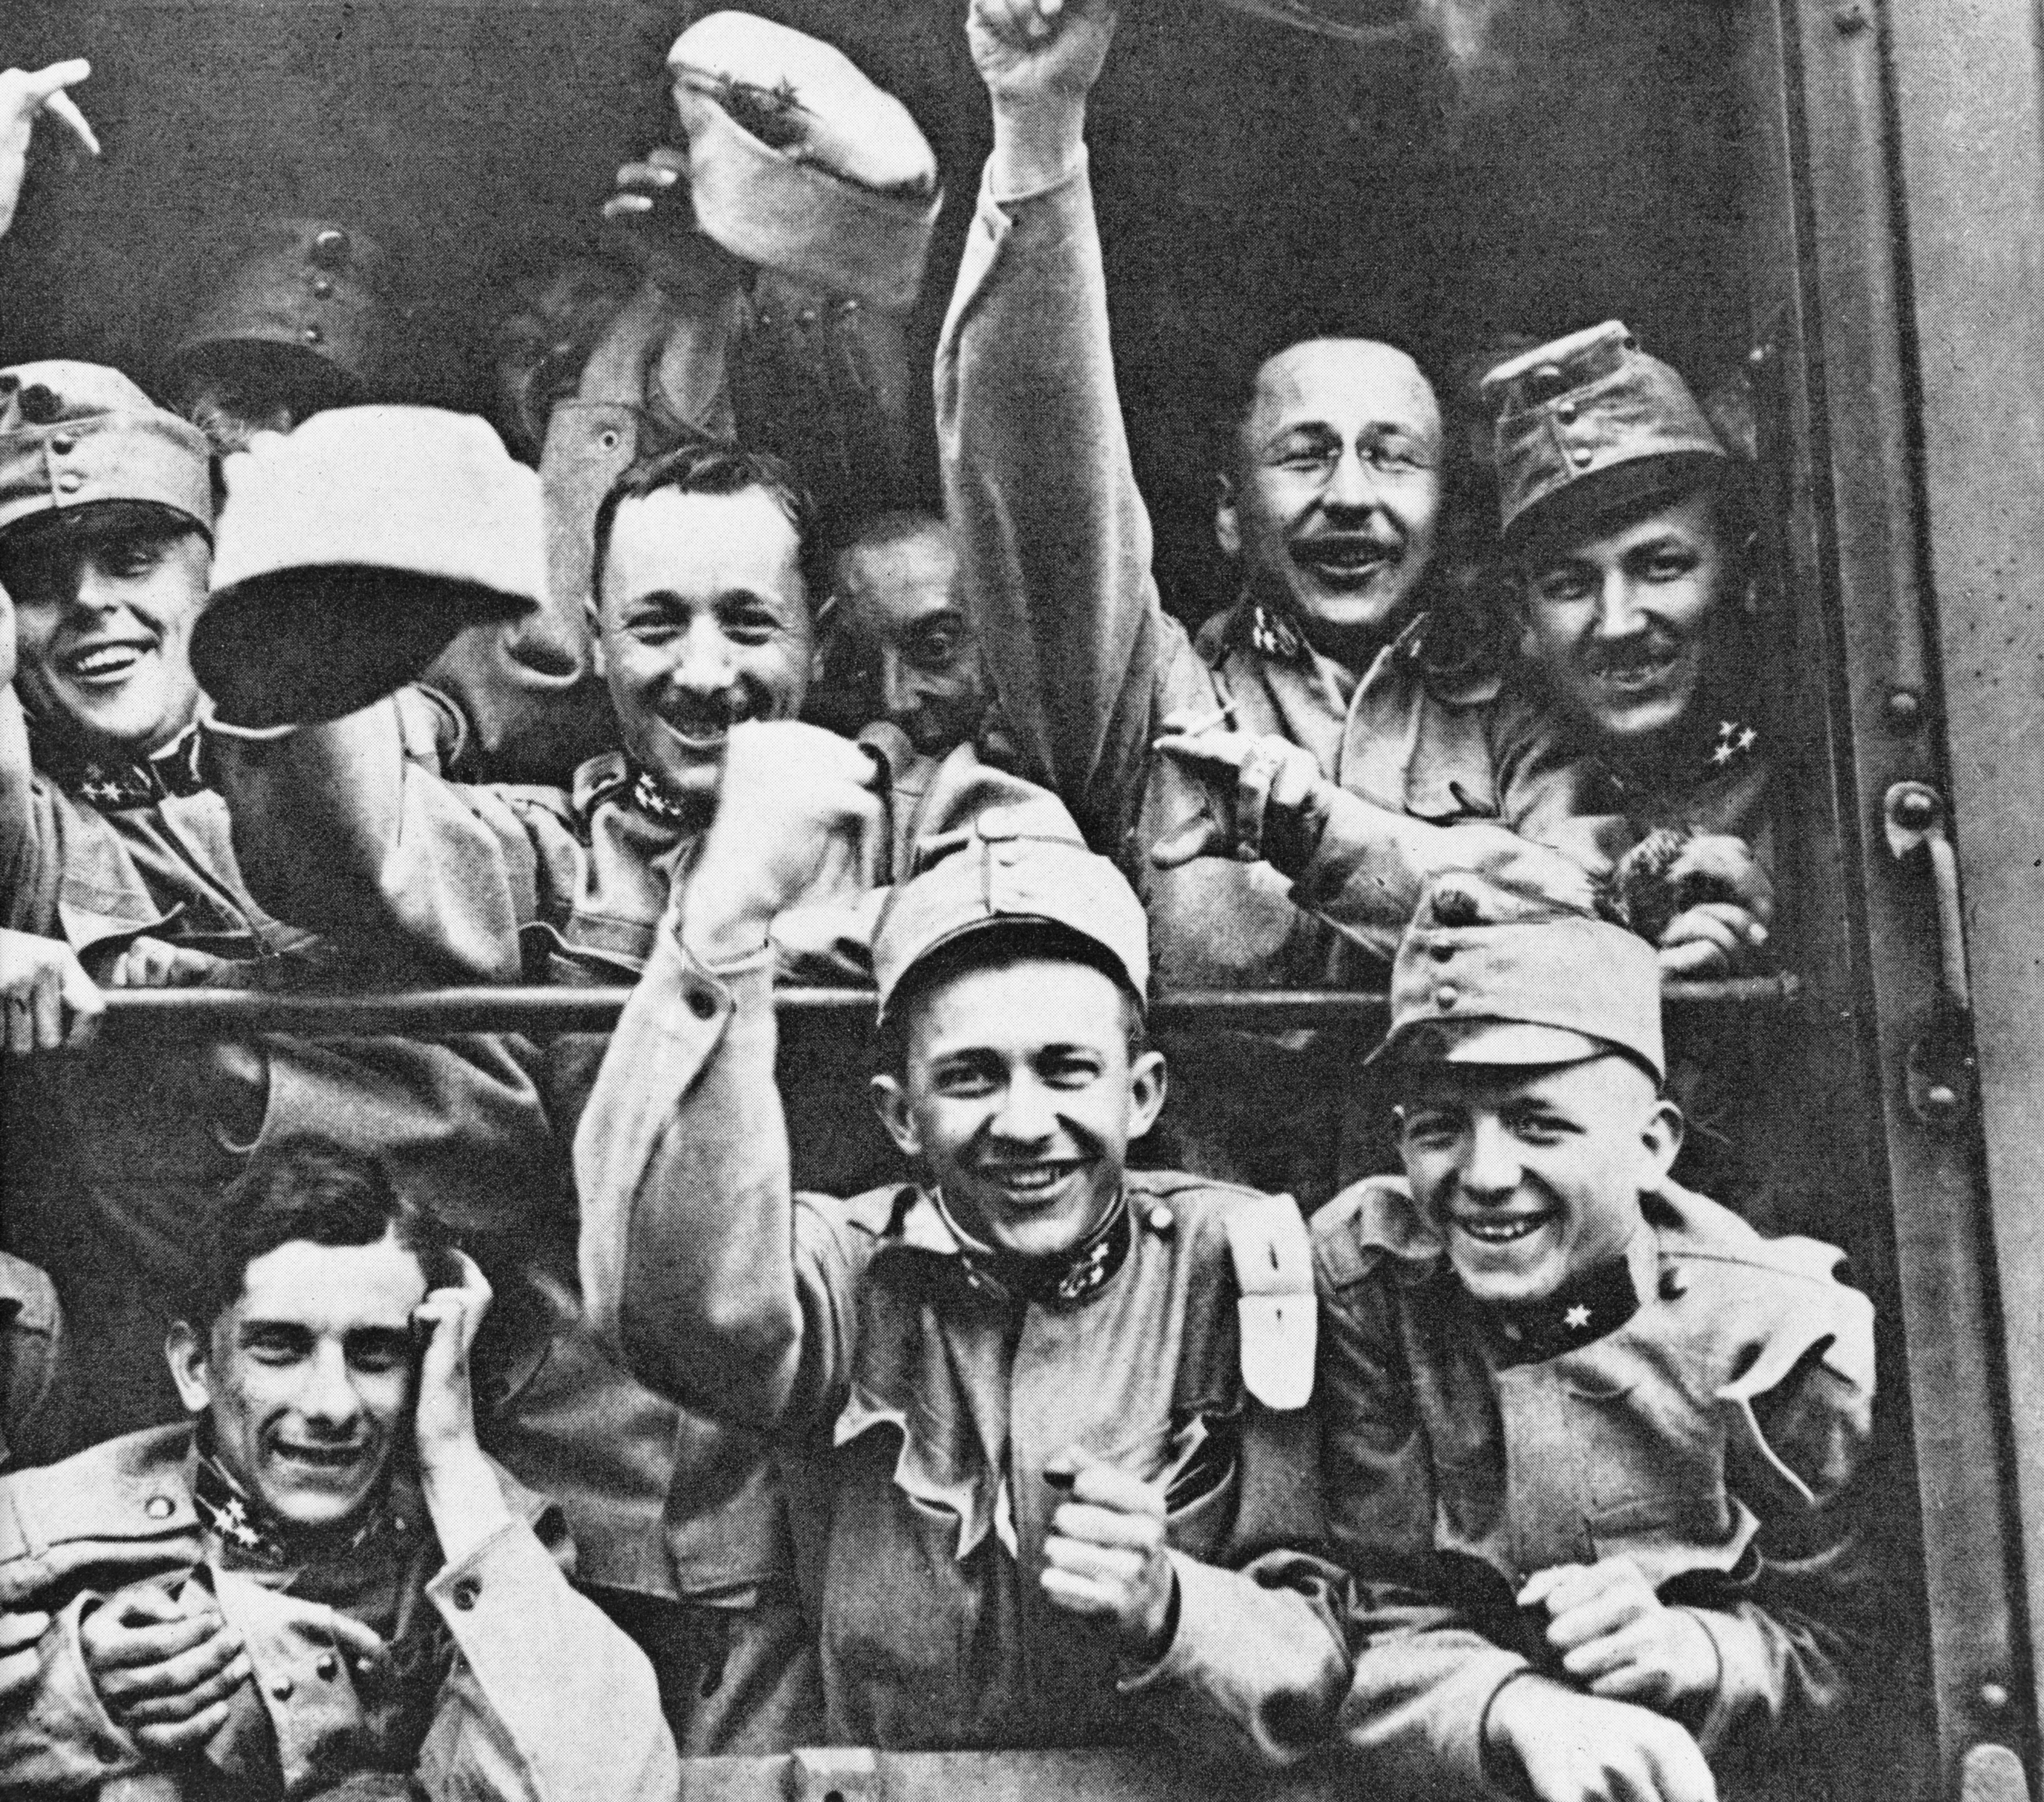
© IWM
PICTURE 2 © IWM (Q 81808)
Notes:
Austria-Hungary began mobilizing its army on 26 July 1914. As shown here, many soldiers were excited about the prospect of war. But the Austro-Hungarian Army contained men of a number of different nationalities and ethnic backgrounds, and not all of them were equally as enthusiastic.
Q 81808 ©IWM

Slide 4
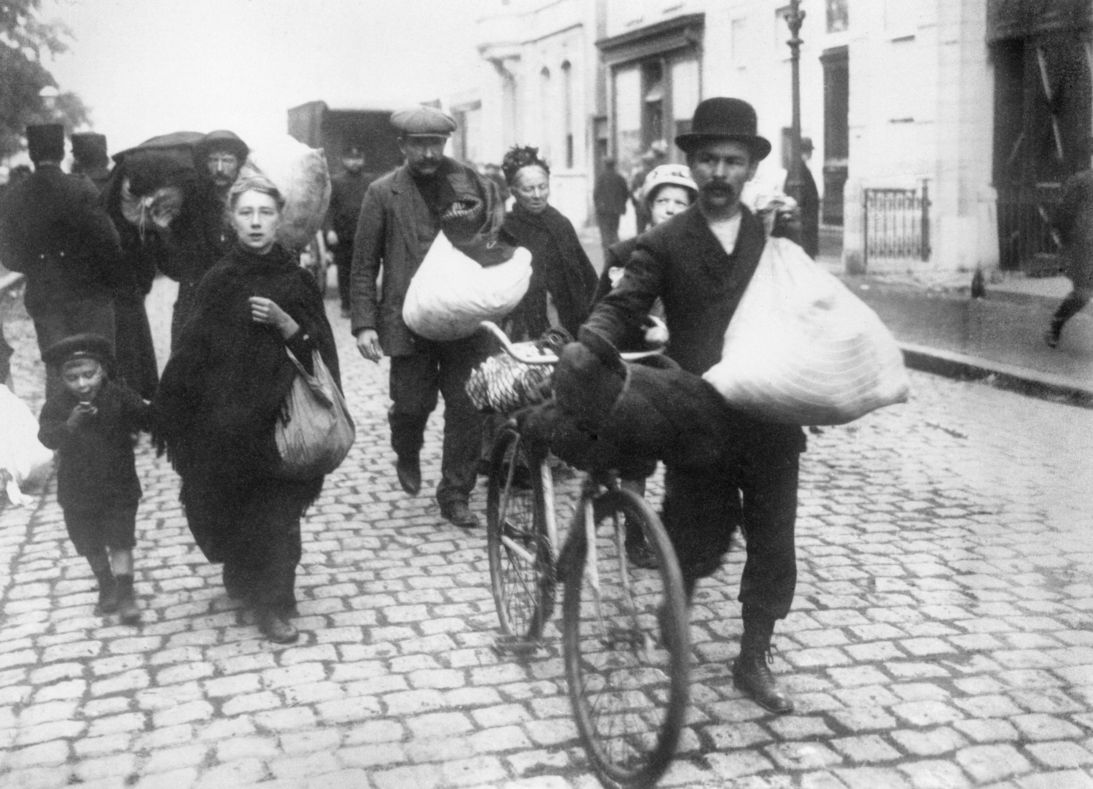
© IWM
PICTURE 3 © IWM (HU 052449)
Notes:
As the German Army advanced through Belgium in August 1914, tens of thousands of civilian refugees left their homes to escape the war. Over 1 million fled the country, many to the Netherlands, including these people leaving Antwerp at the beginning of October. Others made their way to France and Britain.
HU_052449.jpg ©IWM

Slide 5
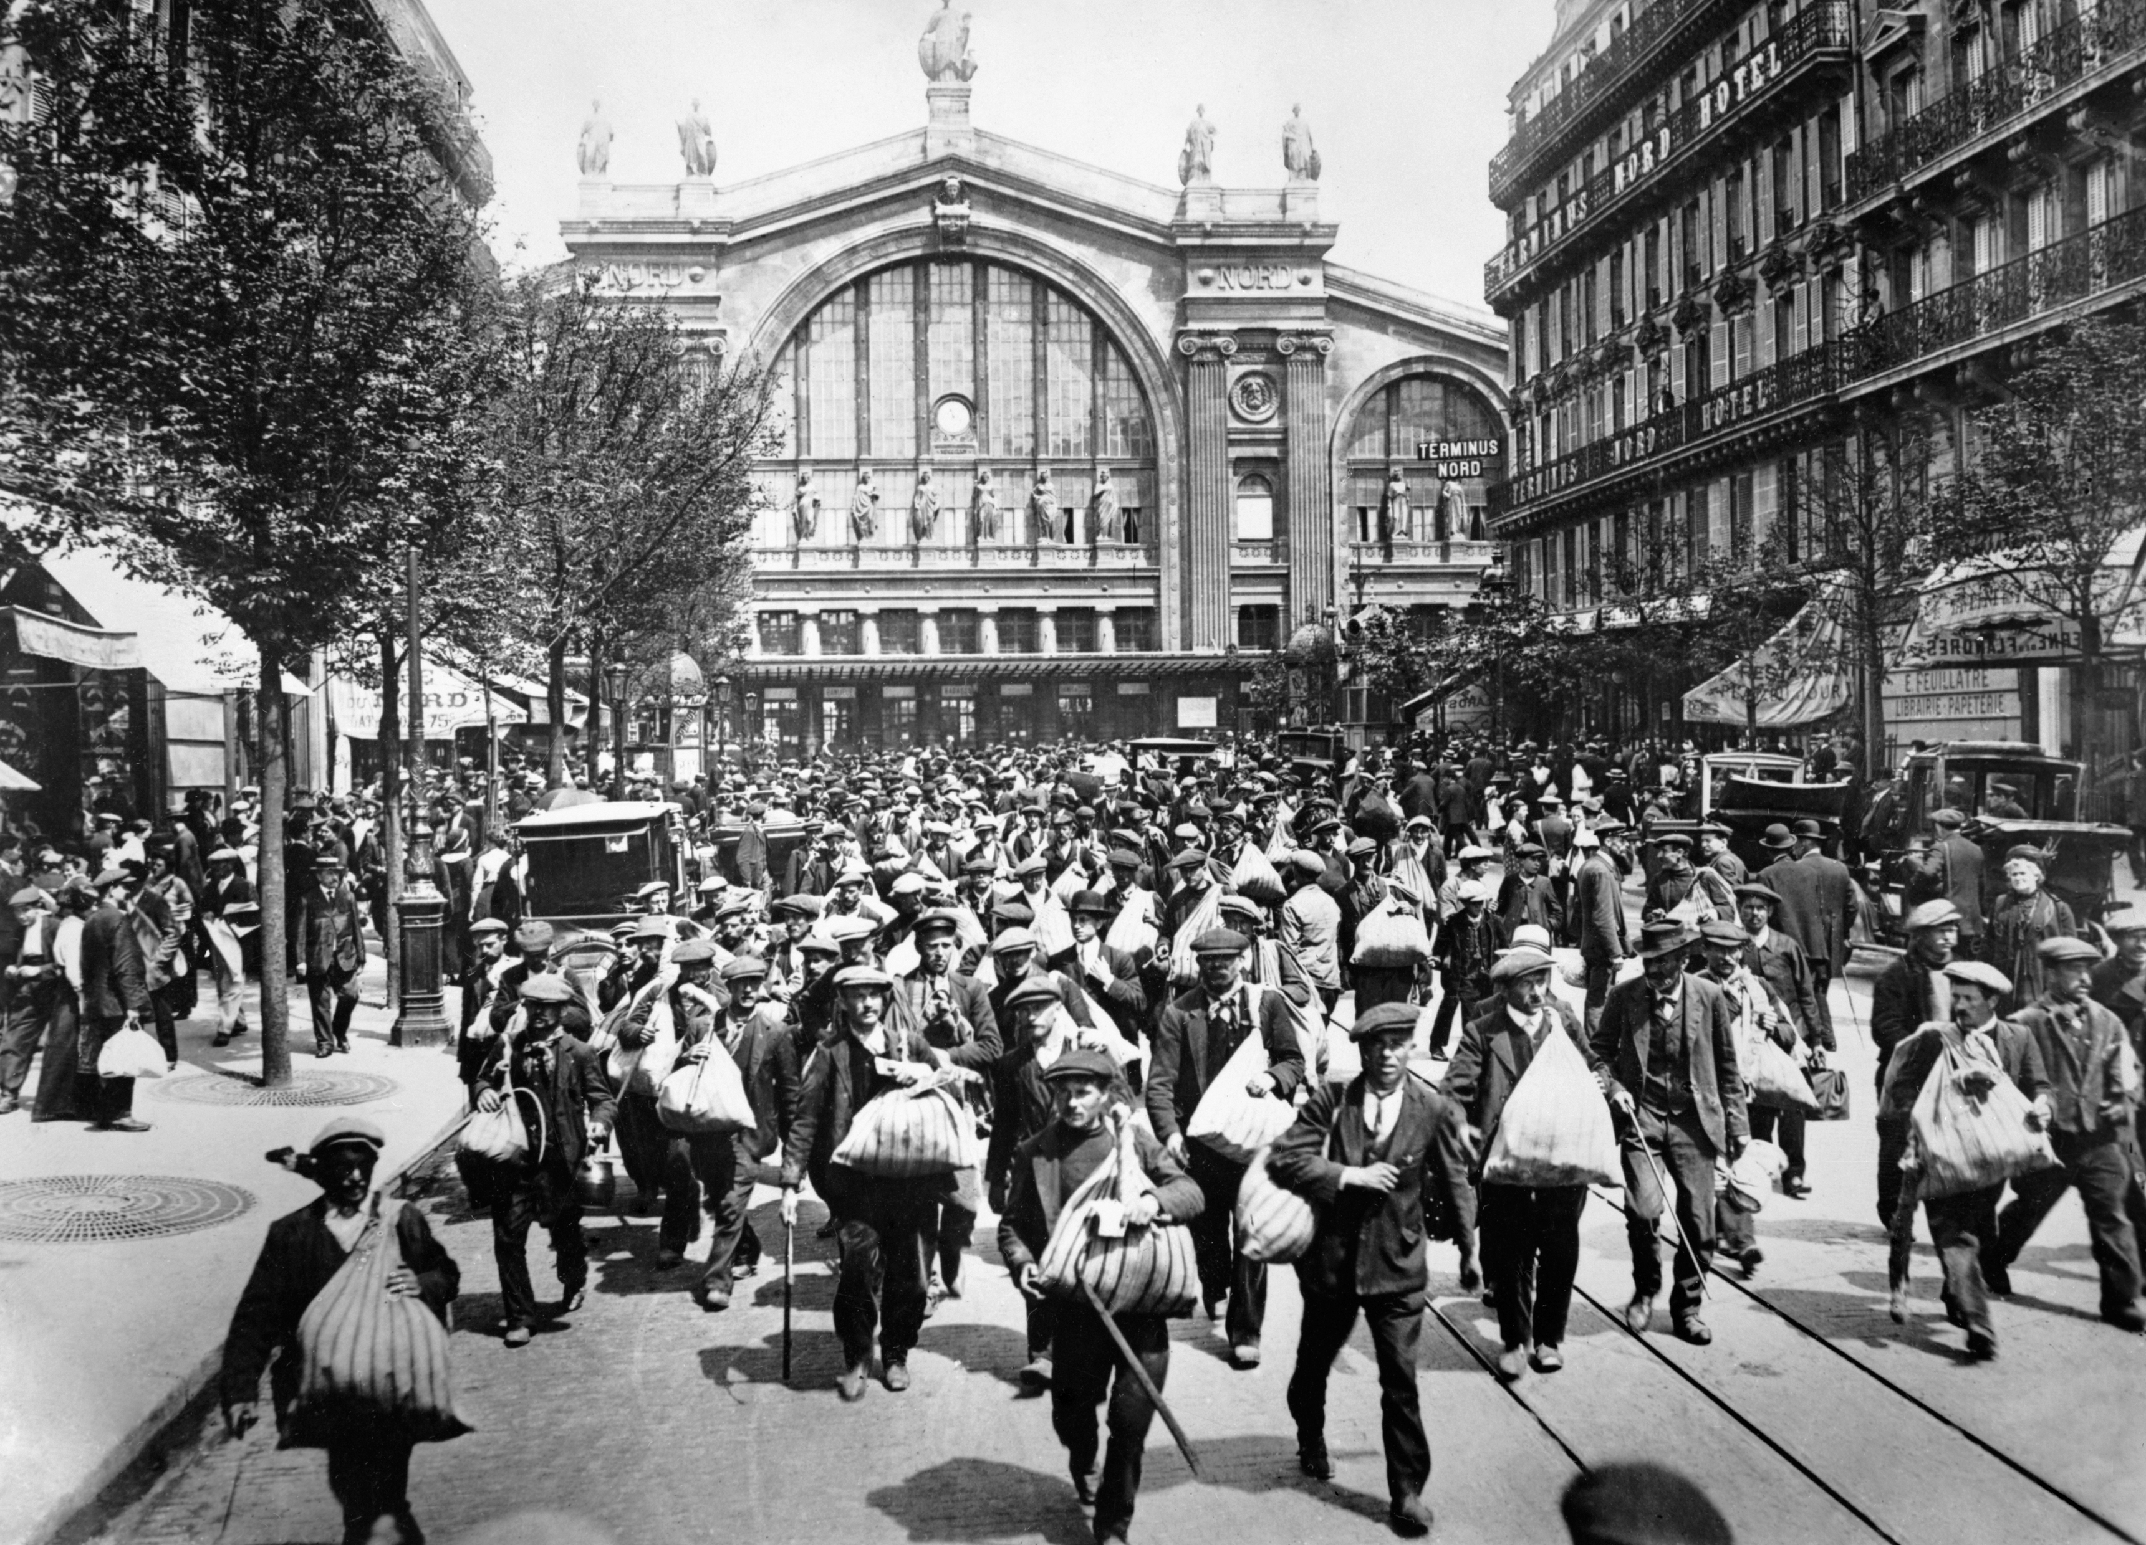
© IWM
PICTURE 4 © IWM (Q 081852)
Notes:
As the individual European nations joined the war, most began by mobilizing their reserve soldiers, the majority of whom had some form of military experience. Here, French reservists in Paris leave the Gare du Nord for their regimental depots where they will be issued with uniforms and equipment.
Q_081852 ©IWM

