Slide 1
Migration and the First World War

Slide 2
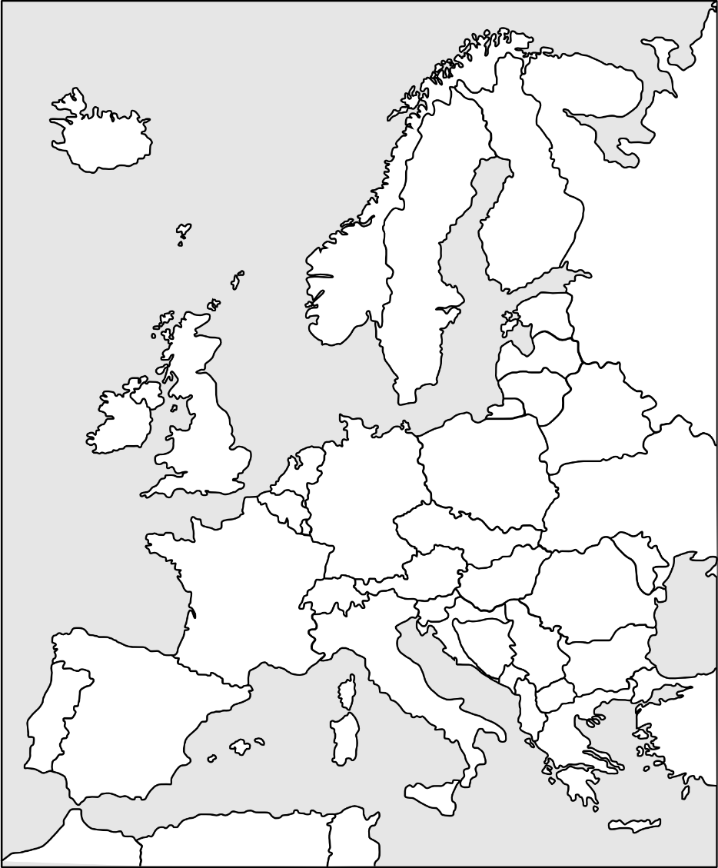
Warmer: Label the countries (Europe)
© IWM
Poland
Switzerland
Germany
Ukraine
Belgium
Serbia
Britain
Greece

Slide 3
Answers: Label the countries (Europe)
© IWM
Poland
Switzerland
Germany
Ukraine
Belgium
Serbia
Britain
Greece

Slide 4
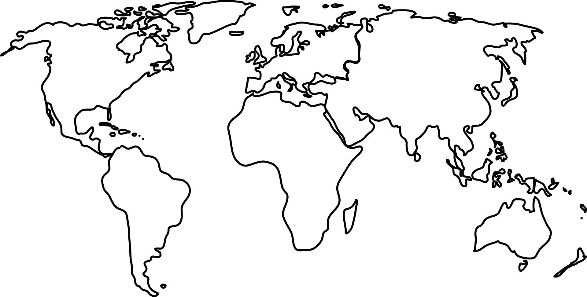
Warmer: Label the countries (the world)
Russia
Canada
New Zealand
South Africa
Australia
Turkey

Slide 5
Answers: Label the countries (the world)
Russia
Canada
New Zealand
South Africa
Australia
Turkey

Slide 6
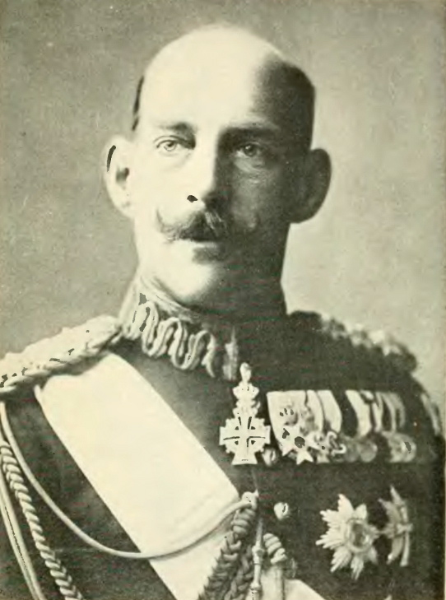
Who are these people? What do they have in common?
Task 1 – Reading and discussion

Slide 7
British troops invading Gallipoli, Turkey, 1915 ©IWM (Q 50473)

Slide 8
Refugees in Antwerp, Belgium, 1914. ©IWM (HU 52449)

Slide 9
Task 4 – Discussion
Talk in small groups. Answer the questions.
Are there any major historical events that made people move to or leave your country? What are they?
Which nationalities are the main immigrants to your country? What reasons do they have for coming to your country?
What rules are there in your country to reduce or increase immigration?
Are people in your country generally quite welcoming to immigrants? Why (not)?
Which countries do people from your country usually emigrate to? Do they usually stay for a short time or for life?
Are there any countries that you’d like to emigrate to or live in? Choose three and say why.
What are the positives and negatives of emigrating?
What are the differences and similarities between migration now and around the time of the First World War?

