Slide 1
The Lord Mayor’s Show
and
Notting Hill Carnival

Slide 2
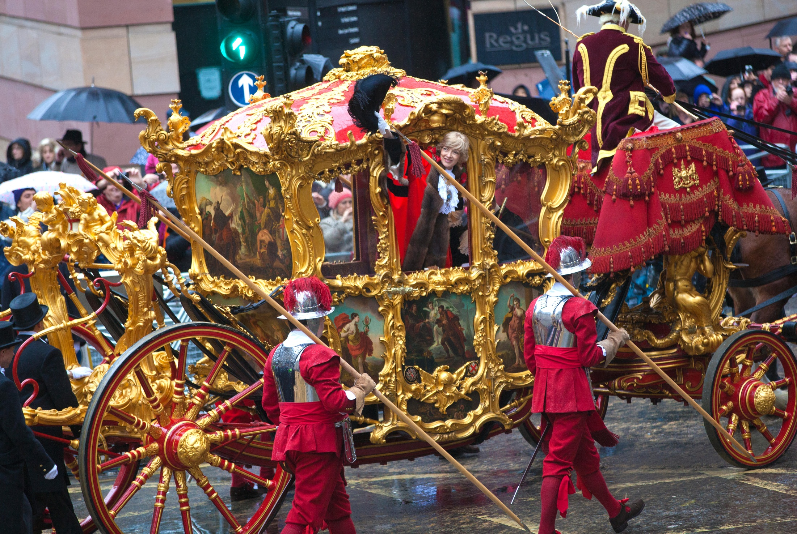

Slide 3
