Slide 1
First World War
Letters Home
Task 2: Life in a Trench

Slide 2
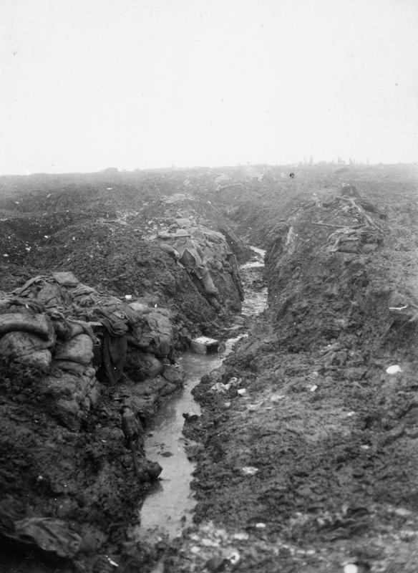
Q56198
During World War 1, soldiers lived in trenches to protect themselves from the enemy © IWM (E(AUS) 575)
Notes:
E (AUS) 575

Slide 3
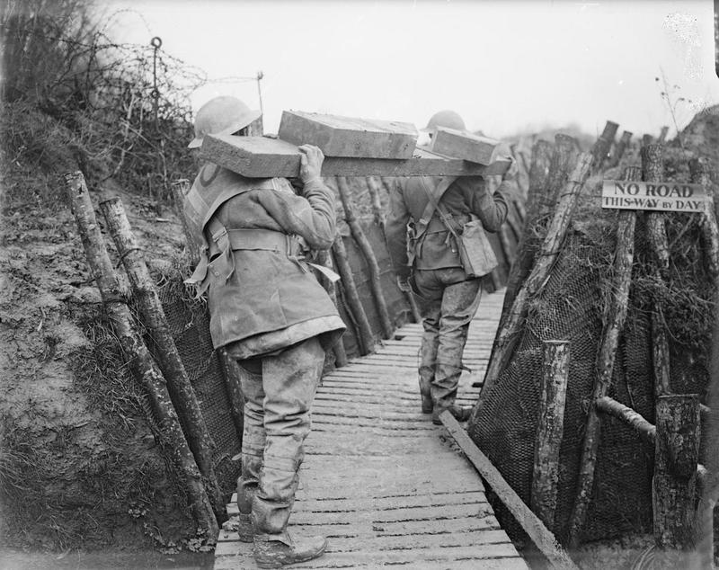
The soldiers constructed the trenches themselves © IWM (Q 5092)
Notes:
http://media.iwm.org.uk/iwm/mediaLib/231/media-231316/large.jpg?action=d&cat=photographs

Slide 4
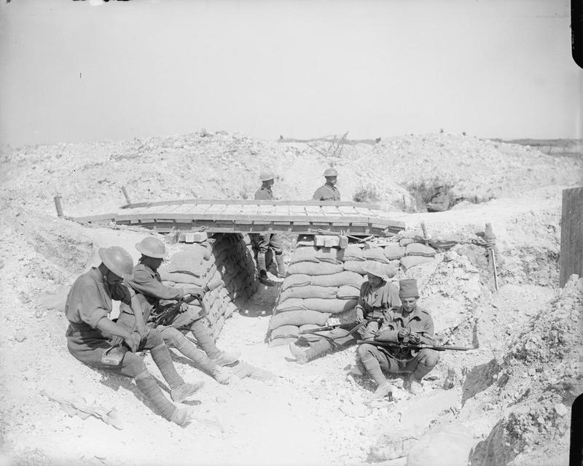
The soldiers worked, ate and rested in the trenches © IWM (Q 4099)
Notes:
http://media.iwm.org.uk/iwm/mediaLib/230/media-230353/large.jpg?action=d&cat=photographs

Slide 5
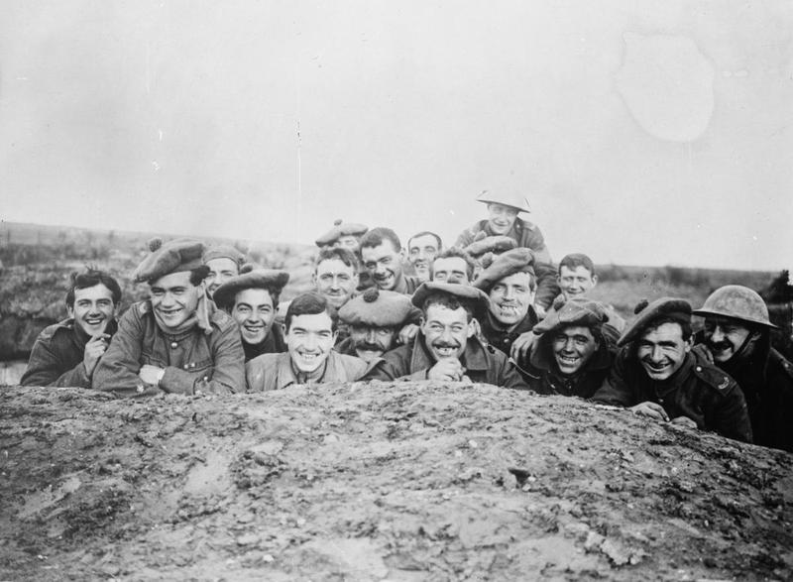
Soldiers tried to keep cheerful © IWM (Q4475)

