Slide 1
Joining the British Army
Recruitment posters for Warmer

Slide 2
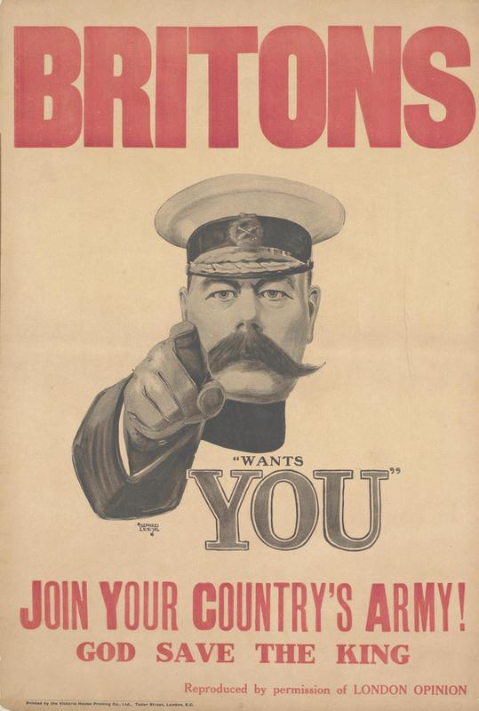
© IWM
Britons. Join Your Country’s Army!
This was one of the most famous and iconic posters in the First World War. It shows Field Marshal Lord Kitchener, the Secretary of State for War at that time, appealing to people to join the British Army.
© IWM (Art.IWM PST 2734)

Slide 3
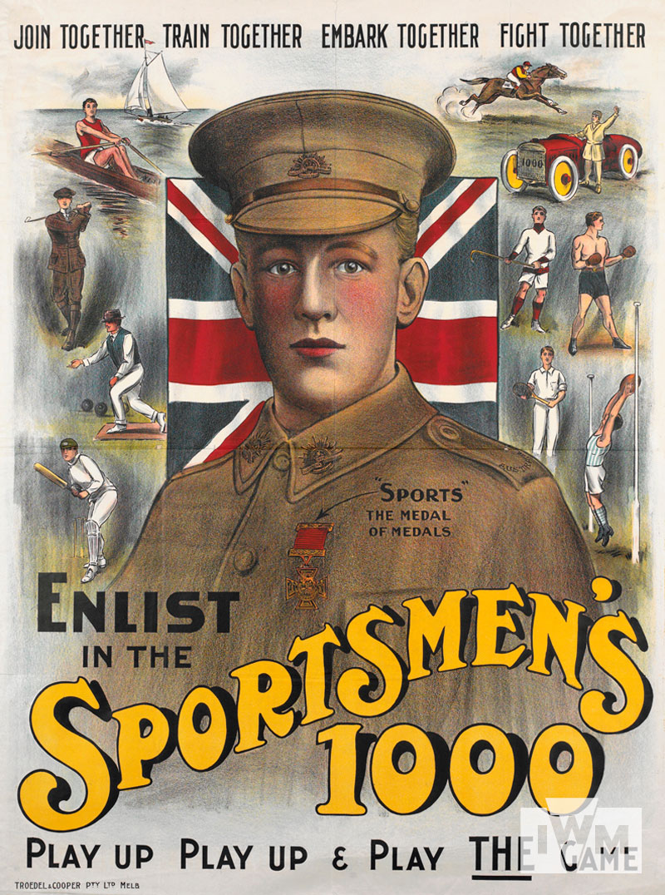
© IWM
Sportsmen's 1000
The idea that team sports were good preparation for war was common across Britain and its Empire. This poster is from Australia, and plays on the country’s sporting pride and its growing sense of identity.
© IWM (Art.IWM PST 12226)

Slide 4
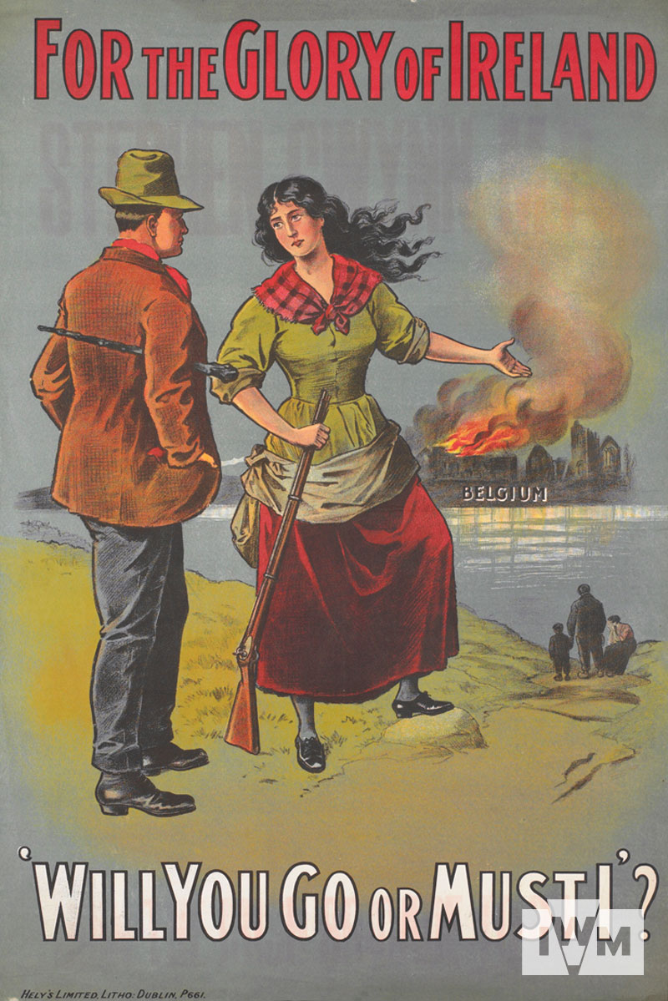
© IWM
For the Glory of Ireland
This Irish recruiting poster uses the German invasion of Belgium as a recruiting tool. It is appealing specifically to Catholics in Ireland, which at this time was still part of the UK, to defend Catholic Belgium.
© IWM (Art.IWM PST 13658)

Slide 5
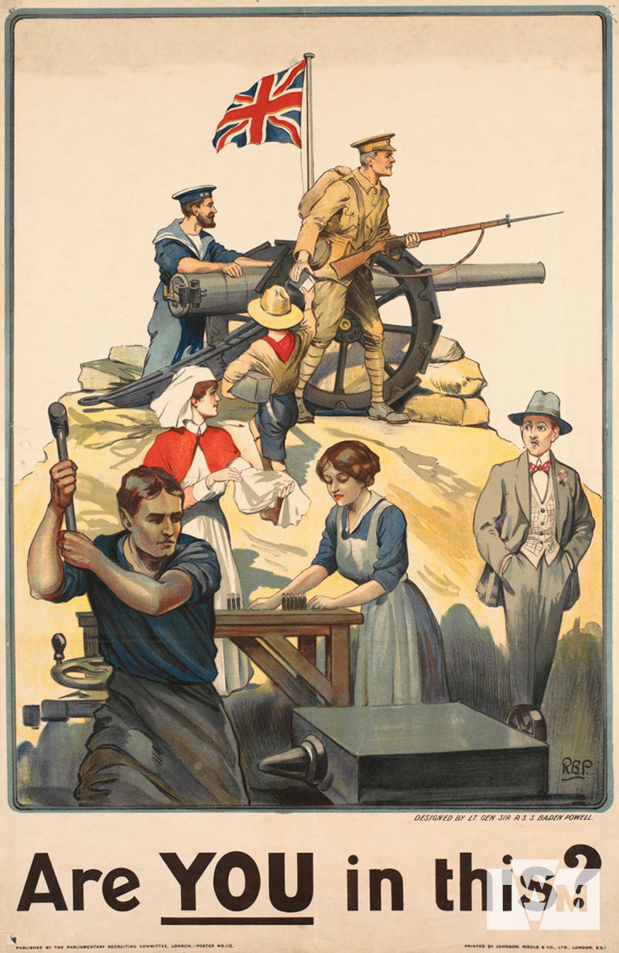
© IWM
Are You in This?
This poster shows how different sections of society are contributing to the war effort, including a scout. On the side lines is a man shown with his hands in his pockets, and smoking a cigarette, who is not yet involved.
© IWM (Art.IWM PST 2712)

Slide 6
Who are the posters mainly appealing to, men or women?
What kind of person is each poster appealing to?
How are they appealing to them (promise of fun, intimidation, making people feel guilty, frightening people)?
Which of these posters do you find the most persuasive? Why?

Slide 7
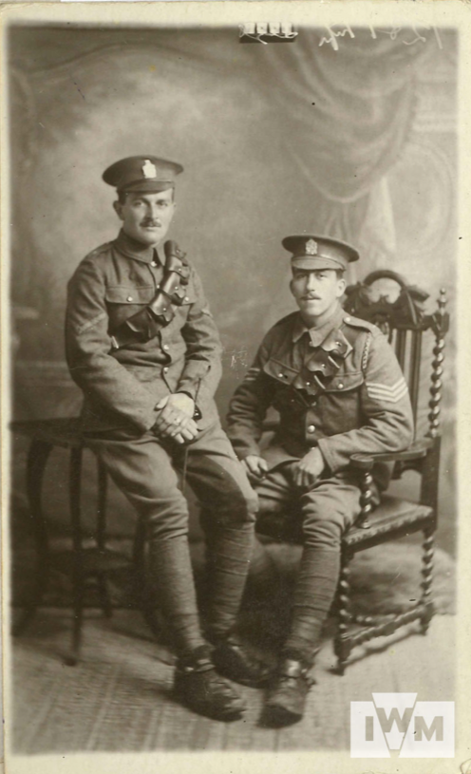
Lieutenant Frederick Wade (sitting)
Frederick Wade enlisted in the British Army in January 1915. Wade saw active service on the Somme throughout most of 1916 and at Messines in June 1917. He was invalided out of the army in September 1917, before travelling to South Africa.
This is a letter he wrote to his mother in 1915, explaining his reasons for wanting to join the army.
© IWM (Documents.7976)

