Slide 1
Getting to know Wales
TeachingEnglish lesson

Slide 2
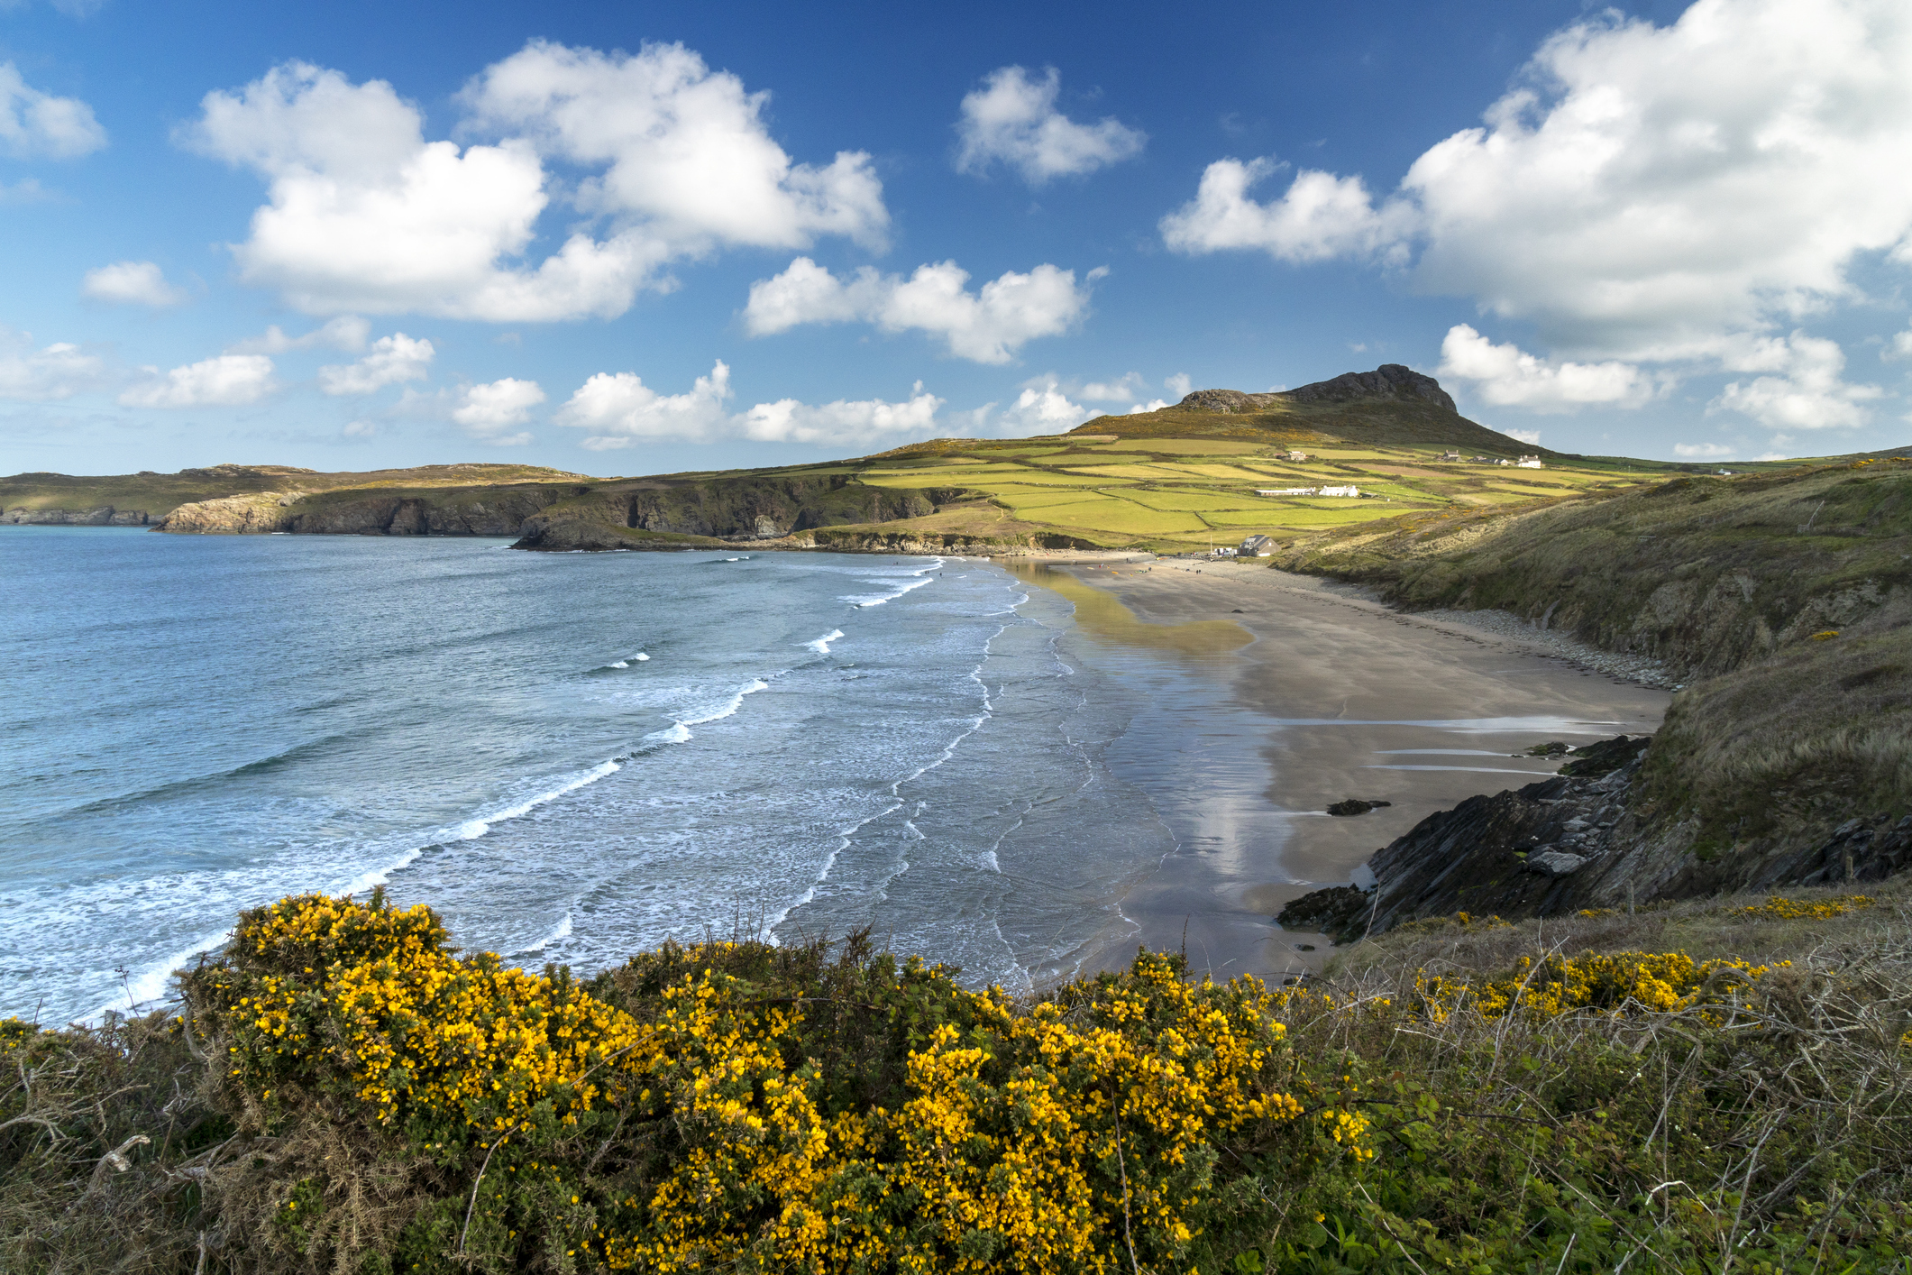

Slide 3
Getting to know Wales
Task 1: Read these statements about Wales. Which is the most surprising?
1. Wales is home to the highest mountain in the UK.
2. Mount Everest, the highest mountain in the world, was named after a Welsh man.
3. Wales has its own language, money and army.
4. The Welsh flag is a white cross on a blue background.
5. One of the most popular sports in Wales is rugby.
6. The capital city of Wales is Swansea.
7. The Eisteddfod is an annual festival to celebrate Welsh arts and culture – especially music.
8. There are around 10 million sheep in Wales – there are more sheep than people!
9. A traditional Welsh dish, Welsh Rarebit, is made using toast and rabbit.
10. The longest word in the world is Llanfairpwllgwyngyllgogerychwyrndrobwllllantysiliogogogoch and it is the name of a place in Wales.

Slide 4
Getting to know Wales
Task 2: You are going to listen to a man called Ieuan from the village of Pontarddulais in South Wales. Read some of the questions he is asked. What do you think he might answer?
1. Can you tell me a little bit about what you like about your area?
2. What mostly happens in that area?
3. What would you say are the major changes in that area?
4. Is your region famous for anything?

Slide 5
Getting to know Wales
Transcript
Interviewer: First of all, Ieuan, can you tell me a little bit about the part of the UK that you’re from?
Ieuan: Yes, so I’m from a small village in South Wales called Pontarddulais. Pontarddulais is about in the middle of South Wales.
Interviewer: Right. And can you tell me a little bit about what you like about your area?
Ieuan: Yes, I really come from a small village, and so it’s a closely knit community and it’s pretty rural really, so there’s lots of facilities there but actually we’re kind of country kids when we grow up there.
Interviewer: What mostly happens in that area?
Ieuan: I’d say mostly rugby; rugby and industry were the two things and farming was the other thing.
Interviewer: Right, and since you’ve lived there, which, is that from since you were a child?
Ieuan: Yes.

Slide 6
Getting to know Wales
Interviewer: What would you say are the major changes in that area?
Ieuan: I think the major change has been the fact that it’s become a lot more built-up and, I suppose, industrialised. It’s along the M4 corridor, so there’s been building all over the place. A lot of the fields I remember when I was a child have been built on with the new housing estates and things like that. So things have changed a lot. There’s a lot more people in the community now that we don’t know, a lot more incomers and I’d say people we don’t know. They’re just, they’re commuters, so they don’t play a big part in the community any more; they just live there in the evenings and the weekends. Apart from that we don’t see them. There has been a positive effect; the school is much more vibrant now, and a lot of the kids are learning Welsh even though they are English incomers. So yes, there has been a positive effect too, I have to say.
Interviewer: Oh, that’s good.
Ieuan: Yeah.

Slide 7
Getting to know Wales
Interviewer: Is your region famous for anything, would you say?
Ieuan: Well, we’ve got a very good male voice choir. I don’t know if that makes us famous or not, but Pontarddulais Male Voice Choir tours the world, really. So for a small village, that’s quite a big thing really. I suppose we’ve produced quite a few rugby players as well. Ryan Evans, Peter Hopkins – people like that.
Interviewer: And, what about music?
Ieuan: Well, we always take part in the Eisteddfod, which is the sort of national music festival of Wales. In fact, that includes all sorts of activities, not just music but also poetry and storytelling and much more, actually, but that’s the main thing, and that tours Wales and recently came to a town near us, which was a great honour for us. Everybody in Wales takes part in music of some sort during their life.

Slide 8
Getting to know Wales
Interviewer: Can you just tell me a little bit about how people speak in your area?
Ieuan: Yeah it’s funny, there’s a distinct accent for this part of the world; we call ourselves the Taffs. This is Llanelli and the nearby town is called Swansea and they have a longer drawn out sort of accent. But here everybody, a lot of the people speak Welsh and that makes the accent a lot stronger and people say we’ve got a sing-song type of accent here, which makes it difficult for some people to understand, but otherwise I think we speak quite slowly so often people say we’re easy to understand. People do call each other ‘boyo’ and ‘bach’ and that sort of thing. All right, bach?

Slide 9
Getting to know Wales
TeachingEnglish lessons
Thanks for attending the lesson

