Slide 1
Get to know the neighbours
TeachingEnglish lesson
May 2020

Slide 2
Which country do you think these doors are in?
Do you have similar doors in the city you live in?
Which of the houses would you most like to live in, and why?

Slide 3
Discussion time
Where is the house?
In a city, a town or a village?
How big is the house?
How many rooms does it have?
Does it have a garden?
Who lives in the house?
A family, a couple, a young person, an old person?

Slide 4
Describing people
Think of adjectives you use while describing people. For example…
shy
Adjectives to describe people
friendly
kind

Slide 5
Describing people
Look at the adjectives given below. Note each adjective on a separate sheet of paper.
Can you also guess their meanings? (don’t shout them out!).
confident
funny
generous
kind
reliable
serious
shy
sociable

Slide 6
Describing people
 | Adjective
a | confident
b | funny
c | generous
d | kind
e | reliable
f | serious
g | shy
h | sociable
 | Meaning
1 | is nervous or embarrassed about talking to other people.
2 | is careful, sensible and not silly.
3 | enjoys spending time with other people.
4 | cares about other people.
5 | feels sure about their ability to do things.
6 | likes to give people things.
7 | is good at making you laugh.
8 | can be trusted to do something well.

Slide 7
Describing people - answers
A person who feels sure about their ability to do things
confident
A person who is good at making you laugh
funny
A person who likes to give people things
generous
A person who cares about other people
kind
A person who can be trusted to do something well
reliable
A person who is careful, sensible and not silly
serious
A person who is nervous or embarrassed about talking to other people
shy
A person who enjoys spending time with other people
sociable

Slide 8
Role play prep time!
Copy the table below. Work with your group to complete the table for each person who lives in the house your group chose.
 | Name | Male/female | Age | Job/school | Personality
1
2
3
4
5

Slide 9
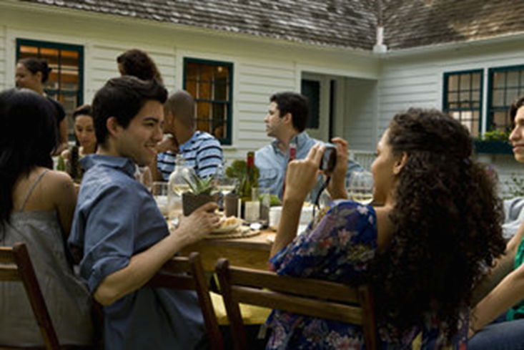
Small talk
Which of these questions do you think are okay to ask someone you don’t know very well?
What do you do for a living? (A polite way of saying ‘what is your job?’)
How much do you earn?
How old are you?
Do you have any children?
Have you lived/worked here long?
Do you have any hobbies?
What are your politics?
Are you going on holiday this year?

Slide 10
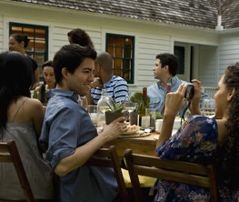
Party time!
You are going to a party with your neighbours
Your teacher will put you into break-out rooms.
Imagine you are one of the people who lives in the house you chose!
Try to have small talk with at least 4 of your neighbours and find out some information about them.
Will you ask questions which are too personal?

