Slide 1
Dorset life
TeachingEnglish lesson

Slide 2
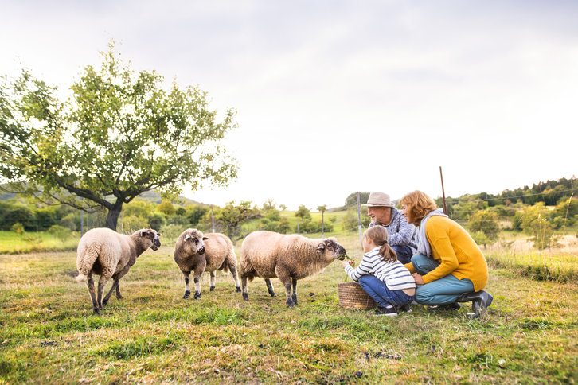

Slide 3
Dorset life
Task 1: Match the words and definitions.
1. Anglo-Saxon | a. (adjective) widely known and famous
2. parish | b. (noun) a woman that takes care of sheep
3. hamlet | c. (noun) busy activity
4. low-key | d. (adjective) relating to the people who lived in England in the Early Middle Ages
5. hustle-bustle | e. (noun) the smallest unit of local government, only in rural areas
6. housing estate | f. (adjective) quiet, not attracting attention
7. renowned | g. (adjective) excellent, better than most
8. outstanding | h. (noun) a very small village
9. shepherdess | i. (noun) a number of houses built at the same time

Slide 4
Dorset life
Task 2: You are going to listen to a man from the village of Sixpenny Handley in Dorset. The name comes from its Anglo-Saxon name: Saxpena Hanlege.
Read some of the questions he is asked. What do you think he might answer?
1. What do you like best about your area?
2. Can you tell me in what way your area has changed in the last 20 years?
3. Is this region famous for anything, would you say?
4. Is this area famous for any special foods?

Slide 5
Dorset life
Task 3: Listen and write in the missing words. Write one word in each gap.
1. In the last twenty, thirty years, we’ve had _________ ________ _______ ________ around the village.
2. Some of them are only perhaps ten houses. It has not really altered the village ________ __’_ _______ ____ ___________ . Because the school’s been able to keep going, the village post office, the shops that we have here.
3. The downside of it is, it’s _________ ________ ________ _______ __________ considerably.
4. There’s not actually many people of my age that were born and bred in Sixpenny Handley that’s actually left in the village ________ ________ ________ ________ ________ ________ ________ and there’s not actually the jobs around here for them.

Slide 6
Dorset life
Transcript: Interview with Rob Jesse
Interviewer: So, Rob, can you just tell me whereabouts in the UK you’re from and what you like about your area?
Rob: Right, I live in a little place called, a little village in Dorset, on the edge of Dorset, which is called Sixpenny Handley. It’s actually got its name as an Anglo-Saxon name, which was Saxpena Hanlege. It’s a small village and it actually has a parish that joins in lots of other small hamlets and things like that. So there’s about six hundred and seventy houses in all the small villages and hamlets around here.
Interviewer: And what do you like best about your area?
Rob: I think it’s sort of low-key, there’s no ‘hustle-bustle’, things like that. People are very, very friendly here.

Slide 7
Dorset life
Interviewer: Can you tell me in what way your area has changed in the last 20 years?
Rob: Right, over the last twenty years I’ve lived here. I’m fifty-nine and I’ve lived here all this time. In the last twenty, thirty years, we’ve had fifteen estates put up around the village. Only small ones – the biggest one’s about thirty, forty houses in them. Some of them are only perhaps ten houses. It has not really altered the village because it’s helped the village. Because the school has been able to keep going, the village post office, the shops that we have here. We have a hairdresser’s. It’s brought a lot of money into the village. The downside of it is, it’s pushed the house prices up considerably. There’s not actually many people of my age that were born and bred in Sixpenny Handley that’s actually left in the village because of the prices of the houses and there’s not actually the jobs around here for them.

Slide 8
Dorset life
Interviewer: Right…and is this region famous for anything, would you say?
Rob: Well, we’re very close to the Cranborne Chase, which is a world-renowned natural sight. It’s got wonderful woods that people come out to. The AONB is doing lots of things around here.
Interviewer: What’s that?
Rob: Area of Outstanding Natural Beauty, which if you’ve been to Sixpenny Handley and walked around, you would agree that it is really outstanding.
Interviewer: And is this area famous for any special foods?
Rob: My wife is a shepherdess. We actually breed Dorset sheep. She actually shows them and we have some Poll Dorset, which is the one without the horns and we have the Dorset Horns – with the horns. So that’s the rare old breed. One time, actually, it nearly died out but it’s making a good comeback now.

Slide 9
Dorset life
TeachingEnglish lessons
Thanks for attending the lesson

