Slide 1
Daily life in the trenches

Slide 2
British troops taking timber for a trench support through a trench at Ploegsteert, Belgium, March 1917 © IWM (Q 5092)

Slide 3
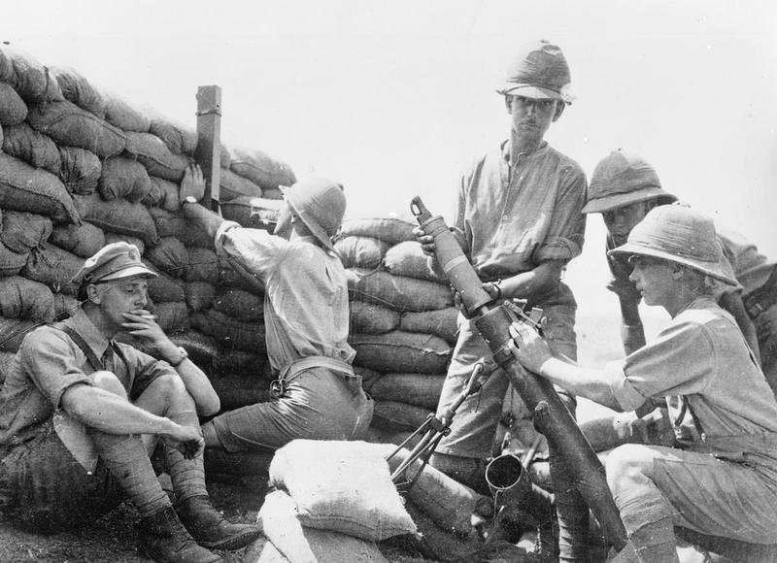
Trench mortars on the Balkan front during the First World War © IWM (Q 55561)

Slide 4
© IWM
Troops of the 2nd Australian Division in a front line trench at Croix du Bac, near Armentieres, May 1916.
The soldier on the right is using a trench periscope. © IWM (Q 579)

Slide 5
Australian Imperial Force on the Western Front 1916-18 © IWM (Q583)

