Slide 1
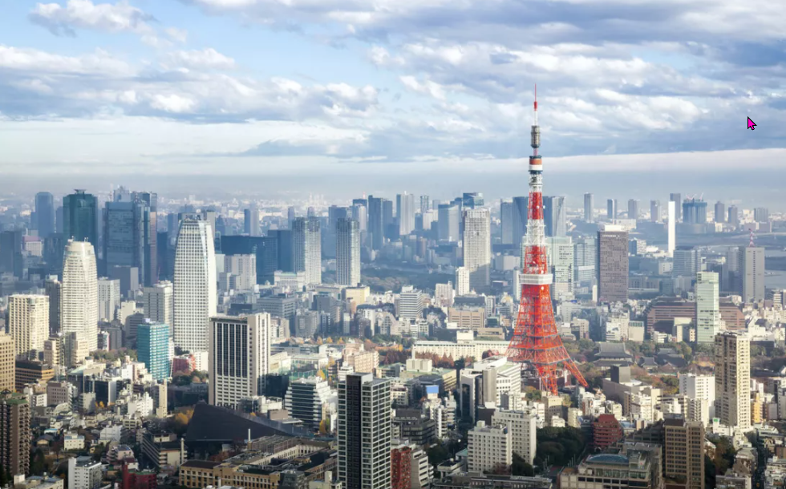
Why do people migrate?
https://www.teachingenglish.org.uk/

Slide 2
Migration
Have you ever been abroad?
Would you like to live and work in another country? Why/why not?
Do you know anyone who lives in another country?
Why do people decide to live and work abroad?
Where would you go if you decided to move to another country? Why?
https://www.teachingenglish.org.uk/

Slide 3
Statistics
“An estimated 281 million people, approximately 3.6% of the world's population, currently live outside their country of origin; many of whose migration is characterized by varying degrees of compulsion.“
Office of the High Commissioner for Human Rights (OHCHR)
https://www.teachingenglish.org.uk/

Slide 4
Language for giving opinions
Giving opinion | Agree | Disagree | Undecided
I believe … should be first I’ve put … first I’m sure that… Does anyone else think … should be first? | I agree I think so too I think the same That’s right | I don’t think so. I don’t think that’s right. For me, … is more important Definitely not | I’m not sure Maybe, but what about… What does everyone else/ do you think?
https://www.teachingenglish.org.uk/

Slide 5
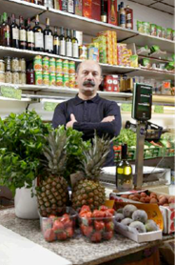
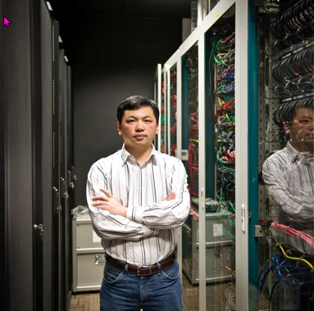
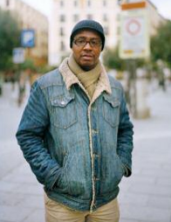
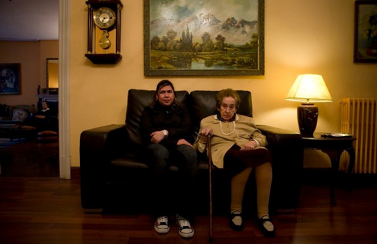
People
3. Gip
Image by Victoria Knysh www.vickyny.com
2.Zhihong
Image by Veronica Vierin www.ctmp.ie
4. Mamadou
Image by Amy Chang www.amychangphoto.com
Miroslav
Image by Martin Fuchs www.martinfuchs.com
5. Chabela
Image by Markel Redondo www.markeiredondo.com
https://www.teachingenglish.org.uk/

Slide 6
Discussion questions
What jobs do they do?
Why did they move from their country of origin?
What made them come to where they are now?
Do you think they have better economic prospects where they live now? Why/why not?
Are they happy where they are now?
Do you think they will go back to their countries of origin?
https://www.teachingenglish.org.uk/

Slide 7
Listening 1
Senegal Dublin Dubai India Bolivia Serbia
Bilbao Sofia Madrid China Austria Bulgaria
1. Miroslav is from ? They live in ?
2. Zhihong is from ? They live in ?
3. Gip is from ? They live in ?
4. Mamadou is from? They live in ?
5. Chabela is from ? They live in?
https://www.teachingenglish.org.uk/

Slide 8
Listening 2
Which person .....
1. is happy about the children being employed?
2. works on a radio station?
3. married someone from where they live?
4. wants to settle down with a wife and daughter?
https://www.teachingenglish.org.uk/

Slide 9
Discussion
In your opinion, which of these people .....
Miroslav/ Zhihong/ Gip/ Mamadou/ Chabela
. has the best job?
. earns the most money?
. is very happy to live where they live?
. live in the city for professional reasons?
. live in the city for family reasons?
. would like to go back to their country of origin?
https://www.teachingenglish.org.uk/

Slide 10
Role play
Think about:
what you miss about your old country.
• what you like about your new city/country.
• the negative things about living where you live.
• how you keep in touch with family and friends back home.
• the new friends and people you have met.
• your hopes for your children.
• your plans for the future.
https://www.teachingenglish.org.uk/

Slide 11
True or false
1. The main movement of population is from developing countries to developed countries.
2. There are 4 million foreign born residents in Germany.
3. Most OECD countries have a foreign population of between 5% and 15%.
4. Many countries in the north would be unable to function without a large population of foreign workers.
https://www.teachingenglish.org.uk/

Slide 12
Reading task - answers
Between 5% and 15% = The migrant population in most OECD countries. (a3)
25% = The percentage of foreign-born residents in Australia (b1)
19% = The percentage of foreign-born residents in Canada. (c6)
33 million = The number of foreign-born residents in Europe. (d2)
35 million = The number of foreign-born residents in the USA. (e4)
5 million = The number of foreign-born residents in Russia, France, Germany and Ukraine. (f5)
https://www.teachingenglish.org.uk/

Slide 13
Why do people migrate?
There are lots of reasons for people to move from one place to another. There are factors that make some people’s countries unattractive, and there are factors that make other places attractive. These factors have been called push and pull factors.
Push factors are the reasons why people want to leave a place – things that push them away from their place of birth.
Pull factors are the reasons why people want to go to one place rather than another – things that pull them towards a place.
https://www.teachingenglish.org.uk/

Slide 14
Push or pull factors?
Difficult living conditions push Affordable house/flats pull Government persecution Unemployment Good economic prospects Good weather War or social unrest Safe streets | Good schools and hospitals Poverty No job opportunities Corruption Presence of family and friends Cinemas, museums, theatres, concert halls, etc. Bad educational infrastructure
https://www.teachingenglish.org.uk/

Slide 15
Push or pull factors - Answers
Difficult living conditions push Affordable house/flats pull Government persecution push Unemployment push Good economic prospects pull Good weather pull War or social unrest push Safe streets pull | Good schools and hospitals pull Poverty push No job opportunities push Corruption push Presence of family and friends pull Cinemas, museums, theatres, concert halls, etc. pull Bad educational infrastructure push
https://www.teachingenglish.org.uk/

Slide 16
Meeting people
Introducing yourself | Moving on
Hello, my name is …. Hi, I’m … and you are? Have we met? I’m … I’d like to introduce myself. I’m … Hello, so what’s your name? I’m … So, why are you here? I’m here because … | I must be sociable. See you later. I must speak to … before they leave Nice talking to you. Catch you later Good to meet you. See you! Sorry, I’ve got a few more people to speak to. See you soon
https://www.teachingenglish.org.uk/

