Slide 1
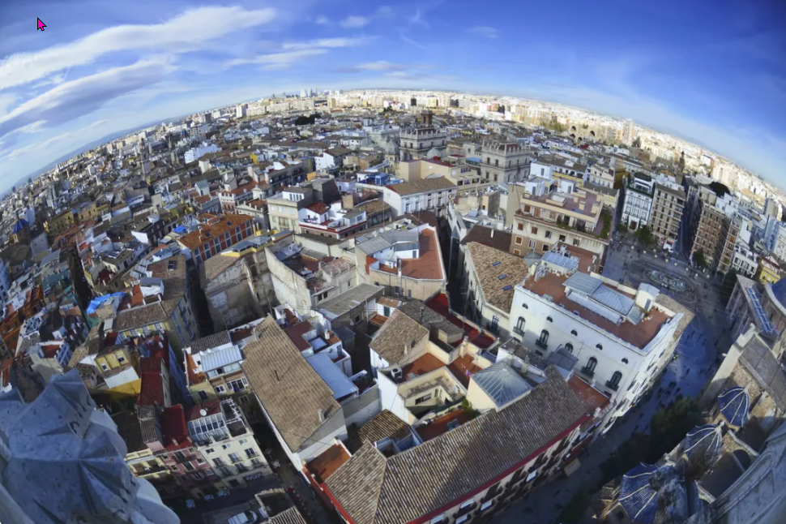
https://www.teachingenglish.org.uk/

Slide 2
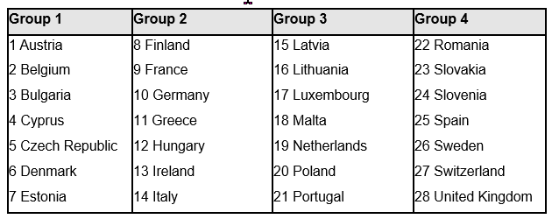
European countries
https://www.teachingenglish.org.uk/

Slide 3
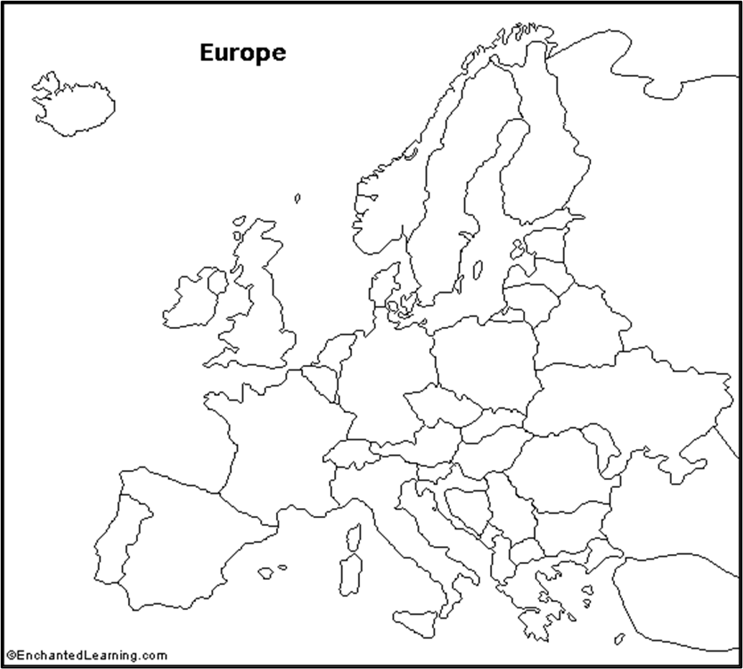
Find the country
https://www.teachingenglish.org.uk/

Slide 4
Questions about places
1. What is the capital of Italy?
2. Where is the European Parliament?
3. What is the biggest city in the south of Spain?
4. What is the capital of Scotland?
https://www.teachingenglish.org.uk/

Slide 5
Answers about places
1. What is the capital of Italy? Madrid
2. Where is the European Parliament? Strasbourg
3. What is the biggest city in the south of Spain? Seville
4. What is the capital of Scotland? Edinburgh
https://www.teachingenglish.org.uk/

Slide 6
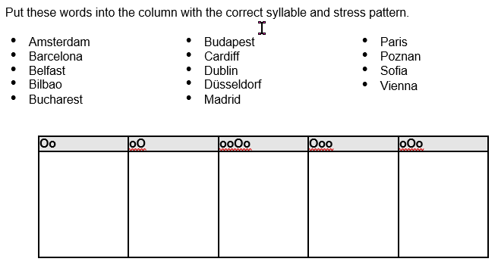
Stress patterns
https://www.teachingenglish.org.uk/

Slide 7
Stress patterns - answers
https://www.teachingenglish.org.uk/

Slide 8
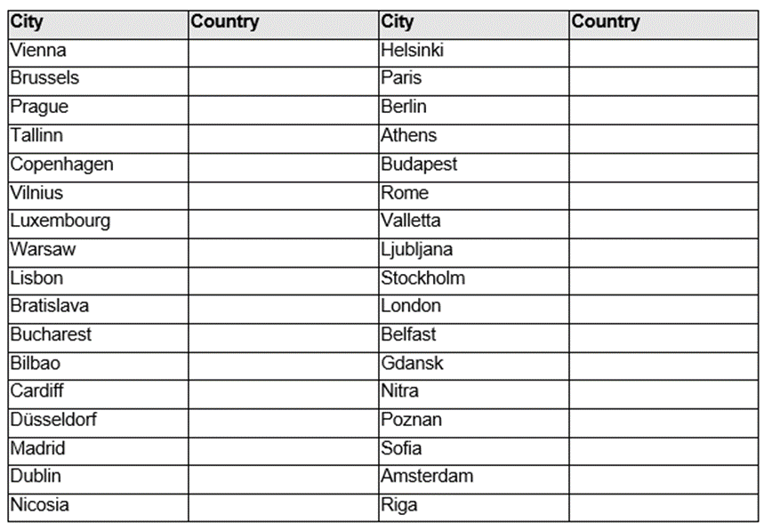
Capital cities
https://www.teachingenglish.org.uk/

Slide 9
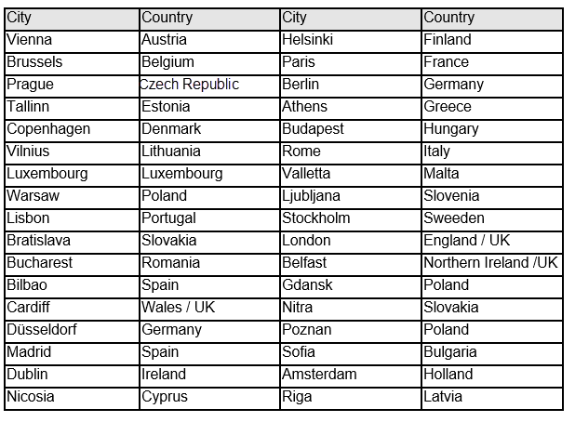
Capital cities - answers
https://www.teachingenglish.org.uk/

Slide 10
True or false
1. Rotterdam has got a port.
2. Cardiff is in Scotland.
3. Milan is in the south of Italy.
4. Portsmouth has a bigger population than Birmingham.
5. Cambridge is famous for its university.
6. Riga is in Russia.
7. London is more expensive than Zaragoza.
8. Las Palmas is an important tourist centre.
9. Volkswagen cars are produced in Goteborg
10. Budapest is in Eastern Europe.
https://www.teachingenglish.org.uk/

Slide 11
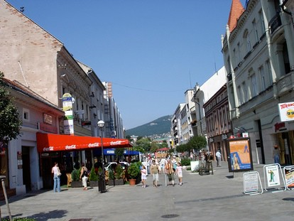
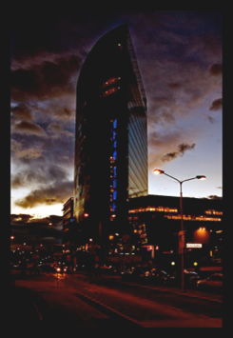
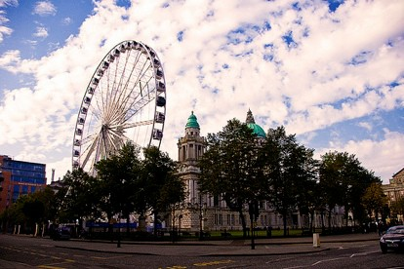
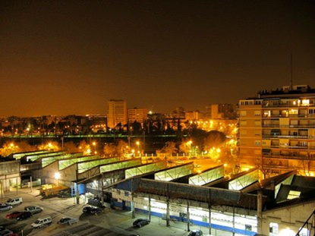
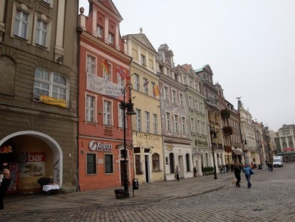
1
3
2
4
5
https://www.teachingenglish.org.uk/

Slide 12
Ways to describe cities
https://www.teachingenglish.org.uk/

Slide 13
Comparatives
Amsterdam is much more modern than Milan
Manchester is a lot more Industrial than Florence
https://www.teachingenglish.org.uk/

Slide 14
Reading
Read the text and answer the questions below.
1. Which three ways of classifying a city are mentioned in paragraph one?
2. What factors did the European Union’s study of the state of Europe’s cities concentrate on?
3. How many types of city did the study identify?
4. What is an international hub?
5. What is a specialised pole?
6. What is a regional pole?
https://www.teachingenglish.org.uk/

Slide 15
Reading - Answers
Which three ways of classifying a city are mentioned in paragraph one? (Size, cost, cultural factors)
What factors did the European Union’s study of the state of Europe’s cities concentrate on? (population and economical factors)
How many types of city did the study identify? (3)
What is an international hub? (A city with an international reputation)
What is a specialised pole? (A city with an important national economical role)
What is a regional pole? (A city that is important within its province or region)
https://www.teachingenglish.org.uk/

Slide 16
Describing cities
1 research centres 2 gateways 3 modern industrial centres 4 transformation poles 5 visitor centres
Cities with a strong industrial past which are transforming their economies. New economies and technologies are important to these cities. E.g. Oporto, Lille
B. Cities where goods and people come and go every day. These cities usually have ports. E.g. Rotterdam.
C. These cities have a service sector geared to tourism. They have large flows of international population. E.g. Malaga, Venice.
D. . These are cities with lots of local companies producing goods for the national economy and for export. They usually have a wide variety of industrial and technological activity. E.g. Valladolid, Aberdeen.
E. These cities have important centres for research and education often linked to scientific innovation. These cities usually have an international reputation. E.g. Cambridge, Toulouse.
https://www.teachingenglish.org.uk/

Slide 17
Describing cities - Answers
Cities with a strong industrial past which are transforming their economies. New economies and technologies are important to these cities. E.g. Oporto, Lille 4. transformation poles
B. Cities where goods and people come and go every day. These cities usually have ports. E.g. Rotterdam. 2 gateways
C. These cities have a service sector geared to tourism. They have large flows of international population. E.g. Malaga, Venice. 5 visitor centres
D. . These are cities with lots of local companies producing goods for the national economy and for export. They usually have a wide variety of industrial and technological activity. E.g. Valladolid, Aberdeen. 3 modern industrial centres
E. These cities have important centres for research and education often linked to scientific innovation. These cities usually have an international reputation. E.g. Cambridge, Toulouse. 1 research centres
https://www.teachingenglish.org.uk/

Slide 18
Types of cities
Marseilles Coimbra Glasgow Leipzig Florence Antwerp Pamplona-Iruñ Las Palmas Bologna Portsmouth | Turin Leicester Cardiff Krakow Naples Nice Zaragoza Le Havre Cork
https://www.teachingenglish.org.uk/

Slide 19
https://www.teachingenglish.org.uk/

