Slide 1
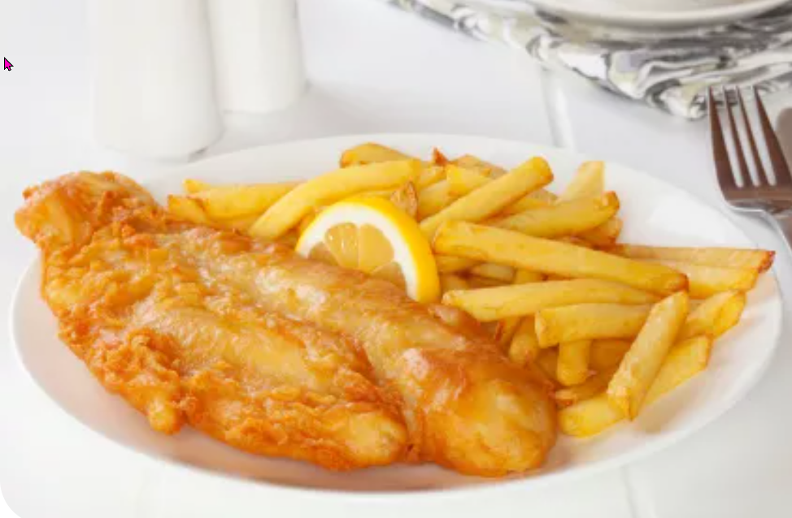
In a cafe
https://www.teachingenglish.org.uk/

Slide 2
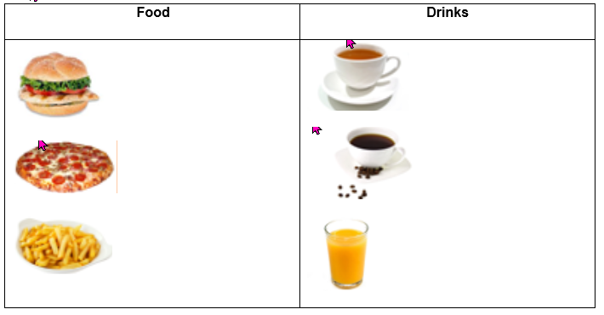
Café menu vocabulary
https://www.teachingenglish.org.uk/

Slide 3
Ordering in a cafe
a) Enjoy your food and drink. b) Take a tray. c) Ask for your food and drink at the counter. d) Choose a table to sit down. e) Collect cutlery and napkins. f) Pay for your food at the till.
1 ……………………………………………………………………………………………… 2………………………………………………………………………………………………. 3………………………………………………………………………………………………. 4………………………………………………………………………………………………. 5………………………………………………………………………………………………. 6……………………………………………………………………………………………….
https://www.teachingenglish.org.uk/

Slide 4
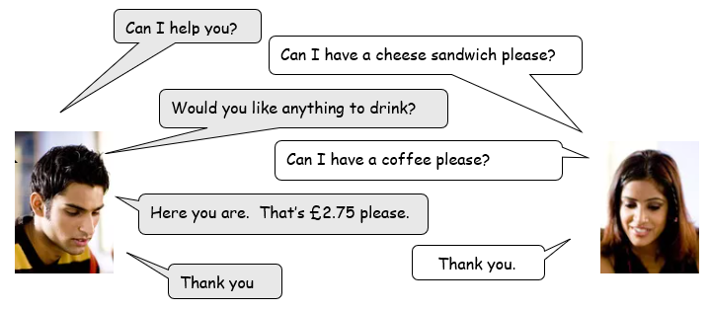
Café dialogue
https://www.teachingenglish.org.uk/

Slide 5
Dialogue order
Thanks. Bye.
Good morning. What would you like? | 1
That’s £2 please.
Thank you.
Here you are. Anything else?
No, thanks.
Can I have a chicken sandwich and a cup of tea please?
https://www.teachingenglish.org.uk/

Slide 6
Dialogue order - answers
Thanks. Bye. | 7
Good morning. What would you like? | 1
That’s £2 please. | 5
Thank you. Here you are | 6
Here you are. Anything else? | 3
No, thanks. | 4
Can I have a chicken sandwich and a cup of tea please? | 2
https://www.teachingenglish.org.uk/

Slide 7
Dialogue
Café staff: Good morning. What would you like?
Customer: Can I have a chicken sandwich and a cup of tea please?
Café staff: Here you are. Anything else?
Customer: No, thanks
Café staff: That’s £2 please.
Customer: Thank you. Here you are
Café staff: Thank you. Bye
https://www.teachingenglish.org.uk/

