Slide 1
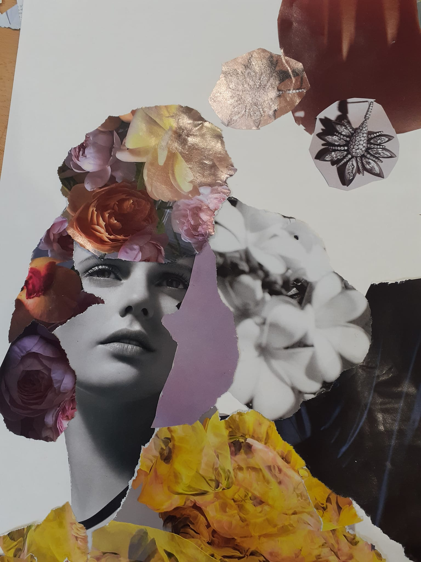
Changing ideas of beauty
https://www.teachingenglish.org.uk/

Slide 2
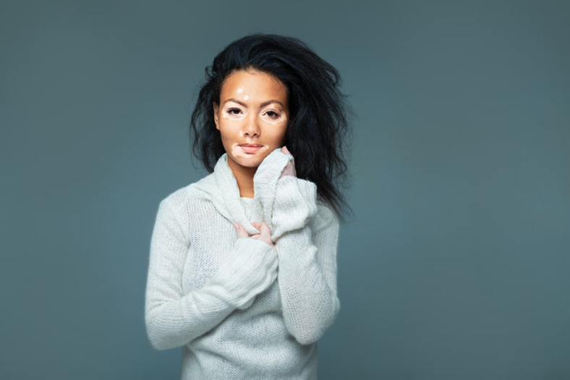
What is beauty?
Do you think she is beautiful? Why/why not?
What makes someone attractive?
Do you know why her skin looks like this?
https://www.teachingenglish.org.uk/

Slide 3
True or false?
a) Chantelle has always had vitiligo.
b) People who have vitiligo usually get better.
c) Chantelle tried to escape the bullies at school.
d) Chantelle became America’s Next Top Model.
e) She uses a different name for her work.
https://www.teachingenglish.org.uk/

Slide 4
Discussion
Why do people who look different often get bullied? Consider the following in your discussion:
Fear
Jealousy
Low self-esteem
Control
Group dynamics
Prejudice and discrimination
https://www.teachingenglish.org.uk/

Slide 5
Tenses
Find and underline an example of each of the following tenses in the article
.
present simple 2. present continuous 3. present perfect
4. past simple 5. past continuous 6. past perfect
https://www.teachingenglish.org.uk/

Slide 6
Matching
1. present simple 2. present continuous 3. present perfect
4. past simple 5. past continuous 6. past perfect
A. Something which happened before now, which has an impact on the present
B. Something that was in progress in the past when something else happened
C. Something that happened before another action in the past
D. Something in progress at the moment
E. Something which is generally or always true
F. Something which happened at a specific point in the past
https://www.teachingenglish.org.uk/

Slide 7
Paragraph headings
Match the paragraph descriptions A–F with paragraphs 1–6 in the article.
A. Gives us details about the person’s very early life.
B. Explains how the person became famous.
C. Introduces the person and says why they are famous.
D. Talks about the person’s childhood.
E. Summarises what is important about this person.
F. Talks about what the person is doing now.
https://www.teachingenglish.org.uk/

Slide 8
Paragraph headings - answers
C1 Introduces the person and says why they are famous.
A2 Gives us details about the person’s very early life.
D3 Talks about the person’s childhood.
B4 Explains how the person became famous.
F5 Talks about what the person is doing now.
E6 Summarises what is important about this person.
https://www.teachingenglish.org.uk/

Slide 9
A biography
Use a similar plan to these paragraphs to write a short biography of a different famous person. Try to use a variety of tenses.
Decide on your own celebrity or select one from the list below:
Milla Jovovich
Chimamanda Ngozi Adichie
Cristiano Ronaldo
Gabriel Garcia Marquez
Pink
Freddie Mercury
Sandra Oh
Belle Gibson
Ryan Reynolds
Samuel L Jackson
Haruki Murakami
https://www.teachingenglish.org.uk/

