Slide 1
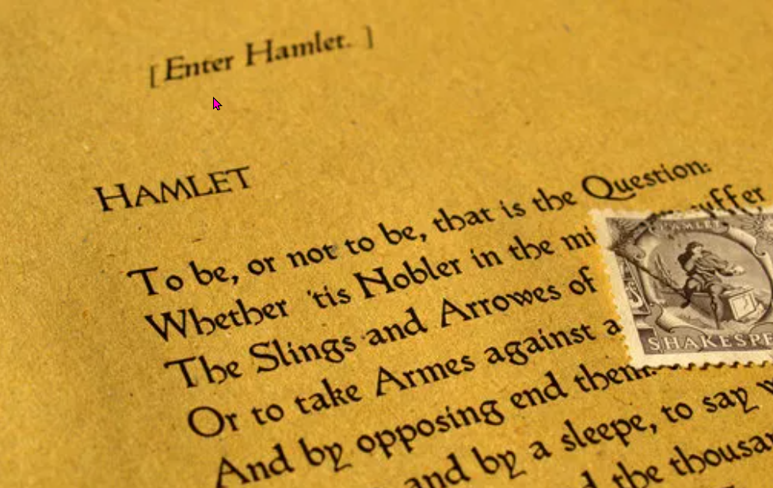
Hamlet's soliloquy
https://www.teachingenglish.org.uk/

Slide 2
Discussion
What successes have you had? Can you name three? Share them.
Now think about the things that were not successful for you, the things that made you angry, frustrated, sad. Can you name three? Share them.
https://www.teachingenglish.org.uk/

Slide 3
Hamlet synopsis
Hamlet has some serious problems. His father has been murdered. His mother has married the man who murdered his father. The girl he was going to marry has drowned. His father’s ghost visits him every night. He must take revenge, but he cannot act – something stops him. As he thinks about the situation, he asks himself many questions. The first: “To be, or not to be: that is the question.
https://www.teachingenglish.org.uk/

Slide 4
Discussion
A But what is there after death? This is a difficult question and maybe there are more problems afterwards! So we prefer to tolerate the problems we have now.
B Who wants to fight against so many problems? We could find peace by killing ourselves.
C This is one great way of avoiding these problems – then we can sleep.
D Is it better to tolerate problems and difficulties, or to fight them?
E But there is another problem: if we die, we sleep, and if we sleep, we might dream. But what kind of dreams would we have?
https://www.teachingenglish.org.uk/

Slide 5
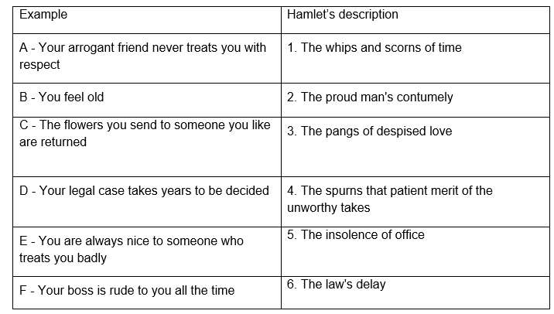
Language used in Hamlet
Hamlet talks about various things that make life difficult. For example, he mentions ‘the oppressor’s wrong’. Can you give a modern example of this?
https://www.teachingenglish.org.uk/

Slide 6
Giving Hamlet advice
Is it better to ‘to suffer
The slings and arrows of outrageous fortune,
Or to take arms against a sea of troubles,
And by opposing end them?’
2. Is it better to ‘quietus make
With a bare bodkin?’ than to ‘bear the whips and scorns of time’?
3. Is it right to feel ‘The dread of something after death’?
https://www.teachingenglish.org.uk/

Slide 7
Giving advice
You should…
If I were you I’d
My advice is…
How about…?
Why don’t you…
You could try…
You’d better…
https://www.teachingenglish.org.uk/

Slide 8
4 Characters in Hamlet
Hamlet | Claudius, (who murdered Hamlet’s father)
Gertrude, (Hamlet’s mother and Claudius’ new wife) | Laertes, (The brother of the girl Hamlet was going to marry, who drowned. He is also the son of a man killed by Hamlet)
https://www.teachingenglish.org.uk/

Slide 9
Hamlet/ Claudius/ Gertrude/ Laertes
1. Hamlet kills several other people but not __________, the man who killed his father.
2. In turn, __________ tries to kill him several times but he is not successful
3. __________ tries to kill __________ one last time by arranging a sword duel between him and __________.
4. There is a trap for __________ : the tip of __________' sword is poisoned.
5. __________ also poisons the victory cup in case __________ wins.
6. The poisoned drink is offered to __________ but he turns it down, and instead
__________ drinks it.
https://www.teachingenglish.org.uk/

