Slide 1
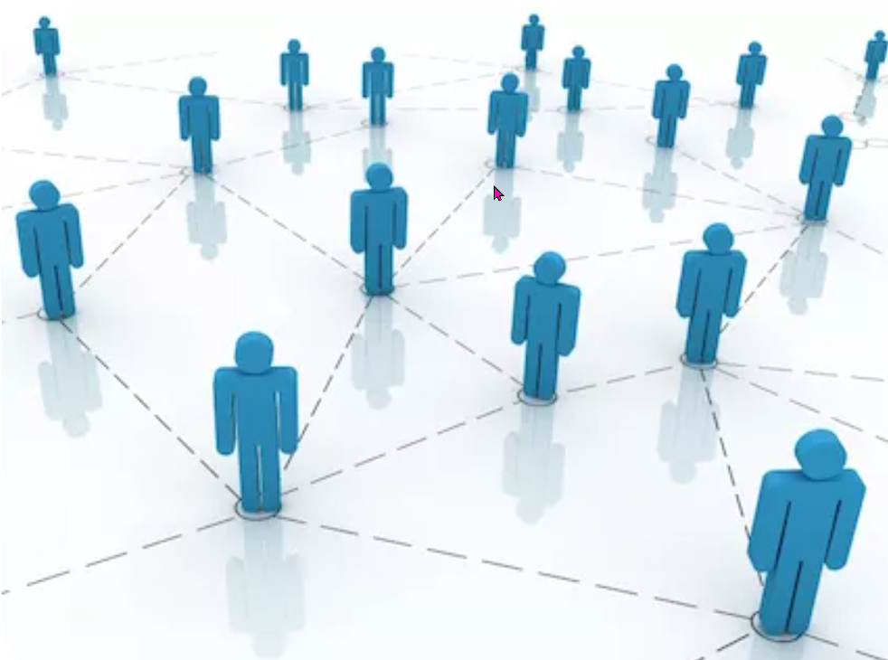
Robot Relationships
https://www.teachingenglish.org.uk/

Slide 2
2000 years into the future…
Can you imagine a world without countries?
Is the idea of a continent like Europe ridiculous or inspiring?
Should the world be more K-Pop or Call of Duty?
Will your generation solve the problem of climate change?
Does the world need more anarchy or control?
Would you have a romantic relationship with a robot?
Do you live in your internet or your country?
Are you Bauhaus or surrealism?
Is your personality because of your origins or your choices?
Do art and design have the power to remove fear?
Are you open to being enhanced by drugs or technology to be stronger and smarter?
https://www.teachingenglish.org.uk/

Slide 3
Her – Love between a man and his operating system.
What do you think are the ingredients that make this love possible? Make notes as you watch
https://youtu.be/dJTU48_yghs?si=v1DfpvM-A8x-cFt9
https://www.teachingenglish.org.uk/

Slide 4
True or false
1.The author suggests that most people won’t like the idea of having a romantic relationship with a robot.
2. A man who was paralysed after a car accident was given bionic hands so he could play computer games.
3. So far, technology has not been able to synthesise the functions of the human brain.
4. 13-year-old Eugene Goostman is a genius computer programmer.
5. There is controversy about whether the Turing test has been successfully passed.
6. In the film Her, it is Samantha’s human qualities that make her attractive to Theodore.
7. We know for sure that other humans are conscious, but we cannot know that about artificial intelligence.
8. The author is highly optimistic about the future of romantic relationships between humans and robots.
https://www.teachingenglish.org.uk/

Slide 5
Useful expressions
1. ridiculous, laughable = …………..
2. you’re not excited or positive about the idea = it doesn’t .... …. …… ……
3. in our day-to-day existence = in our ………….. ……….
4. combining, uniting gradually = …………..
5. using the rules unfairly to get a desired result = ………… the …………
6. (changing) really fast = at a ……………. ……..
7. unclear distinctions between one thing and another = ………….. lines
8. gradually learn more about someone = …… …. …….. someone
9. understand what you find funny = …… your ………. of …………
10. the one problem = the …….. ……….
https://www.teachingenglish.org.uk/

Slide 6
Useful expressions - answers
1. ridiculous, laughable = ludicrous
2. you’re not excited or positive about the idea = it doesn’t do it for you
3. in our day-to-day existence = in our daily lives
4. combining, uniting gradually = merging
5. using the rules unfairly to get a desired result = cheating the system
6. (changing) really fast = at a dizzying rate
7. unclear distinctions between one thing and another = blurred lines
8. gradually learn more about someone = get to know someone
9. understand what you find funny = get to know your sense of humour
10. the one problem = the only catch
https://www.teachingenglish.org.uk/

Slide 7
Discussion
A. Do you know of any other examples of humans being enhanced or cured by technology?
B. Do you think Eugene Goostman passed the Turing test? Or do you agree that his makers cheated the system?
C. Have you ever had any experience interacting with Siri, or other programs with artificial intelligence? How intelligent did it seem?
https://www.teachingenglish.org.uk/

Slide 8
Discussion continued
"I don't know if you're conscious. You don't know if I'm conscious. But we have a kind of gut certainty about it.”
Michael Graziano, neuroscientist, Princeton University, USA
D. What is consciousness? Do you think a robot could ever be conscious? If consciousness is created out of non-biological materials, is it still consciousness? What are the implications then in the way we treat robots?
E. Is it possible to fall in love with someone very different from you?
F. How can you know if someone loves you back? Can you ever be sure that someone loves you in the same way as you love them?
G. Now you’ve thought about it, do you think a human could have a romantic relationship with a robot?
https://www.teachingenglish.org.uk/

Slide 9
Review your initial answers
8. Thinking back to the Collecting Europe questions
A. Which of your answers show the most about you? Why?
B. What did your classmates’ answers show about them? In what ways are they different to you? How do you respond to these differences?
C. How might the people you have relationships with define you as a person?
D. Write six questions for your own quiz about boundaries and identity.
https://www.teachingenglish.org.uk/

